Slide 1
ENROLMENT PLANNING AT THE UM:
WHAT’S ON THE HORIZON?
January 2018
Susan Gottheil, Vice-Provost (Students)
Todd Mondor, Vice-Provost (Graduate Education)
& Dean, Faculty of Graduate Studies
Randy Roller, Executive Director, OIA

Slide 2

If you don’t know where you’re going, any road will take you there.
Cheshire Cat,
Alice Through the Looking Glass

Slide 3
Institutional Planning Processes
Strategic planning – answers “why”
Academic program planning – answers “what”
Facility planning – answers “where”
Enrolment planning – answers “who”
Budget planning – answers “how”

Slide 4
  SEM is a comprehensive approach to integrating all of a college or university’s programs, practices, policies and planning related to achieving the optimal recruitment, retention and graduation of students.
  - David Kalsbeek, 2009

Slide 5
SEM is…
The range of activities that influence a student’s initial and continued enrolment
The programs, policies and processes that impact institutional enrolment
The organizational framework and structure that supports institutional and student goals
It is tied into the institutional academic and strategic plan
Notes:
Jesse: How do I add underlines?
A way of thinking and doing
Interplay of institutional mission and student goals

Slide 6
All PSEs are NOT the Same
Size
Location
Student body
Mission
Accessibility
We can’t be all things to all people.
*** SEM IS ABOUT MAKING CHOICES
AND BEING STRATEGIC***

Slide 7
SEM Plan Background
Current SEM goals were established in 2013
First institution-wide plan to examine current and future enrolment
Represented a means of connecting the student experience to the mission and identity of our University
  The U15 Group of Canadian Research Universities (commonly shortened to U15), which UM had recently joined, was used as a comparator group
Identified critical enrolment goals, including student outcomes for both undergraduate and graduate students

Slide 8
Current SEM Goals for 2018
Total Enrolment: 32,000
Undergraduate
  Enrolment = 25,600
  10% indigenous students; 10% international students
  90% retention rate (1st to 2nd year)
  60% graduation rate after 5 years
Graduate
  Enrolment = 6,400
  5% indigenous students; 20% international students
  Match the average of the U15 in completion time & ratio of Masters to PhD

Slide 9
Progress Toward Meeting Undergraduate Goals
 | SEM Goal | Status
Enrollment | 25,600 | 25,065 (Nov 1, 2017)
Indigenous Students | 10% (2,560) | 8.9% (2,221; Nov 1, 2017)
International Students | 10% (2,560) | 16.1% (4,024; Nov 1, 2017)
Retention Rate (1st to 2nd yr) | 90% | 88.7% (for 2015 cohort)
Graduation Rate (after 6 yrs) | 60% | 50.3% (for 2010 cohort)

Slide 10
Progress Toward Meeting Graduate Goals
 | SEM Goal | Status
Enrollment | 6,400 | 3,721 (Nov 2017)
Indigenous Students | 5% (320) | 5.8% (214; Nov 2017)
International Students | 20% (1,280) | 32.4% (1,206; Nov 2017)
Ratio Research Masters to PhD | 0.50 | 0.43 (2016)
Master’s Graduation after 5 yrs | 80% | 79.3% (2010)
PhD Graduation after 9 yrs | 75% | 74.1% (2006)
Mean # Terms to Graduation | Master’s = 7 PhD = 15 | Master’s = 8.1 (2010) PhD = 17.0 (2006)

Slide 11
SEM STRATEGIES 2013-2018
Enrolment Policies and Procedures
New Admissions Target Policy & Procedures (2015)
Annual meetings with Deans to review institutional and faculty SEM targets/plans and issues
Annual review of program targets and report to Senate and Board
Data
Establishment of Enrolment Data Working Group
Creation of SEM Data Analyst position within OIA

Slide 12
STRATEGIES - RECRUITMENT
Institution-wide inventory and calendar of domestic, international and Indigenous recruitment activities to enhance coordination and outreach to prospective students
Implementation of Connect recruitment marketing/communications system
  Working with each Faculty/School to develop marketing communications plans for prospective students

Slide 13
STRATEGIES - ADMISSION
New admissions software system (for undergraduate and graduate students) simplifies and enhances application experience
New admission policy bases 1st year undergraduate admission on interim rather than final Grade 12 grades to enable earlier admission offers
Direct entry admission policy under review: aim to enhance flexibility and ensure students enter programs with appropriate preparation to ensure academic success
Transit and progression rules for U1, Arts & Science are under review
Limited Admissions (U1) under review to determine student persistence and success

Slide 14
STRATEGIES - ADVISING
Revision of First Year Guide provides clearer and more structured advice for entering 1st year students (both U1 and direct entry programs)
Implementation of U.achieve degree audit system to help students and academic advisors track academic progress, manage degree requirements, estimate time-to-completion, and find alternative study/career paths
Implementation of Career Compass degree maps: integrates program and course requirements, career planning and co-curricular activities for each undergraduate program/major
Establishment of Distance Education Advisor

Slide 15
STRATEGIES - PERSISTENCE
Revision to VW, AW and course repeat policies (2016) aims to enhance course capacity for students and help with timely degree completion
Implementation of registration course waitlists to help students access courses needed for timely degree completion
Pilot of Early Alert system in first year courses to assess efficacy in identifying students needing academic and/or personal supports/interventions

Slide 16
STRATEGIES -
INDIGENOUS STUDENTS
Self-identification campaign to increase numbers of students willing to self-identify and “be counted”
Establishment of donor-funded Qualico Bridge to Success program (transition & bridging supports)
Neechiwaken mentoring program established
Increased bursary and scholarship supports through donor funding
Expansion to childcare centre with priority placement for Indigenous student parents/families

Slide 17
STRATEGIES –
INDIGENOUS STUDENTS
Establishment of ARTS 1110 section for Indigenous first-year students
Academic and personal supports (Student Counsellor, Academic Learning instructor) housed in Migizii Agamik
New Indigenous advisor positions added, including Arts Indigenous Advisor and Indigenous Graduate Student Advisor
Increased hours/presence for Elders

Slide 18
STRATEGIES –
INTERNATIONAL STUDENTS
Using funds from increased differential tuition fee increases, enhanced supports for:
  health and wellness;
  student advocacy;
  academic integrity;
  English language;
  writing and study skills; and
  advising supports.

Slide 19
STRATEGIES –
GRADUATE STUDENTS
Increased graduate student funding (GETS, UMGF, Indigenous, International)
Established maximum time-in-program limits
Developed the GradSteps program to provide career and academic support workshops

Slide 20
CHALLENGES
International enrolment target well exceeded
  2015 Provost’s Council Working Group reviewed targets and agreed still within median of U15 for both undergraduate and graduate international enrolment
No movement towards undergraduate outcomes goals
  Complexity of factors influencing student persistence and academic success
At the graduate level, enrollment has not increased significantly; time-to-completion remains slow
SEM Plan V2 needs to be developed

Slide 21

WHAT IS ON THE HORIZON?
“Most of us see
the writing on the wall,
we just assume it’s addressed to someone else”

Slide 22
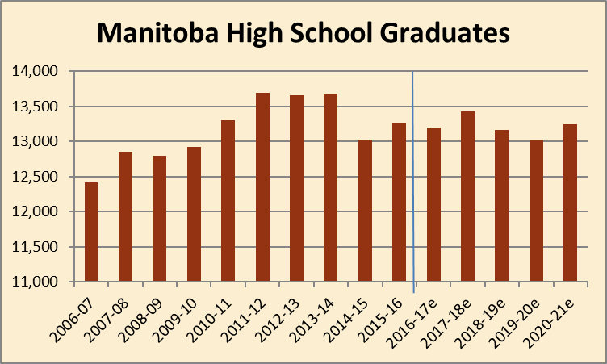
High School Graduates

Slide 23
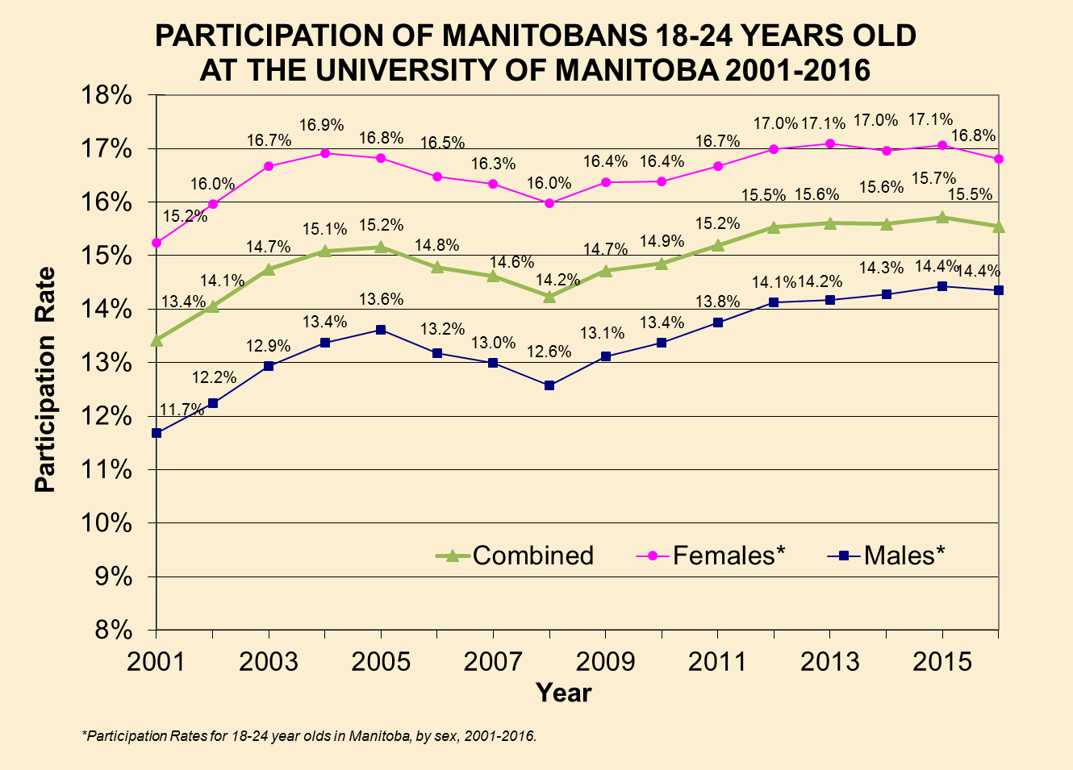
Participation Rate

Slide 24
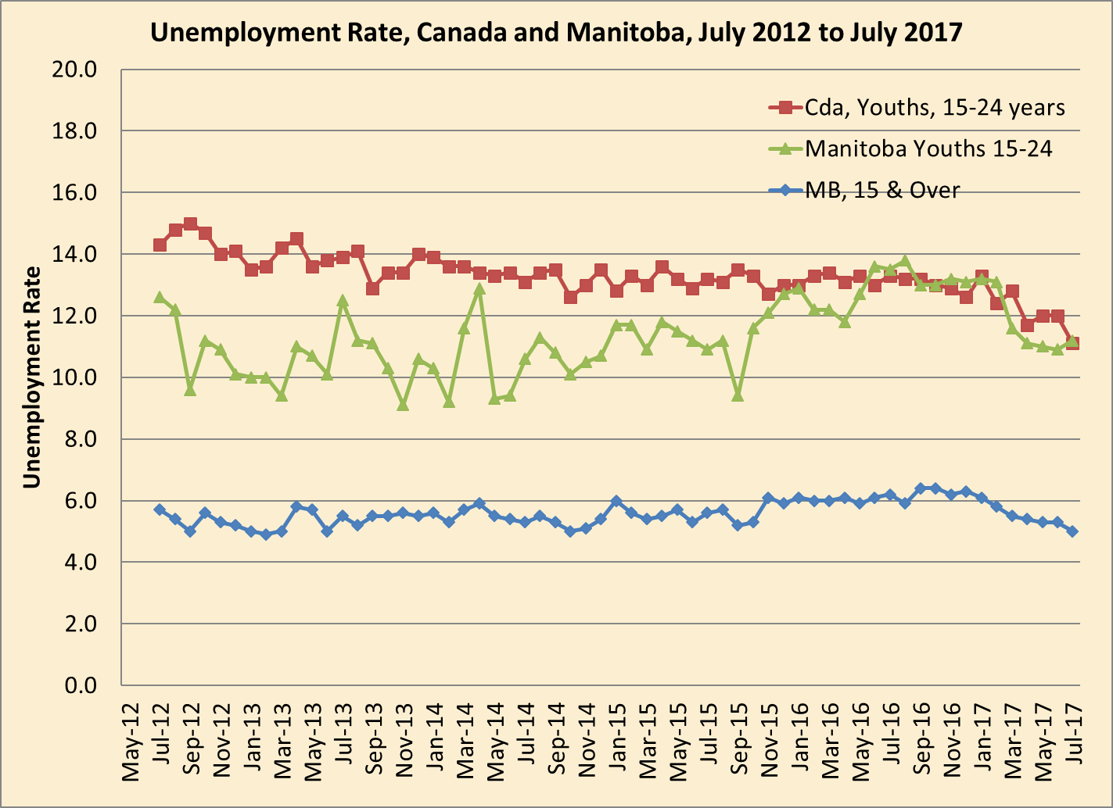
Impact of Economic Conditions on University Enrolment

Slide 25
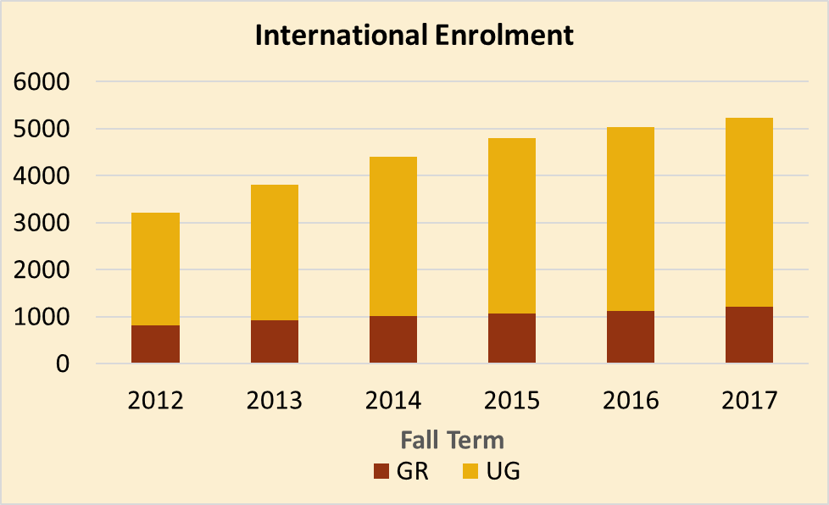
International Students

Slide 26
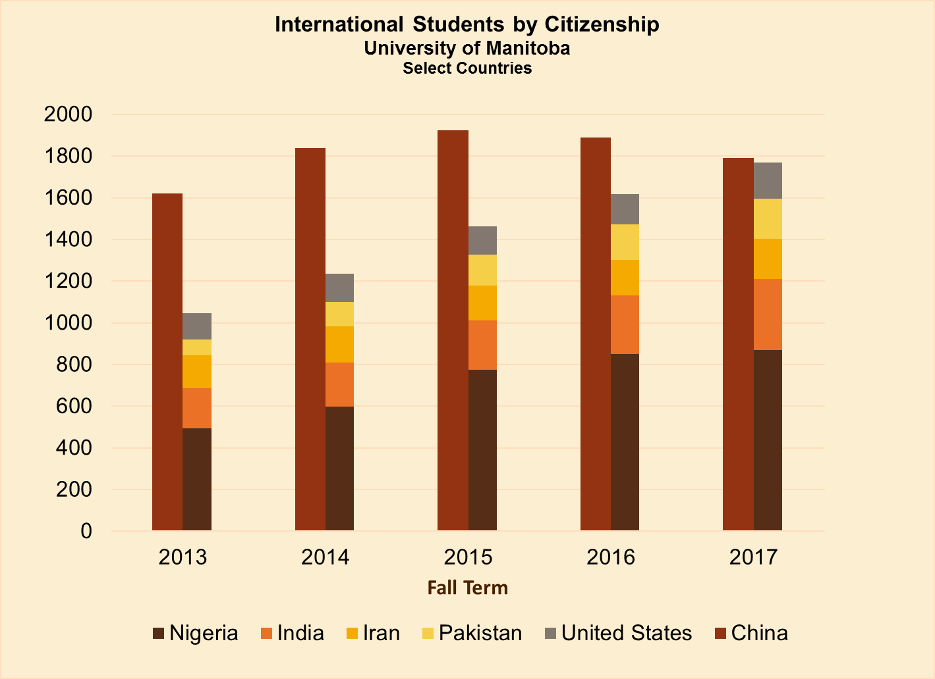
International Students

Slide 27
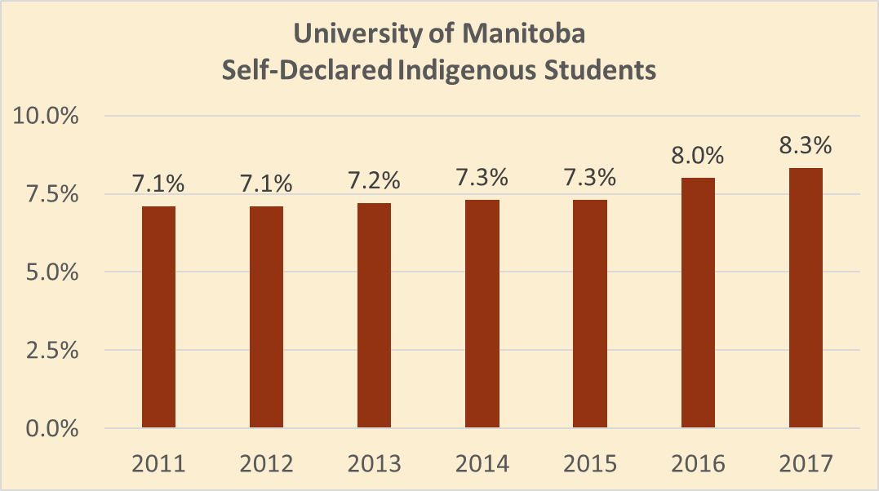
Self-Declared Indigenous Students

