Slide 1
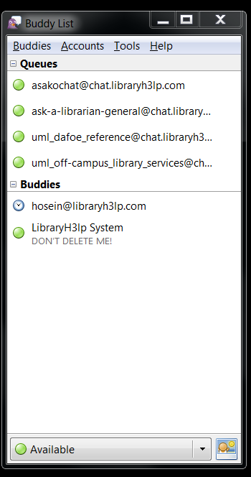
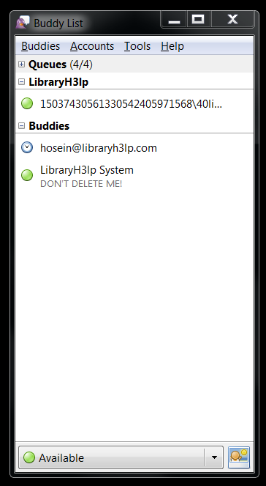
Pidgin with Queues showing
Pidgin with Queues not showing
Patron

