Slide 1
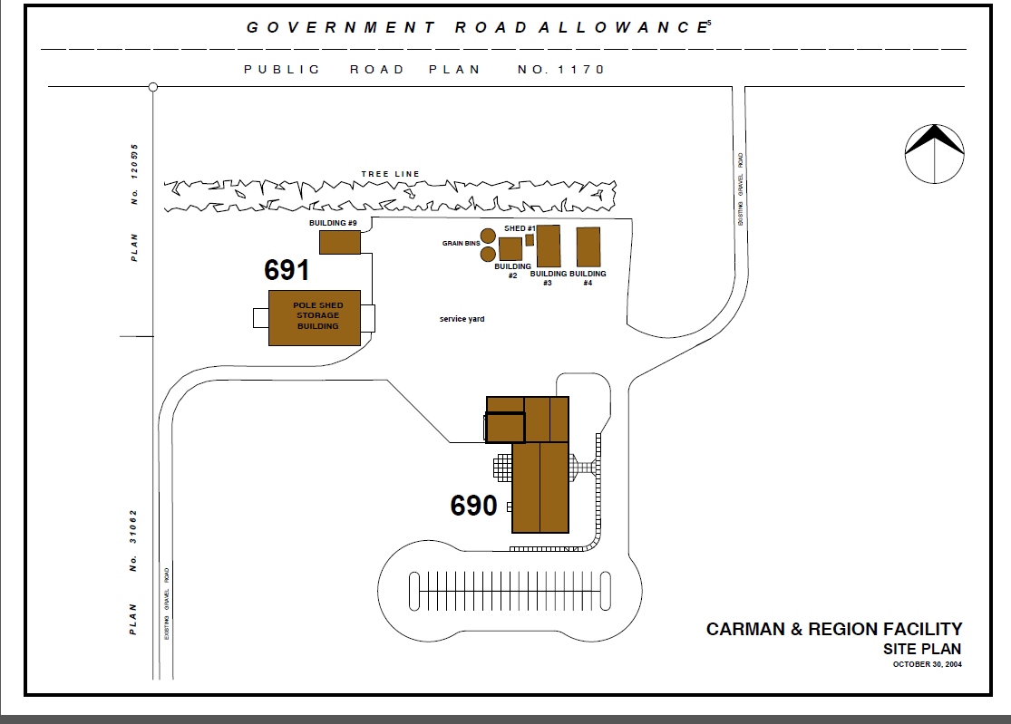
Parking lots at Carman Research Facility
Personal/Public Vehicles
Department / Vehicles entering the plots

