Slide 1
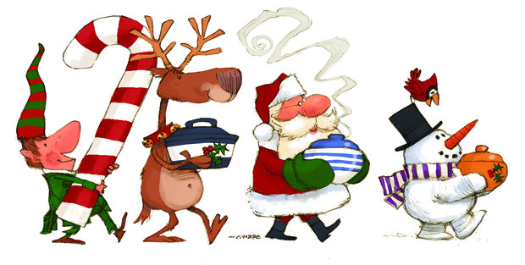
2016 Graduate Student Christmas Party
Locations & Time: Room 218 on Dec 8th, 2016
Christmas potluck at11:45 & Secret Santa at 13:15
You can join the potluck without participating in the Secret Santa

