Slide 1
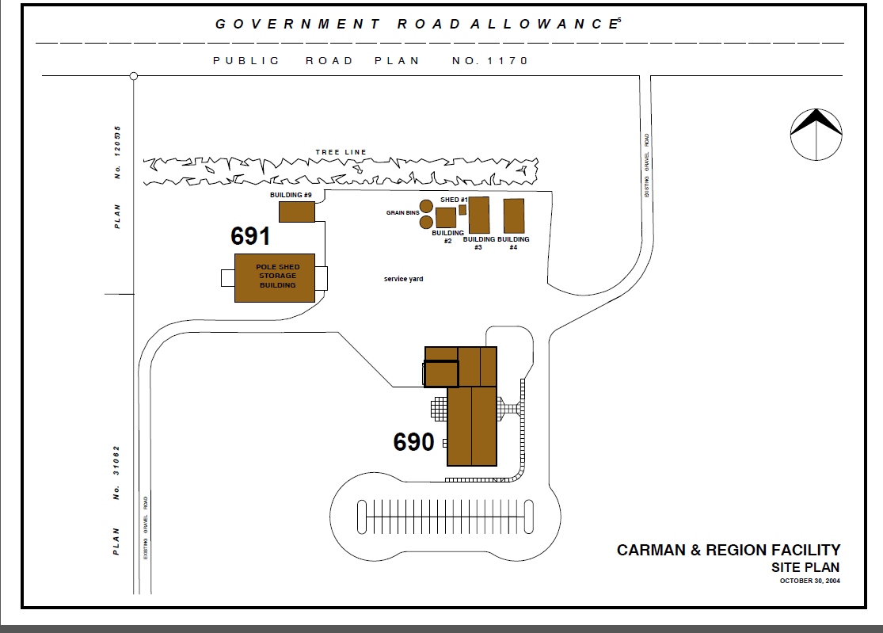
Parking lots at Carman Research Facility
Personal Vehicle Parking
Department Vehicle Parking

