Slide 1
Student Accessibility Services

Slide 2
Welcome

Slide 3
Traditional Territories Acknowledgement
The University of Manitoba campuses are located on original lands of Anishinaabeg, Ininiwak, Anisininewuk, Dakota Oyate and Dene, and on the National Homeland of the Red River Métis. We respect the Treaties that were made on these territories, we acknowledge the harms and mistakes of the past, and we dedicate ourselves to move forward in partnership with Indigenous communities in a spirit of Reconciliation and collaboration.
Notes:
We first want to acknowledge that…

Slide 4
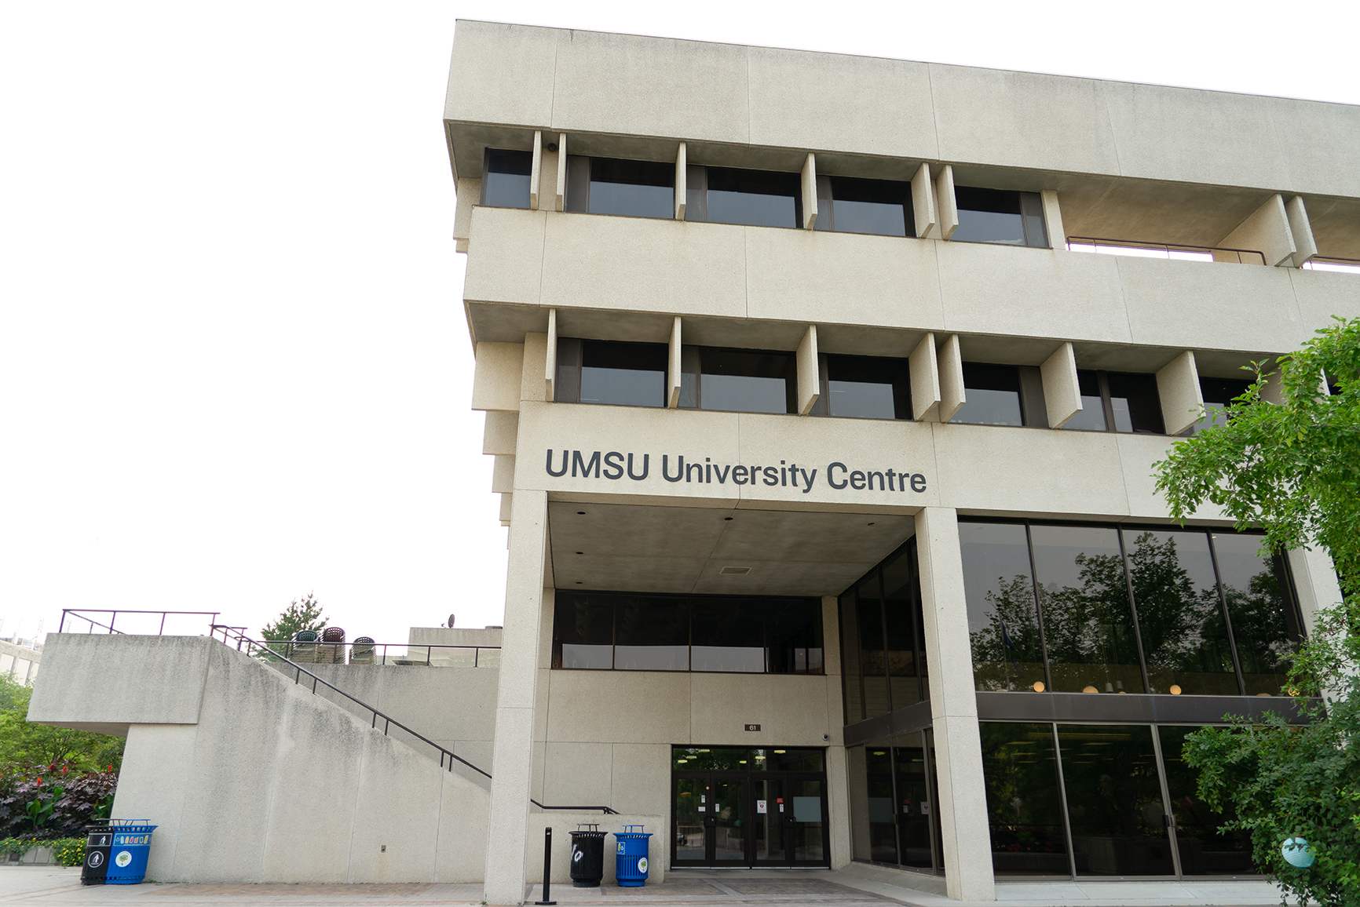
Our Team
Director
Accessibility Coordinators
Assistive Technologist
Exam Centre Staff
Program Staff
Front Desk
Accommodations / Program Administrator
Notes:
We have a great team of people that work at SAS. Our core team is approximately 15 people, but in total, if we include core staff, program staff, and student staff, we have approximately 100 people working in our office.
Accessibility Coordinators
-Each Coordinator carries a caseload of approximately 300 – 500 students (recommended caseload size is 150-200)
-Each Coordinator has a different background and area of expertise, so when students are booking, we try our best to match with best person to support them.
Our Assistive Technologist on staff can help with alternate formats and helps to ensure that students are using the right technology that best fits with their needs.
Exam Centre Staff
We have multiple people in our exam centre. Core staff there include our Exam Coordinator, and Exam Assistant. But we also hire invigilators, scribes, and various others to help with exams.
Program Staff
We have various programs that run through our office. We are often looking to hire students to fill many different positions, such as ASL translators and Academic Attendants.
Front Desk
Our front desk staff is often the first point of contact. They help to ensure that you are connected to the right person and will let you know what is needed to register with our office, all done in a confidential manner.
Our Accommodations Administrator wears many hats, from making sure our database is working to helping to coordinate all the schedules for all of our programs.

Slide 5
Student Services at Bannatyne
Many units under one umbrella with a one-stop shop or ‘no wrong-door’ approach:
SAS
Student Advocacy
Counseling
Career
Academic Learning Centre
Spiritual care
Financial Aid

Slide 6
Student Accessibility Services
The University of Manitoba has designated Student Accessibility Services (“SAS”) to facilitate the implementation of accommodations for students with documented disabilities.
Students with a diagnosed disability (permanent, chronic, or temporary) who may require academic accommodations, can contact SAS to learn more about our confidential support.

Slide 7
Student Accessibility Services
SAS provides support and advocacy for students with disabilities, such as: hearing, injury-related, learning, mental health, medical, physical, visual or temporary disabilities.
SAS act as a liaison between students, faculty, staff and service agencies.
SAS upholds the Manitoba Human Rights Code, the Accessibility for Manitobans Act and the University of Manitoba's Accessibility Policy

Slide 8
UM & Accessibility
“…ensure that all members of the University community, including those with disabilities, are provided with an accessible learning and working environment.”
The University of Manitoba Accessibility Policy
“…students with disabilities who are admitted to The University of Manitoba can gain access to and participate in all programs for which they are academically qualified.”
Student Accessibility Procedure
Notes:
Accessibility is important and a priority at UofM for Faculty, staff, and students. It is a requirement, and we have a duty to provide reasonable accommodations.
For students, this is where SAS comes in.
SAS is the office that has been mandated by the U of M to facilitate academic accommodations for students with diagnosed disabilities.
UM Accessibility policy includes ensuring...
SAS Procedure includes...
These two things inform how we operate in SAS.

Slide 9
Student Accessibility Services
As of April 2025
approximately 3000 students
Notes:
Large growth rate, currently providing support to approximately 3000 students
Just under half of students registered with our office have their primary reason for registration as “mental health”
Cognitive includes ADHD, ASD & LD
Physical / Medical (mobility / chronic)
There are often comorbid disabilities occuring and impacting students’ academic success

Slide 10
We Support Students With:
Mental Health Disabilities
ADHD
Learning Disabilities
Visual Disabilities
Hearing
Acquired/ Traumatic Brain Injuries
Autism Spectrum Disorder (ASD)
Chronic Illnesses
Physical/ Mobility Disabilities
Temporary Disabilities
And more!
Notes:
Many different reasons why a student may choose to come and register with SAS.
Temp disability examples (surgery, broken bones)

Slide 11
Steps in Accessing SAS
Student contacts SAS to set up an intake/consultation (can be done by phone, web conference or in person).
Student provides SAS with medical documentation
from a registered medical health professional and includes a diagnosis and accommodation recommendations.
Student speaks with an Accessibility Coordinator to:
create individualized accommodation plan based on documentation, best practice, and student provided input.
uphold academic standards (eg: essential skills & technical abilities).
Continued partnership between student/College/SAS

Slide 12

What is an Academic Accommodation?
A different way of doing a task.
Allows the student work better and more efficiently.
Uses strengths to work around areas of weakness or barriers.
Levels the playing field without lowering the standards or compromising the integrity of a program.
Notes:
Something that is provided to address a need.
-In University context this could mean:

Slide 13
What is a barrier?
A barrier can be considered as anything within the academic and/or campus environment that interferes with a student's ability to:
Fully engage and participate in the same activities;
Utilize the same information shared with everyone;
Have the same opportunity to achieve;
Enjoy the same campus services, benefits and experiences as a person without a disability.
Due to the interaction of the student’s disability with the activity or environment.
Presentation: Would This Be a Fundamental Alteration? Practical Guidance For Working with Students and Faculty Jamie Axelrod, Northern Arizona University Adam Meyer, University of Central Florida
Notes:
Post secondary institutes have many barriers.
These include physical access to space / materials, and systemic access through policies and program requirements.
A barrier includes…

Slide 14
Equitable Access:
People experience equitable access when they are able to:
Fully engage and participate in the same activities;
Utilize the same information shared with everyone;
Have the same opportunity to achieve;
Have the same opportunity to enjoy the same campus services, benefits and experiences offered to a person without a disability.
Notes:
So, the goal is to eliminate or lessen the barrier as much as possible to ensure equitable access to campus, course experiences, course content, really to ensure that all students have equitable access to the same university experiences and opportunities.
Equitable access means…
It is important to remember that equitable access is not intended to be a leg up, or an advantage. But rather, the right for all students to have fair and equitable access. We recognize that equality is not a perfect system, but it is one that we are working towards improving everyday.
Spoon theory/ battery analogy

Slide 15
Reasonable accommodation
Must offer accommodations which are reasonable, not necessarily perfect – needs, not desires
Students obligated to accept reasonable offer
Process is as important as the accommodation (flexible, private, individualized, respectful, timely)

Slide 16
Sample Academic Accommodations
Test and exam accommodations
extra time, alternate space
Volunteer note-taking
Sign language interpretation (ASL) and transcription service
Assistive technology
Alternate formats for course material
Planning for practicum or clinical
Other accommodations and programs are available.
Notes:
While we strive to provide reasonable accommodations, we recognize that accommodations are not always perfect. A reasonable accommodation is intended to meet the need without jeopardizing the academic requirements of the course.

Slide 17

Clinical Accommodations
May be implemented based on consultation with the student’s healthcare provider and the Accommodation Team for the College
Notes:
Some programs have practicum of clinical accommodations that students may require support in. Again, it is important to note that accommodations would not be implemented that would impact the ability to demonstrate and essential skill, however there are still circumstances in which a student may require accommodations while in a school practicum. This could include interpreters, various technological requirements, accessibility to buildings and clients that a student may need to see, and many others.
Before an practicum or clinical accommodation is implements, our office would meet with what is called the Accommodation Team of the faculty that the student is registered in. Through discussion, it is determined what options may be available to accommodate the student while they are completing their practicum.

Slide 18
Accommodation Team for Complex cases
Decisions regarding unusual or non-standard accommodations are not made in isolation
Accommodation Team created with representation from the college and SAS.
Accommodations arrived at through discussion (balancing academic/clinical standards with needs caused by disability)

Slide 19
Confidentiality
Student signs a confidentiality and consent form.
Medical documentation, including diagnosis, is not shared unless student provides written consent to do so.
Standards set by FIPPA and PHIA are followed.
Letters of accommodation are sent to College

Slide 20
Funding Available
Canada Student Grant for Students with Disabilities
Permanent, persistent or prolonged conditions
$2800 grant per academic year ($1400/ semester)
Additional services & equipment funding available
Apply through Manitoba Student Aid and show at least $1 of financial need in order to qualify

Slide 21

Manitoba Student Aid
To learn more about funding possibilities for students with disabilities, you can access the MSA website in the link below:
https://www.edu.gov.mb.ca/msa/applying-for-student-aid/frequently-asked-questions-for-students-with-disabilities.html
Notes:
If you have a Manitoba Student Aid-verified permanent, persistent or prolonged disability, you may be eligible for the same loans and grants as other full-time and part-time students. You may also be eligible for grants that take into account your disability.
PD Grant
CSG

Slide 22
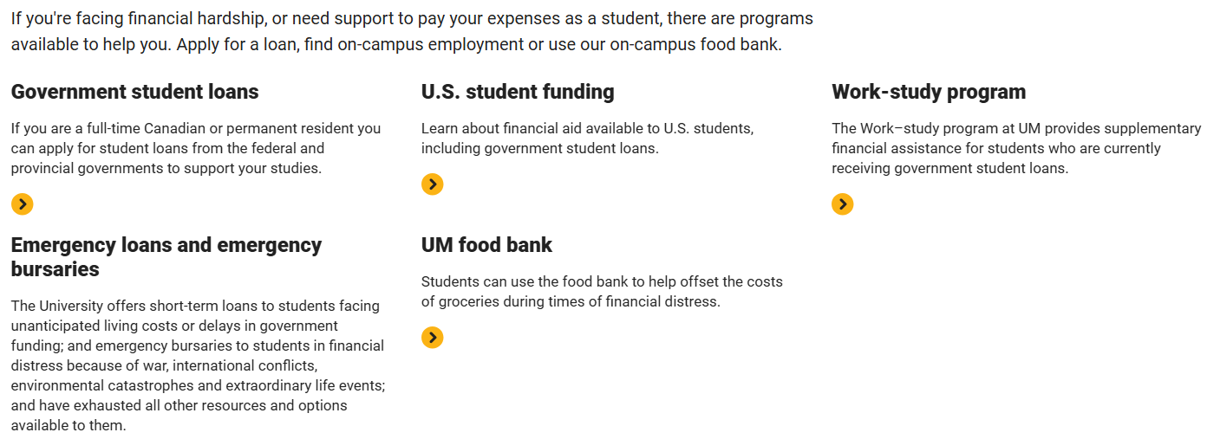
University of Manitoba Financial Aid & Awards Office
To learn more about funding possibilities through the University of Manitoba, you can access the FAA Office in the link below:
https://umanitoba.ca/financial-aid-and-awards

Slide 23
SAS Contact Information
Reception/Coordinator Staff (Fort Garry Campus)
520 UMSU University Centre
Phone: 204-474-7423
Email: student_accessibility@umanitoba.ca
SAS Bannatyne (Student Services @ Bannatyne)
S211 Medical Services Building
Phone: 204-272-3190
Email: student_accessibility@umanitoba.ca
Website
http://umanitoba.ca/student-supports/accessibility

Slide 24
Questions…

