Slide 1
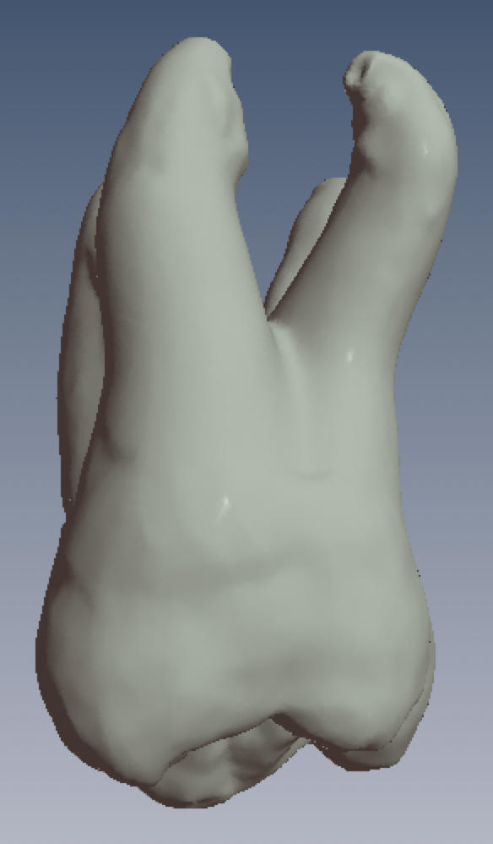

Viewing 3D Images
Permanent Tooth ID Exercises
B. Cleghorn DMD MS
Dalhousie University, Faculty of Dentistry
2.7 B View
2 palatal roots

Slide 2
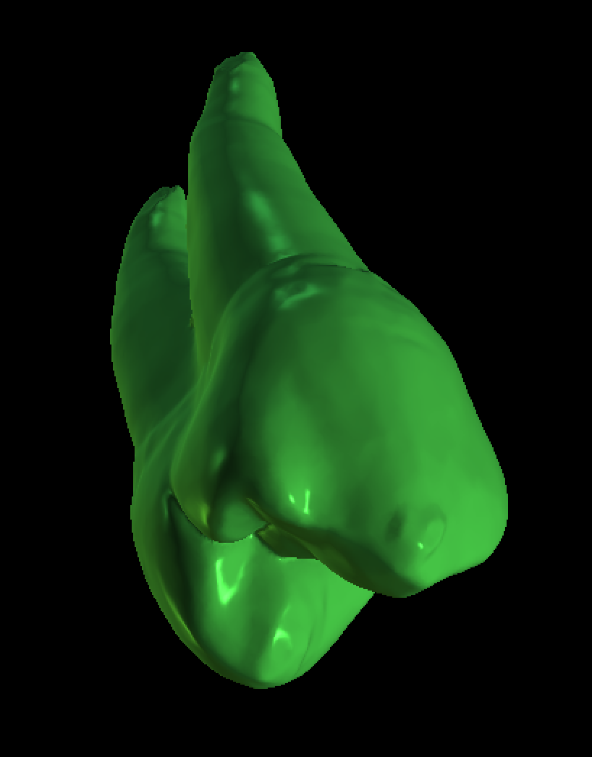
3D pdf viewers
There are a number of different free options for viewing 3D pdfs on Macs and PCs. Here are some options that have been tested.
Mac & PC
  ViewSTL (web-based app)
  BlueSkyPlan4 (desktop app)
PC
  Adobe Acrobat Reader DC (desktop app)
iPad
EMB3D (this is the best!)
Mac Only
Preview (not great)

Slide 3
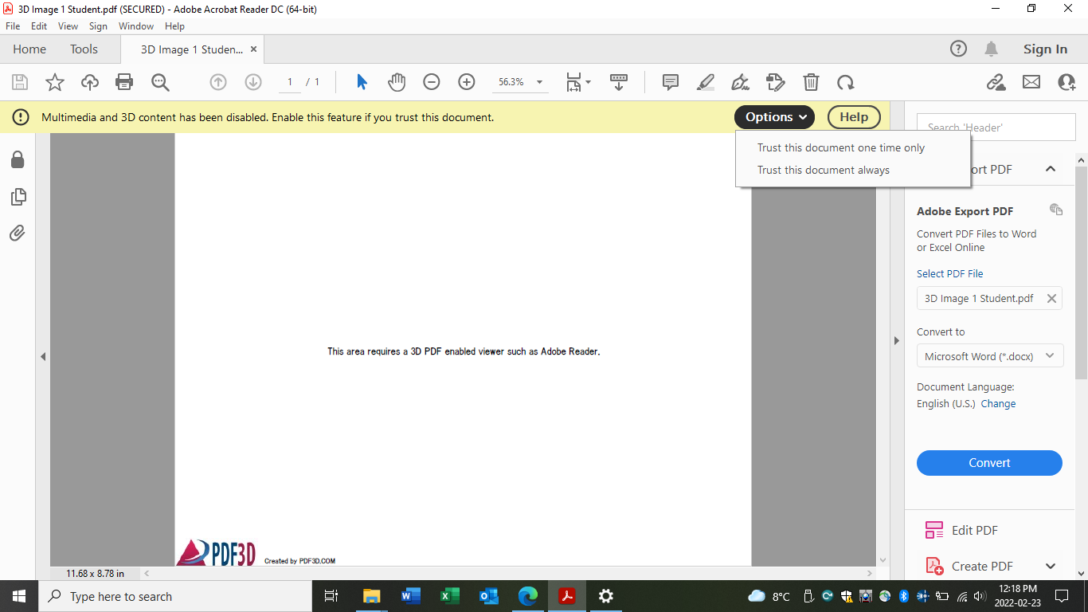
PC Instructions Using Acrobat Reader DC
3D Image X Student.pdf
The 3D pdf files can be viewed on Adobe Acrobat Reader DC (free version). Download a copy from the Adobe web site.
When opening the 3D Image X.pdf file, click on the OPTION button and choose “Trust this document always”.
Mac users should use ViewSTL to view the images as there are bugs in the current Mac version of Adobe Acrobat Reader DC at this time.

Slide 4
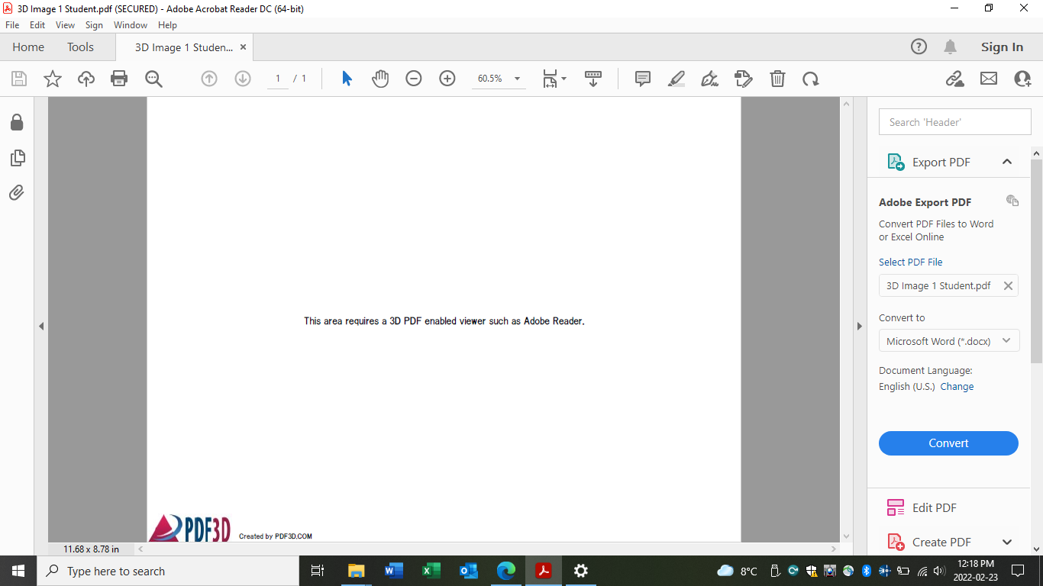
PC Instructions Using Acrobat Reader DC
3D Image X Student.pdf
Click on the text in the middle of the screen to open the 3D Image (“This area requires a 3D enabled viewer such as Adobe Reader”).

Slide 5
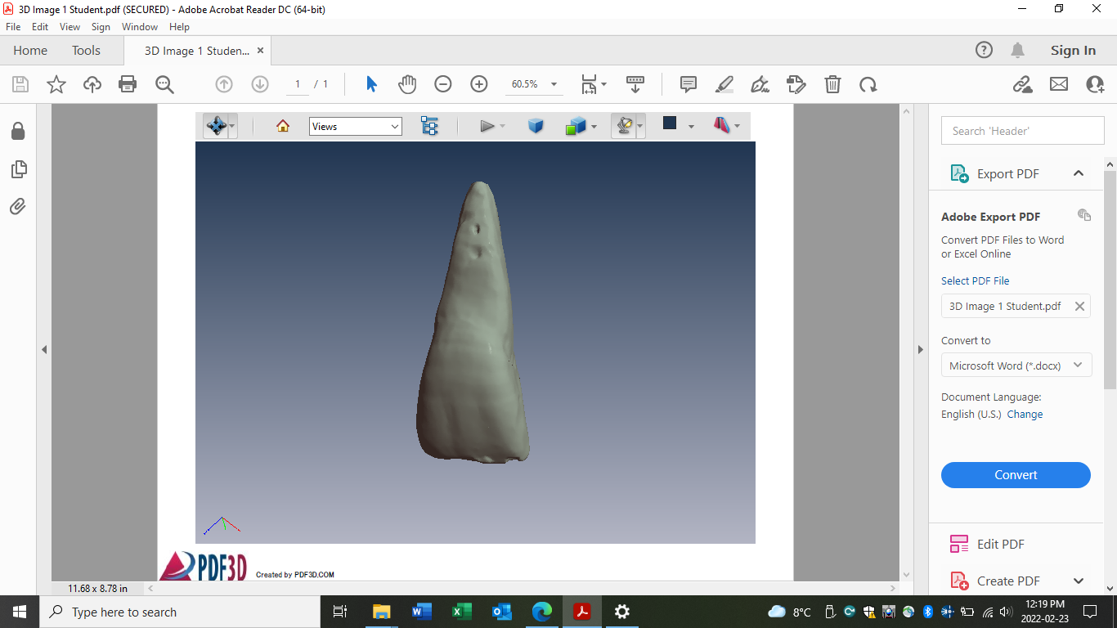
PC Instructions Using Acrobat Reader DC
3D Image X Student.pdf
To resize the image, right click and hold, then make the image larger or smaller.
To rotate the image, use the left click and hold, and turn the image in any direction.

Slide 6
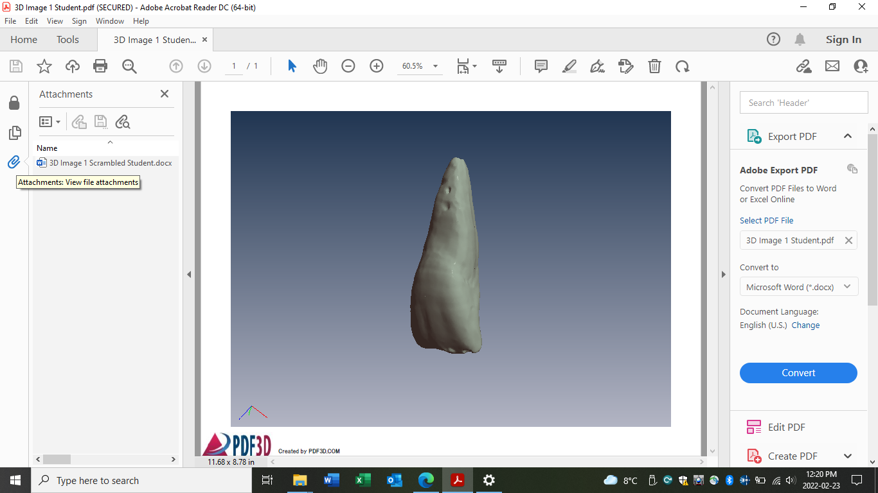
PC Instructions Using Acrobat Reader DC
3D Image X Student.pdf
On the 3D Image X Student.pdf, have the student click on the paperclip to open the attached “3D Image Scrambled Student.doc” file. The student will use this doc to identify the tooth (longhand, shorthand) and each surface of the tooth.
The 5 views may have been scrambled (Buccal/Labial may be at the top or bottom; Mesial and Distal may be on the left or right, etc.)

Slide 7
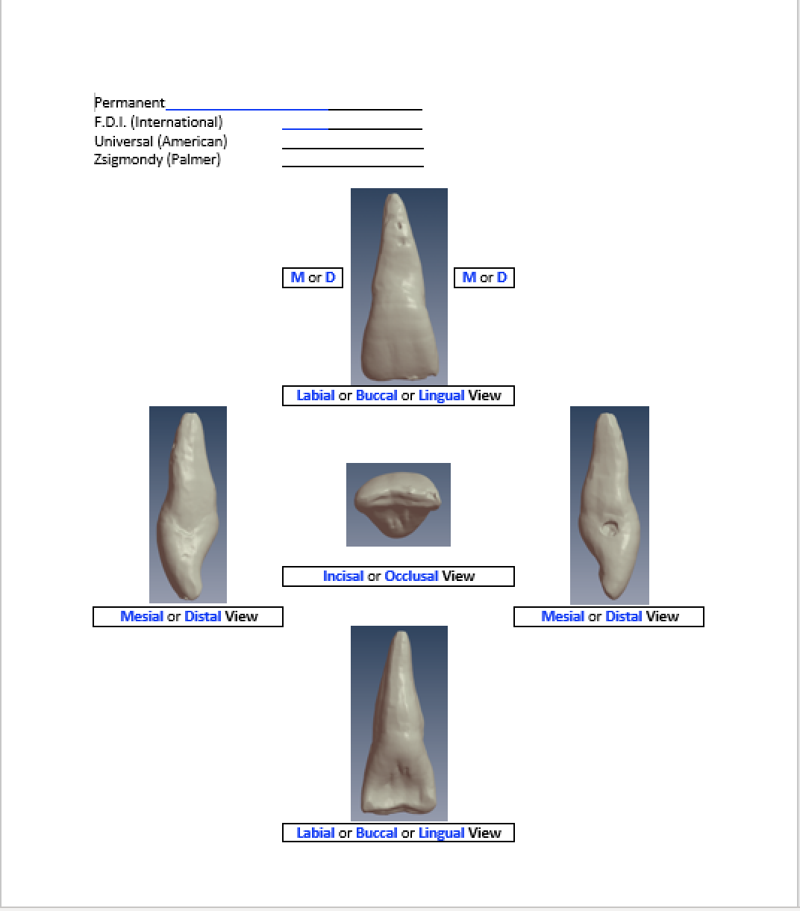
PC Instructions Using Acrobat Reader DC
3D Image X Student.pdf
On the 3D Image X Student.pdf, have the student click on the paperclip to open the attached “3D Image Scrambled Student.doc” file. The student will use this doc to identify the tooth (longhand, shorthand) and each surface of the tooth.

Slide 8
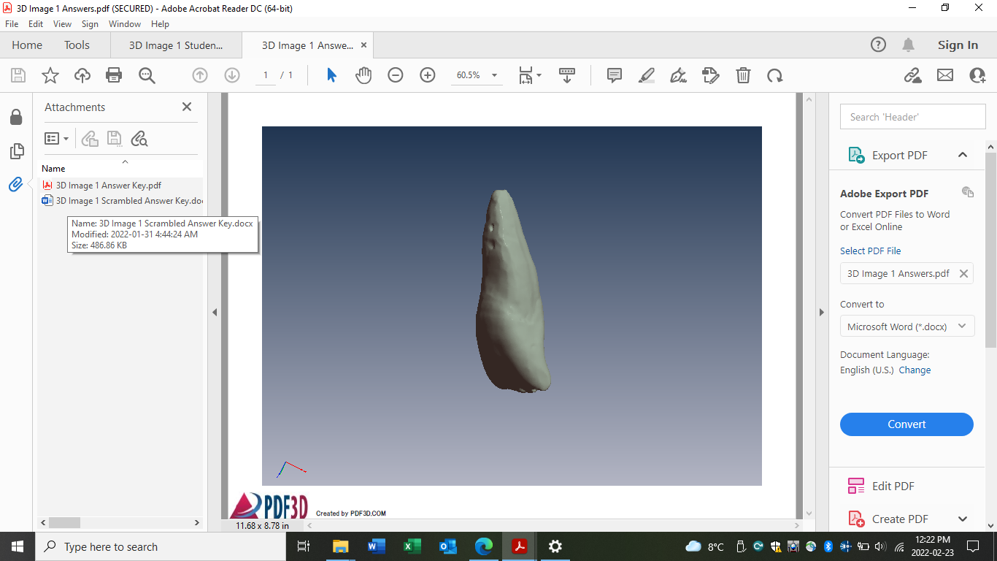
PC Instructions Using Acrobat Reader DC
3D Image X Answers.pdf
Provide the students with the 3D Image X Answers.pdf once they have completed the exercise. This file has 2 attachments with answers.
Go to the OPTIONS button first to trust the document.
Click on the text in the middle of the screen to open the 3D Image (“This area requires a 3D enabled viewer such as Adobe Reader”).

Slide 9
PC Instructions Using Acrobat Reader DC
3D Image X Answers.pdf
Click on the paperclip to view the two attached answer keys.

Slide 10
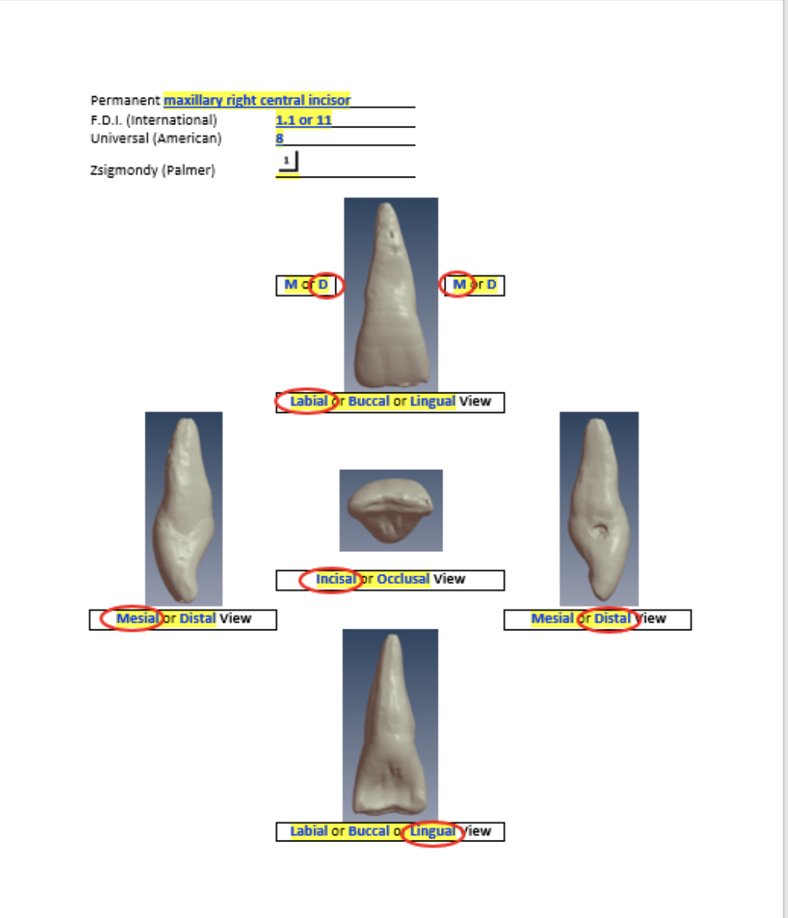
PC Instructions Using Acrobat Reader DC
3D Image X Answers.pdf
Go to the paperclip to open the 3D Image Scrambled Answer Key Word doc to check the student’s answers.
In this example of tooth 1.1, the 5 views have not been scrambled. Other 3D files may have the Buccal/Labial view on the bottom and the Mesial view on the right so the students will need to be careful to identify each of the 5 views of each tooth.

Slide 11
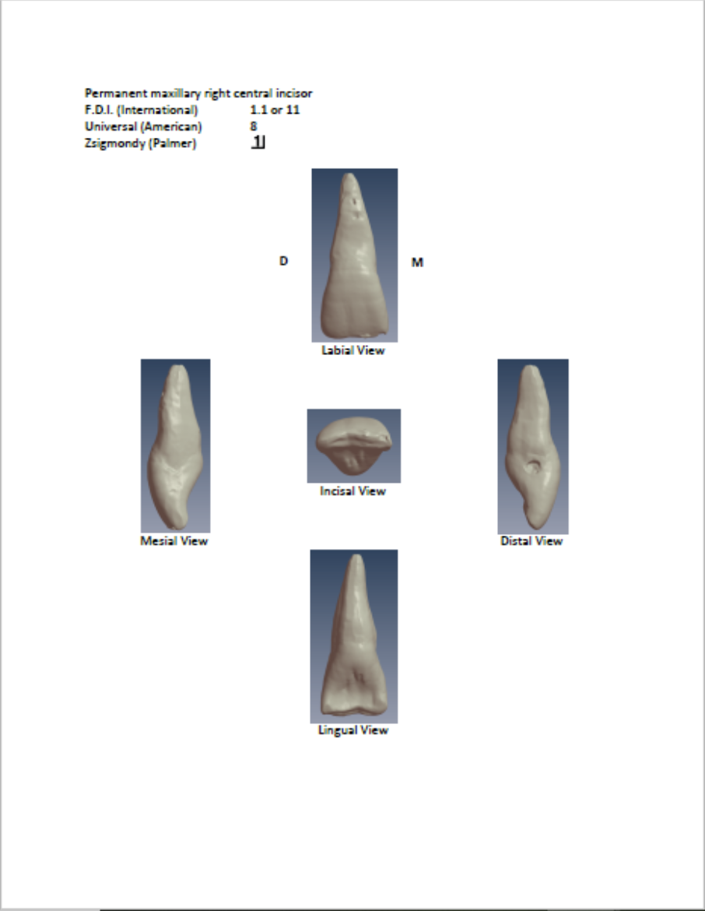
PC Instructions Using Acrobat Reader DC
3D Image X Answers.pdf
Open the 3D Image X Answer Key.pdf to view the tooth with the 5 views in standard locations (Labial/Buccal – top, Incisal/Occlusal – middle, Mesial – left side, Distal – right side, Lingual – bottom).

Slide 12
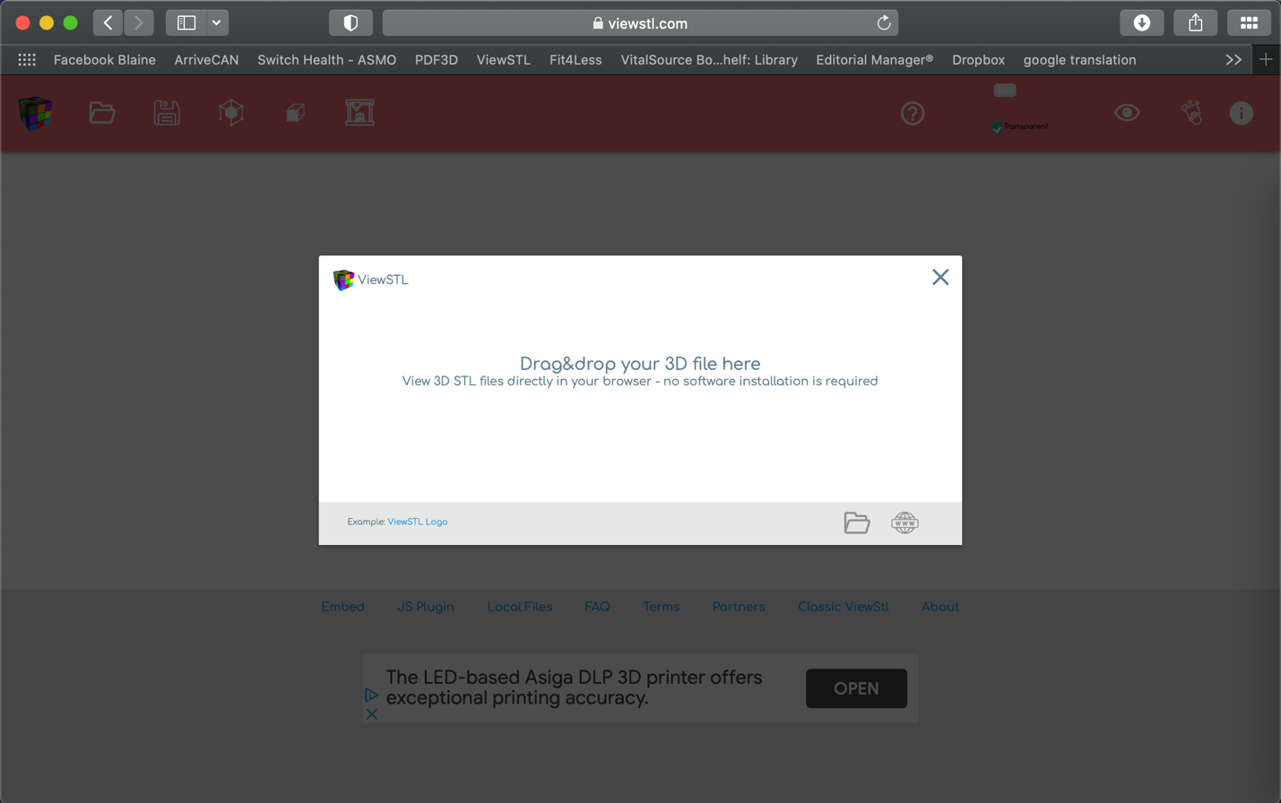
ViewSTL for PC and Macintosh
The .stl files can be viewed directly on your browser (Safari, Firefox or Chrome) through ViewSTL. Click on the link and bookmark the page.
Acrobat Reader DC for Macintosh currently does not work properly so Mac users need to use ViewSTL.
PC users can use ViewSTL or Acrobat Reader DC.

Slide 13
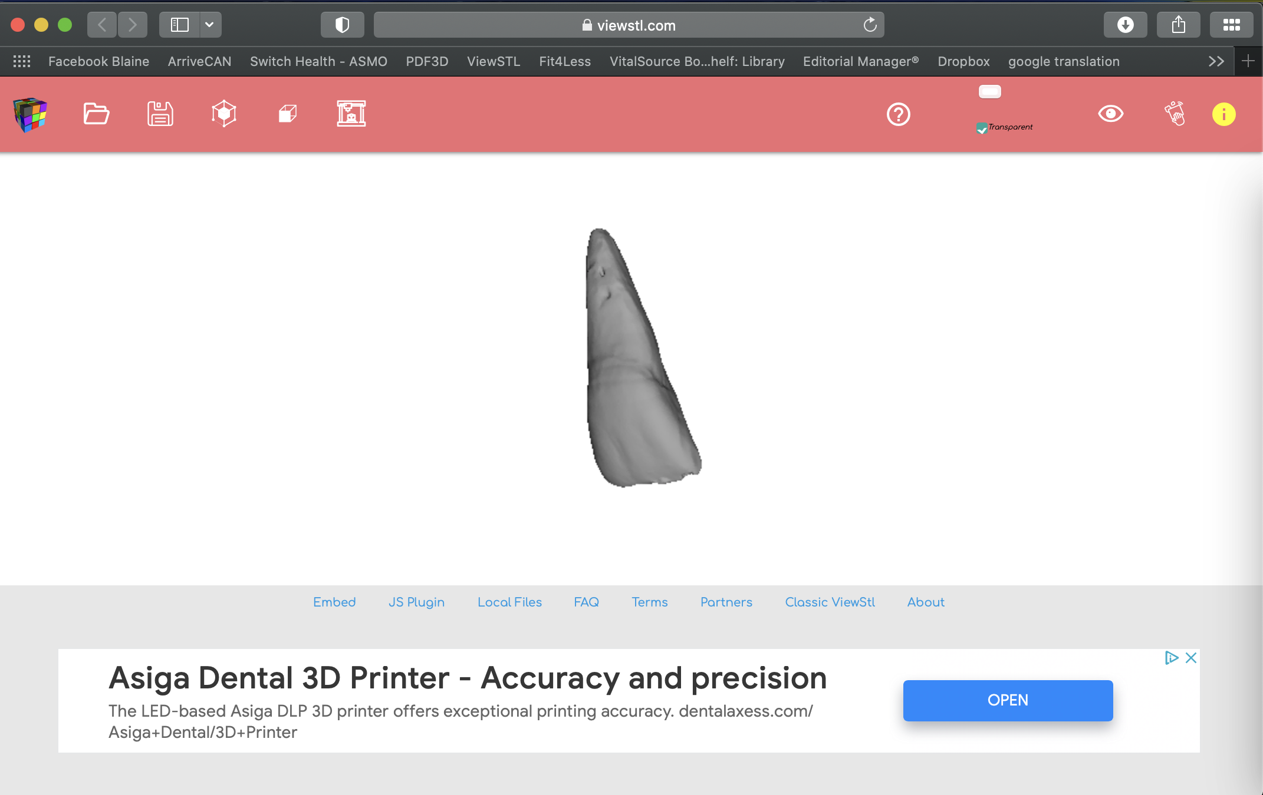
ViewSTL for PC and Macintosh
Drag and drop the .stl file on the window (Image 1.stl is shown on the right). The image can easily be resized and rotated in any direction.

Slide 14
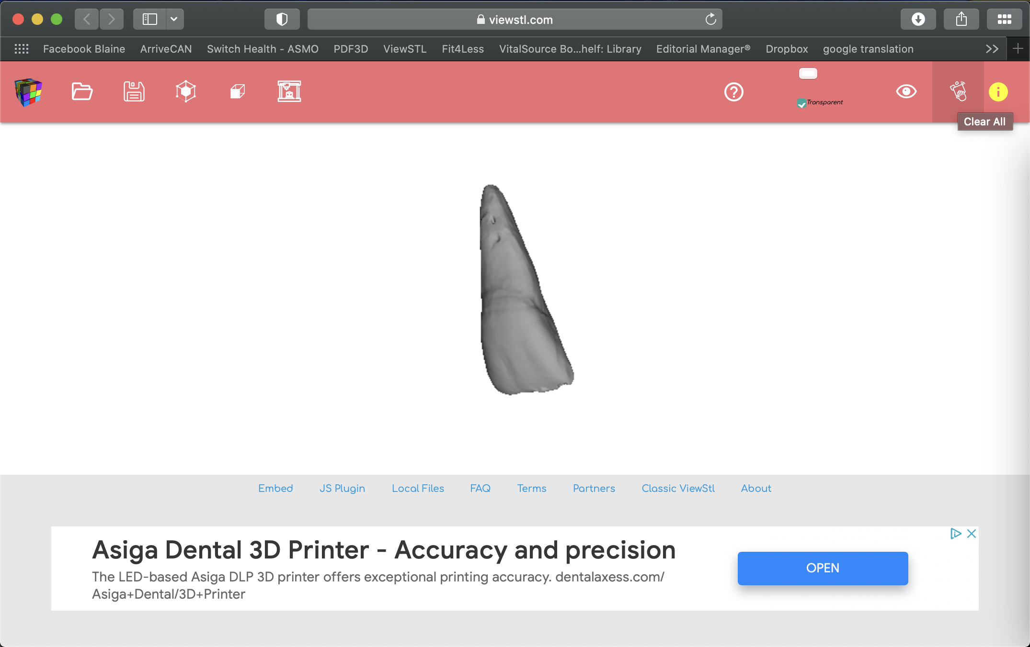

ViewSTL for PC and Macintosh
Click on the icon shown on the right to clear the image before uploading the next image.
Repeat the process to view the next image.

Slide 15
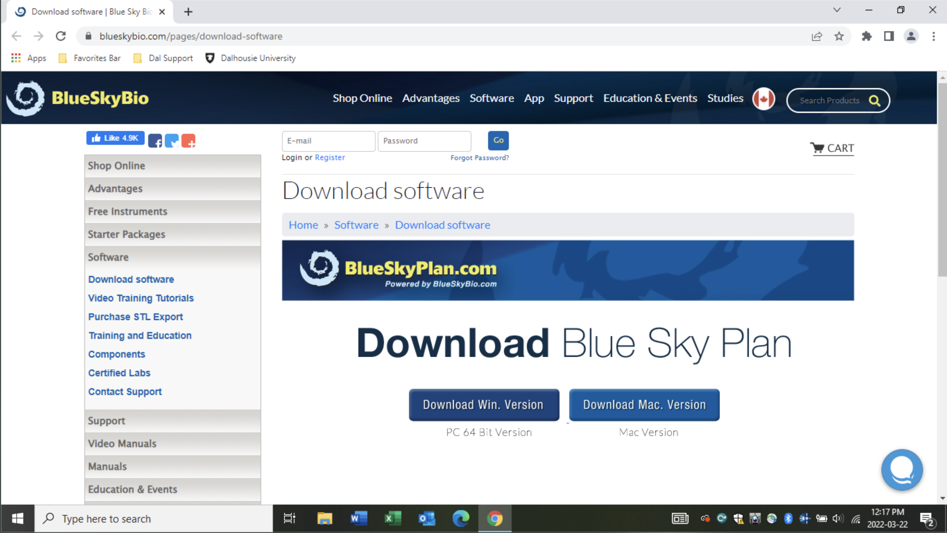
BlueSkyPlan4 for PC and Macintosh
Go to https://blueskybio.com/pages/download-software
and download the software.

Slide 16
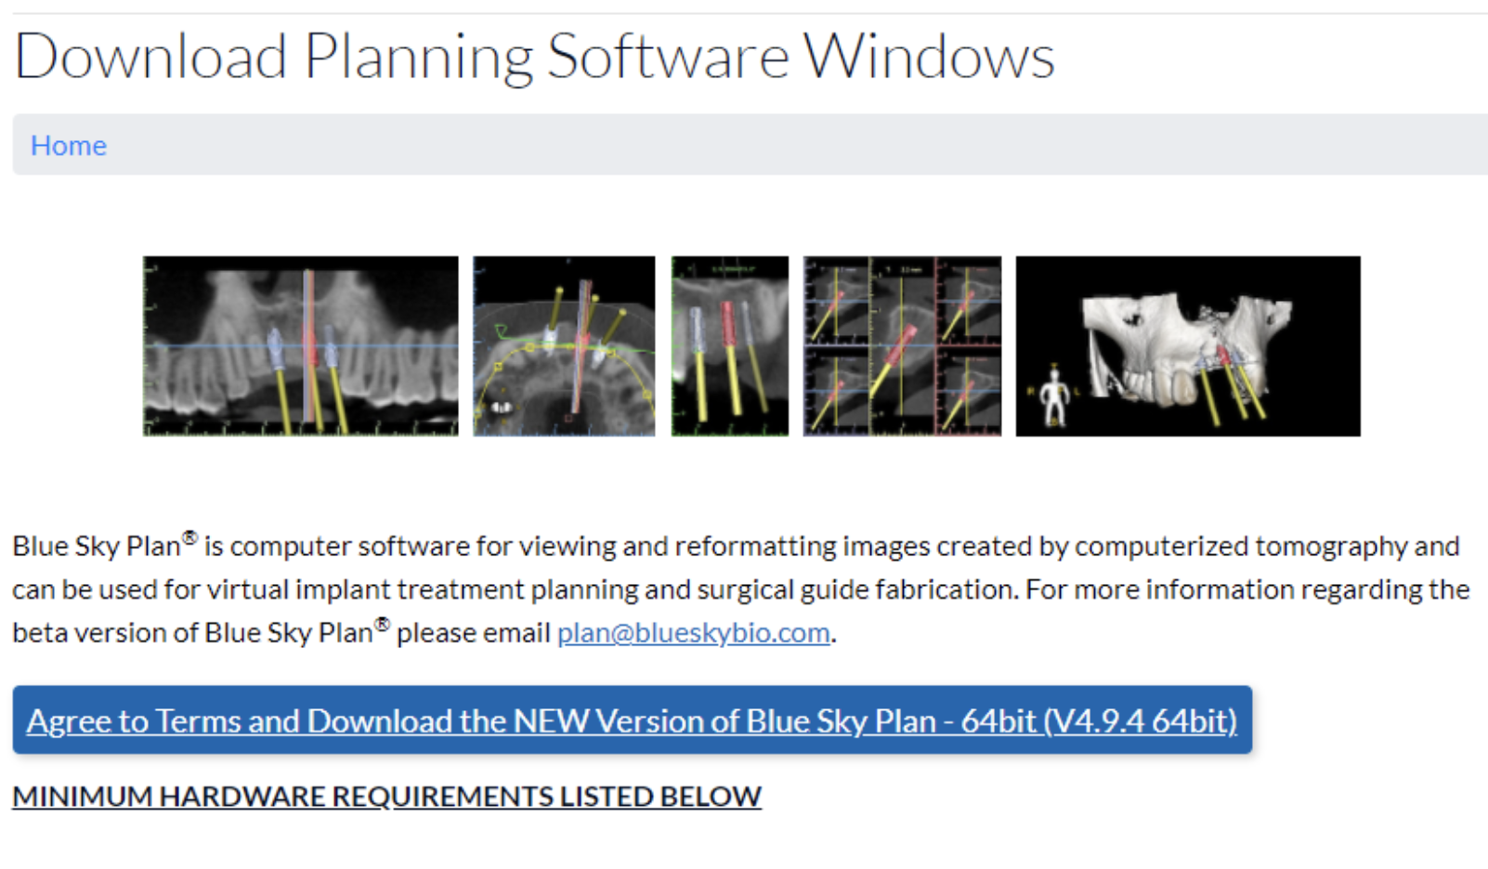
BlueSkyPlan4 for PC and Macintosh
Click on the “Agree to Terms” button.

Slide 17
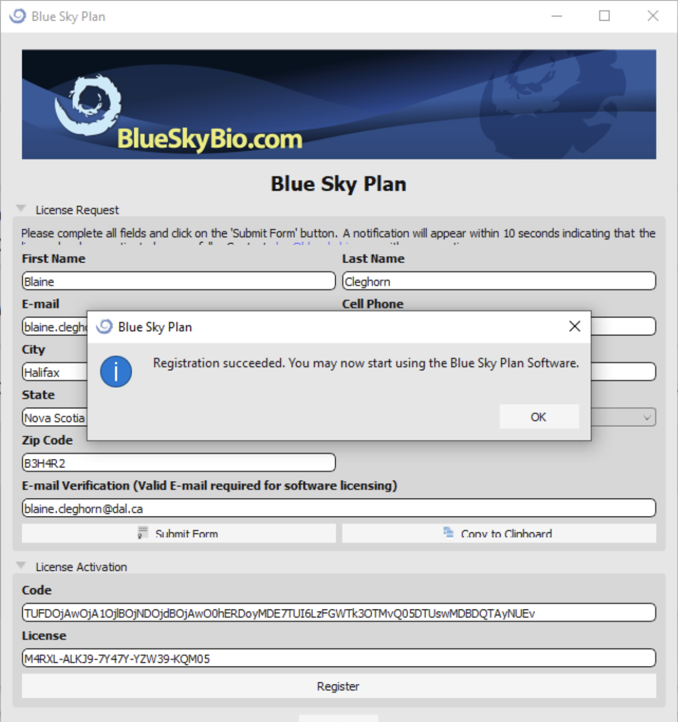
BlueSkyPlan4 for PC and Macintosh
Even though the software is free, you will need to complete the registration to acquire a licence.

Slide 18
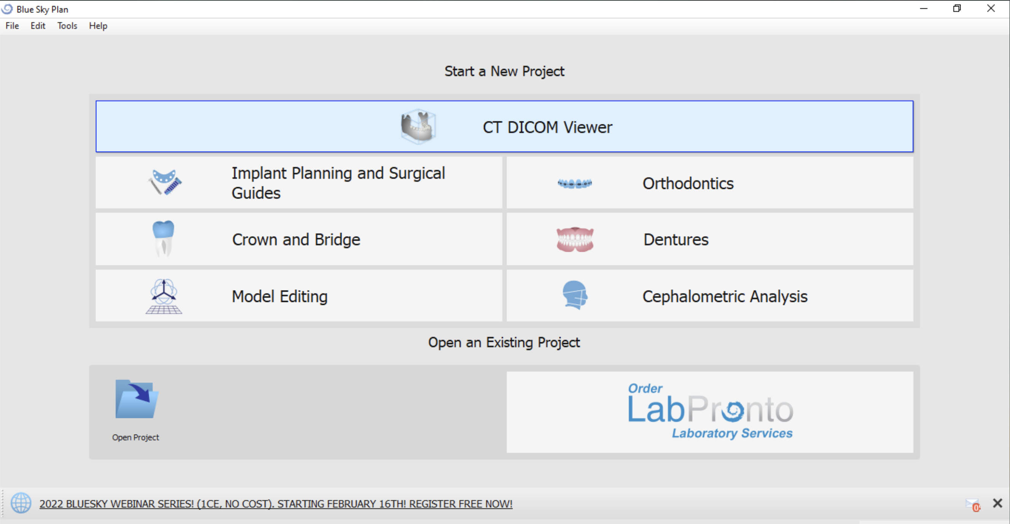
BlueSkyPlan4 for PC and Macintosh
Click on the “Model Editing” icon.

Slide 19
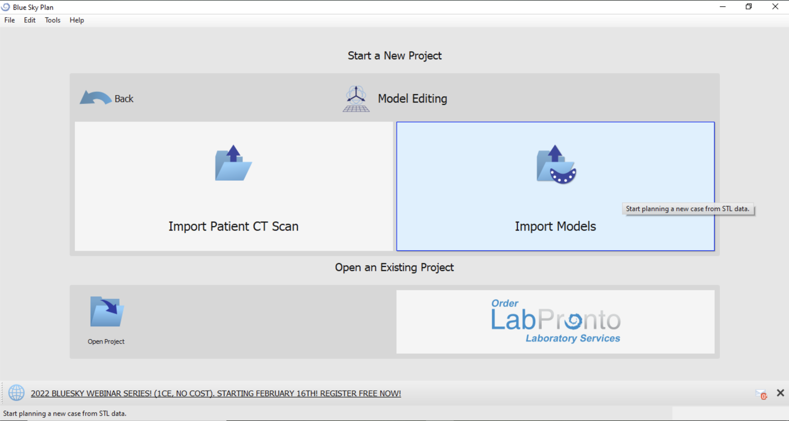
BlueSkyPlan4 for PC and Macintosh
Click on the “Import Models”
icon and find the .stl file you
want to open or just drop the
.stl file on the icon.

Slide 20
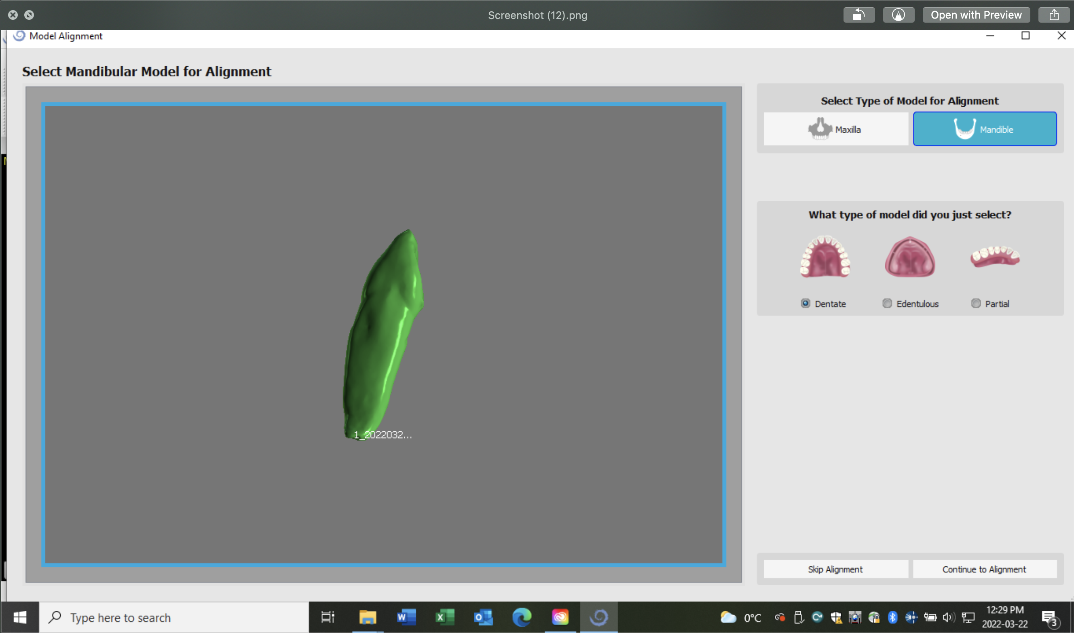
BlueSkyPlan4 for PC and Macintosh
Click on the “Continue to Alignment” icon.

Slide 21
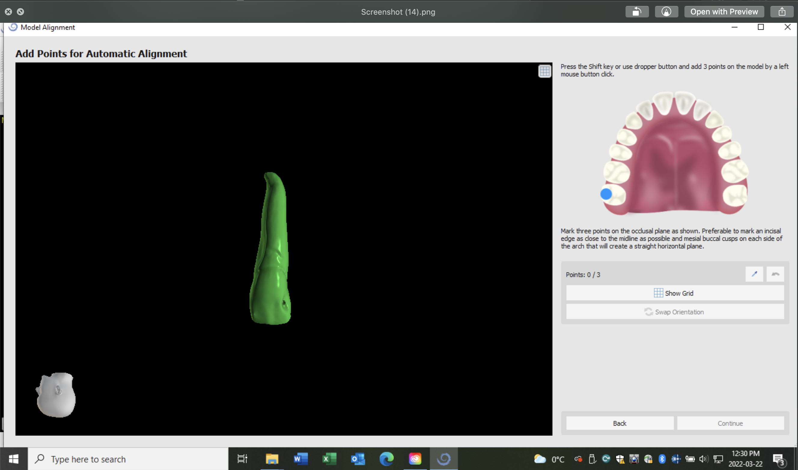
BlueSkyPlan4 for PC and Macintosh
The image can now be resized and rotated in any direction.

Slide 22
BlueSkyPlan4 for PC and Macintosh
To go to another .stl file, first
click on the “Back” button.

Slide 23
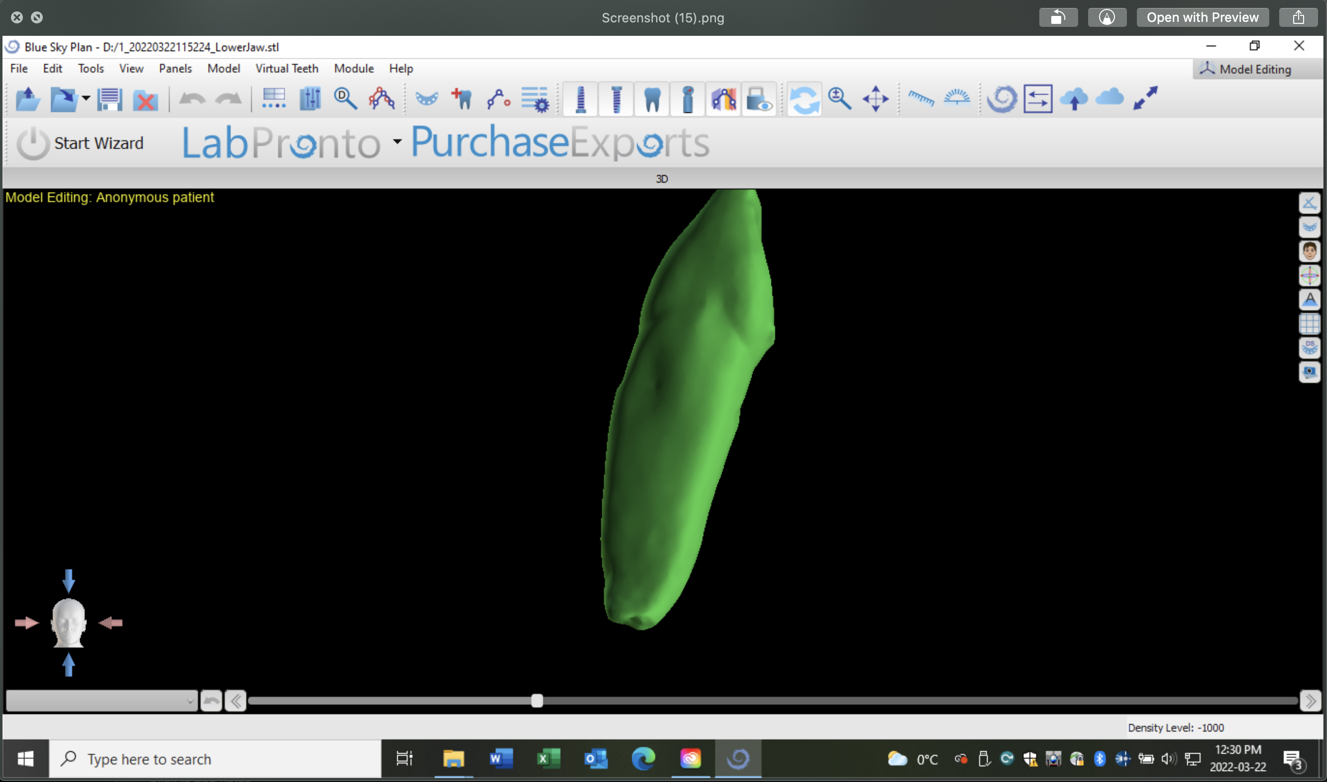
BlueSkyPlan4 for PC and Macintosh
Click on the red X to delete the file.

Slide 24
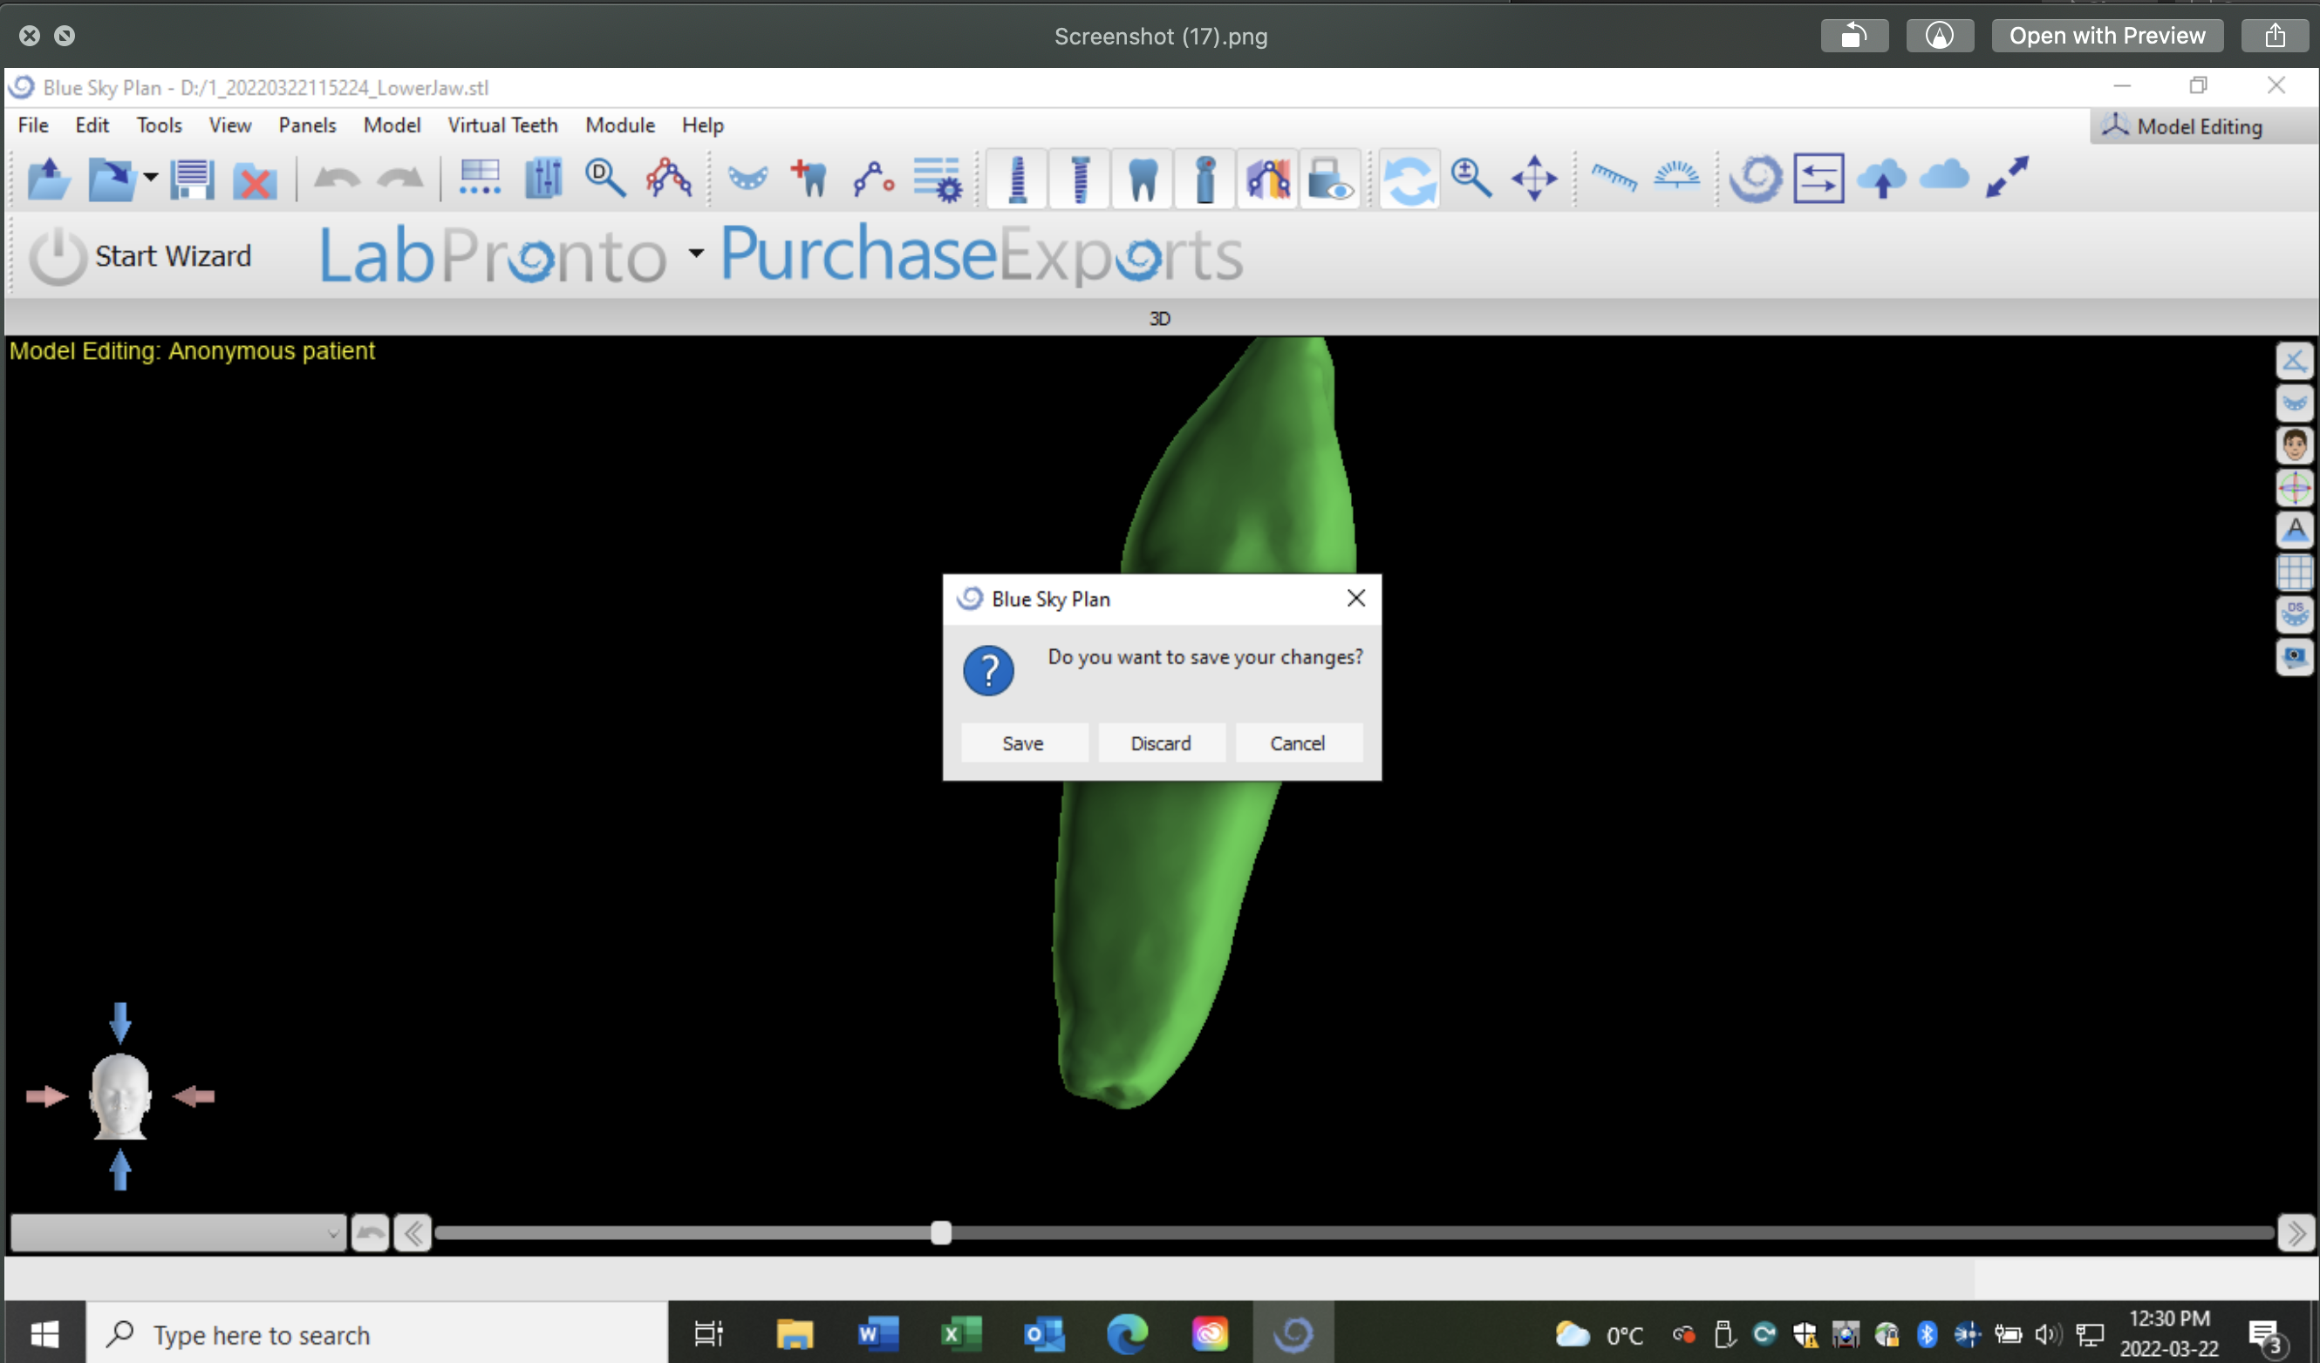
BlueSkyPlan4 for PC and Macintosh
Click on “Discard”.

Slide 25
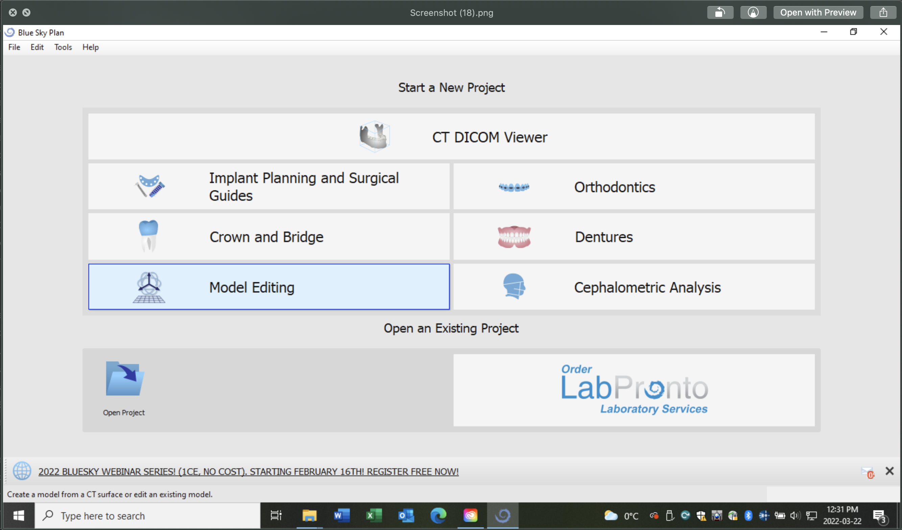
BlueSkyPlan4 for PC and Macintosh
Now start over and click on the “Model Editing” icon to add a new .stl file.

