Slide 1
Management of Medically Compromised Pediatric Dental Patients

Slide 2
Medically Compromised Children
We as dentists must be aware of the impact of medical condition on the management of our patients
Certain medical conditions may affect the provision of dental care.
Failure to address the medical needs of a pediatric patient can have life-threatening implications

Slide 3
Medically Compromised Patients
•
Heart disease
•
Bleeding disorder
•
Immunocompromised patient (Cancer/Organ Transplant)
•
Asthma
•
Epilepsy
•
Diabetes Mellitus

Slide 4
Medically Compromised Children
Get to know your patient before any dental treatment.
Medical history
Family history
General observation of the child
Modify the dental treatment as per your findings

Slide 5
Heart Disease
Individuals with heart disease may require special precautions during dental treatment. Must investigate nature and extent of disease and treat accordingly
•
•
Divided into two general types: congenital and acquired.

Slide 6
Congenital heart defects
  1. 8-10/1000 live births
  2. Structural abnormalities -> turbulent blood flow -> audible murmurs
  3. Acyanotic or Cyanotic
  Symptoms
    VSD / Pulmonary Stenosis
        Breathlessness on exertion
        Tiring easily
        Recurrent respiratory infections
    Tetralogy of Fallot / Vascular defects
        Cyanosis
        Finger clubbing
        Delayed growth and development
Notes:
Many defects are slight (innocent heart murmur) and cause little of any disability. A child with a more severe defect may present with breathlessness on exertion, tiring easily and/or suffering from recurrent respiratory infections (VSD, pulmonary stenosis). Children with severe defects (tetralogy of Fallot and vascular defects which have cyanosis, finger clubbing and may have delayed growth and development)
Acyanotic conditions
The acyanotic group of conditions is characterized by a connection between the systemic and pulmonary circulations or a stenosis (narrowing) of either circulation. Infants often present with feeding difficulties, breathlessness and failure to thrive. Shunts are from the left to right.
Cyanotic conditions
All cyanotic conditions exhibit right-to-left shunting of desaturated blood. Cyanotic defects become clinically evident when 50 g/L of desaturated haemoglobin is present in peripheral arterial blood. Infants with mild cyanosis may be pink at rest but become very blue during crying or physical exertion. Children with cyanotic defects are at significant risk for desaturation during general anaesthesia and preoperative consultation with the paediatric cardiologist and anaesthetist is essential.

Slide 7
Congenital Heart Defects
Acyanotic conditions
  Connection between systemic and pulmonary circulation OR a stenosis of either circulation
      Atrial septal defect (ASD)
      Ventricular septal defect (VSD)
      Patent ductus arteriosus (PDA)
      Coarctation or localised constriction of aorta
      Aortic stenosis
      Pulmonary stenosis
Cyanotic conditions
  Right-to-Left shunting of desaturated blood
      Tetralogy of Fallot
      Transposition of great vessels
      Eisenmenger’s syndrome
      Tricuspid atresia
      Pulmonary atresia
Notes:
Acyanotic conditions
The acyanotic group of conditions is characterized by a connection between the systemic and pulmonary circulations or a stenosis (narrowing) of either circulation. Infants often present with feeding difficulties, breathlessness and failure to thrive. Shunts are from the left to right.
Cyanotic conditions
All cyanotic conditions exhibit right-to-left shunting of desaturated blood. Cyanotic defects become clinically evident when 50 g/L of desaturated haemoglobin is present in peripheral arterial blood. Infants with mild cyanosis may be pink at rest but become very blue during crying or physical exertion. Children with cyanotic defects are at significant risk for desaturation during general anaesthesia and preoperative consultation with the paediatric cardiologist and anaesthetist is essential.
● Atrial septal defect (ASD) – usually located near foramen ovale.
● Ventricular septal defect (VSD) – in the membranous septum of the ventricular
wall.
● Patent ductus arteriosus (PDA) – caused by failure of closure of the ductus connecting the pulmonary artery with the aorta (normally closes soon after birth). If cardiac failure develops the infant is digitalized and prescribed diuretics if necessary. Hospitalization, oxygen, nasogastric tube feeding and antibiotic therapy for chest infection may also be required. If the lesion does not close spontaneously, surgery to reduce torrential pulmonary flow or repair of the defect is indicated.
Acyanotic defects with obstruction include:
● Coarctation or localized constriction of the aorta – usually in the area related
to the insertion of the ductus.
● Aortic stenosis or narrowing of the aortic central orifice – due to fusion of the
aortic valve cusps.
● Pulmonary stenosis – due to narrowing of the pulmonary valve which may also
involve the pulmonary arteries.
Cyanotic Conditions
● Tetralogy of Fallot – which includes a VSD, pulmonary stenosis at valve or sub-valve levels, a large overriding aorta and right ventricular hypertrophy.
● Transposition of great vessels – when the aorta exits the heart from the right side and the pulmonary artery exits from the left. Although the internal heart anatomy is normal, the systemic blood circulation cannot be resaturated with oxygen and immediate management of transposition by opening the ductus
arteriosus and corrective surgery is required.
● Eisenmenger’s syndrome – this refers to cyanosis from any right-to-left shunt caused by increased pulmonary resistance through a VSD or PDA.
● Tricuspid atresia – due to absent tricuspid valve and may present with an absent right ventricle and pulmonary valve. The pulmonary circulation is maintained
through a PDA in the neonate.
● Pulmonary atresia – which is similar to tricuspid atresia except that the tricuspid valve is patent.

Slide 8
Congenital Heart Disease
•
Incidence is approximately 9 in 1000 births
•
Most common types are:
Ventricular septal defect (22%)
Patent ductus arteriosus (17%)
Can be further classified as Acyanotic Congenital Heart Disease and Cyanotic Heart Disease.
Dental implications?
  Some require prophylaxis prior to dental treatment and some do not!
  Degree of severity will dictate dental treatment options
•

Slide 9
Cardiomyopathies
      Myocardial disease
      Pericardial disease
      Cardiac arrhythmia
      Rheumatic heart disease
      Infective endocarditis
      Rheumatic heart disease
  Rheumatic fever
    Streptococcal infection of URT
        Joint pains, carditis, high fever
        During healing phase most of the carditis resolves, except for the lesions on the cusps of the heart valves which may become fibrosed and stenotic and could become a site for the growth of blood born bacteria
        Infective endocarditis
Notes:
Both CHD and RHD can predispose the internal lining of the heart to bacterial or fungal infection (infective endocarditis) and lead to the formation of friable vegetations of blood cells and organisms. Vegetations may embolize and cause renal, pulmonary or myocardial infarcts or cerebrovascular accidents. Streptococcus viridans, a common commensal organism in the oral cavity, is most frequently responsible for chronic infective endocarditis, whereas Staphylococcus aureus is often implicated in the acute fulminating form of infective endocarditis.

Slide 10
Acquired Heart Disease
Rheumatic Fever
  Streptococcus infection that can involve the heart, joints, skiing, CNS, subcutaneous tissue
  Cardiac involvement can lead to scarring and deformity of the heart valves.
Infective Endocarditis
  Bacterial infection of the heart valves
  Develops in persons with preexisting congenital cardiac disease or rheumatic valvular lesions.

Slide 11
Bacteremia (bacteria in the bloodstream) is anticipated following invasive dental procedures and can lead to complications in an immunodeficient patient.
High-risk cardiac disease, immunosuppression, and immunodeficiencies may compromise one’s ability to fight simple infection.
The rationale for anti-biotic prophylaxis is to reduce or eliminate transient bacteremia caused by invasive dental procedures

Slide 12
Dental Management of Patients with Heart Diseases
No dental treatment is to be performed until all details of the conditions are obtained and the patients physician has been consulted.
Implementation of aggressive preventive regiment
  Dietary counselling
  Fluoride treatment
  Sealants
  Frequent recall

Slide 13
AP suggested
All dental procedures that involve manipulation of gingival tissue or the periapical region of teeth or perforation of the oral mucosa.
AP not suggested
Anesthetic injections through noninfected tissue
Taking dental radiographs
Placement of removable prosthodontic or orthodontic appliances
Adjustment of orthodontic appliances
Placement of orthodontic brackets
Shedding of primary teeth
Bleeding from trauma to the lips or oral mucosa.
Notes:
procedures likely to breach the integrity of the oral mucosa or pulpal tissue and cause bleeding
Pulpotomy/pulpectomy contraindicated due to possibility of subsequent chronic bacteremia
OH & Preventative regimen
MD consult
Antibiotic prophylaxis
Endo treatment only on teeth with high probability of success
All active disease must be treated prior to cardiac surgery
Children with advanced CV disease should receive only palliative dental care until their medical condition has stabilized
Pulpally involved teeth - extract
Preferable to manage under GA
If multiple visits are necessary, Rx ABX and wait one month between appointments to reduce bacterial resistance
Avoid use of electrosurgery, electronic pulp testers and ultrasonic cleaning in children with cardiac pacemakers

Slide 14
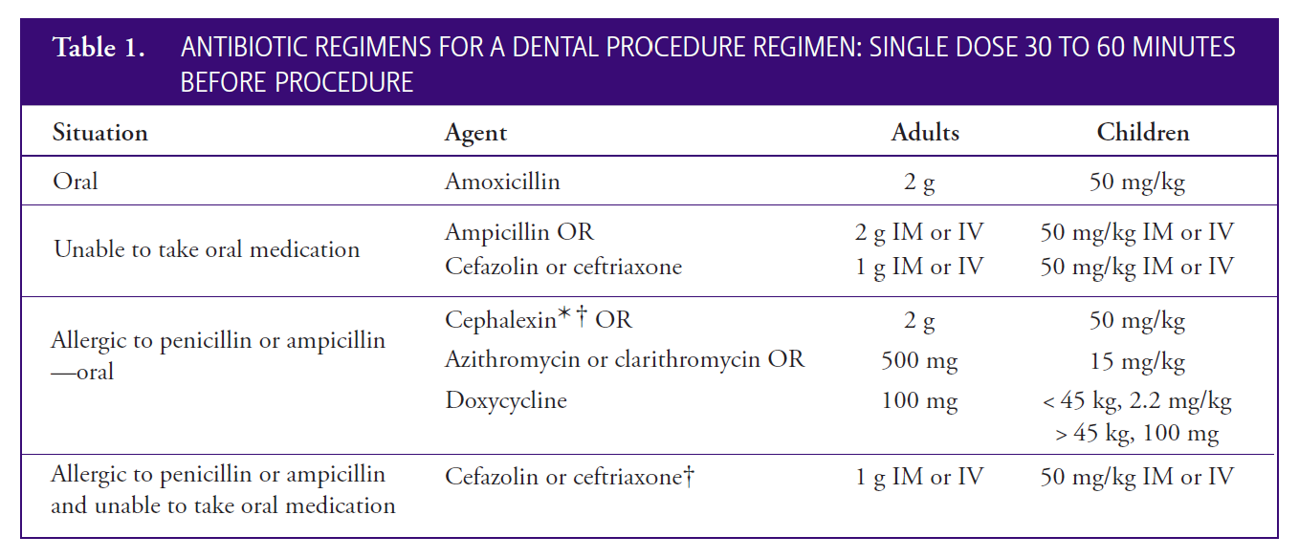

Slide 15
Prophylactic Antibiotics
Prior to performing dental procedures which involve gingival manipulation, some patients may require prophylactic antibiotics.
Recently American Heart Association (AHA) guidelines have removed the use of clindamycin due to frequent and severe drug reactions related to community-acquired Clostridium difficile infections.
Doxycycline is recommended as an alternative for patients unable to tolerate a penicillin, cephalosporin, or macrolide .Short-term use (less than 21 days) of doxycycline had not been associated with tooth discoloration in children under eight years of age.
Antibiotic prophylaxis should be given 30-60 minutes prior to the procedure; however, it can be given up to two hours after a dental procedure.
A different class of antibiotics is indicated if the patient is already on oral antibiotic therapy or has an allergy or anaphylactic reaction.

Slide 16
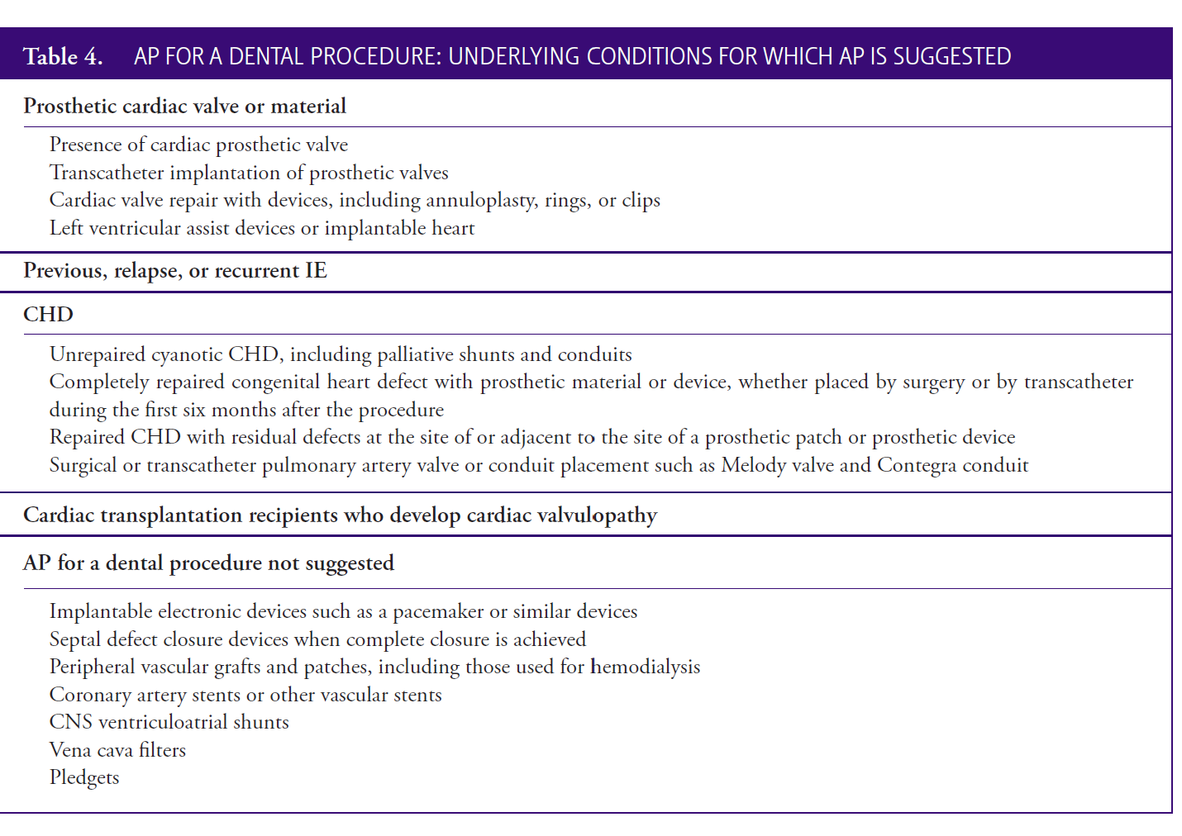

Slide 17
Patients with compromised immunity
Noncardiac patients with a compromised immune system may be at risk for complications of bacteremia and distant site infection following invasive dental procedures.
Consultation with the patient’s physician .
High-risk patients who should be considered for use of prophylaxis includes :
a. human immunodeficiency virus (HIV);
b. severe combined immunodeficiency (SCIDS) and other primary immunodeficiency diseases;
c. neutropenia and other neutrophil-related disorders (e.g., severe congenital neutropenia, leukocyte adhesion deficiency, Chédiak-Higashi syndrome);
d. cancer chemotherapy, immunosuppressive therapy and/or radiation therapy; or
e. hematopoietic stem cell or solid organ trans-plantation.
2. history of head and neck radiotherapy.
3. autoimmune disease (e.g., juvenile arthritis, systemic lupus erythematosus).
4. sickle cell anemia.
5. asplenism, status post splenectomy, or complement deficiencies.

Slide 18
Bleeding Disorders

Slide 19
Classification :
Coagulation disorders
a) Congenital b) Acquired
- Hemophilia A - Vit K Deficiency
- Hemophilia B - Liver Disease
- Von Willebrand Disease - Drug Induced
Platelet Disorders
3. Vascular Disorders
4. Fibrinolytic Disorders

Slide 20
Haemophilia A – deficiency of factor VIII
  Inherited X-linked recessive
  30% spontaneous mutation
Haemophilia B – deficiency of factor IX
  Christmas disease
  Inherited X-linked recessive
  Easy bruising, urinary tract bleeds, nosebleeds
  Any surgical procedure to include tranexamic acid
Von Willebrand’s disease
  Inherited autosomal dominant
  Epistaxis, gingival and gastric bleeding
Notes:
Primary haemostasis is initiated after injury to a blood vessel with the formation of a primary platelet plug. This process is mediated by interactions between the platelets and coagulation factors in the plasma and the vessel wall. Secondary haemostasis or coagulation is also triggered by the initial injury and reaches its greatest intensity after the primary platelet plug is formed. Fibrin deposition provides the framework for the formation of a stable blood clot.
Prolonged bleeding can occur when either phase of haemostasis is disturbed. The clinical manifestations of a haemostasis disorder vary depending on the phase affected. Defects in primary haemostasis generally result in bleeding from the skin or mucosal surfaces, with the development of petechiae and purpura (ecchymoses). These disorders include von Willebrand’s disease as well as defects in platelet function. In contrast, defects in secondary haemostasis, such as haemophilia, lead to bleeding that tends to be more deep-seated in muscles and joints. In both disorders, uncontrolled prolonged oral bleeding can occur from innocuous insults such as a tongue laceration or cheek biting.
Haemophilia A
Severe <1% factor VIII – spontaneous bleeding in joints and muscles
Moderate (2-5% factor VIII) less severe bleeding usually following minor trauma
Mild (5-25% factor VIII) – may not manifest until middle age following significant trauma or surgery

Slide 21
Dental and medical evaluation of the patient is very important and necessary before treatment ,especially if we are planning an invasive procedure .
- Previous unusual bleeding
- Spontaneous bleeding
- Frequent bruising
- Family History (hereditary)
- Complete Drug History

Slide 22
Drug History
1. If on anticoagulants – CONSULT their physician before any major surgical procedure
2. Medications can interfere with hemostasis and can cause prolonged bleeding
- Aspirin interferes with hemostasis
- NSAIDS increase the effect of warfarin
-Penicillin,tetracycline,metronidazole,erythromycin potentiate the effect of warfarin and increase the risk of bleeding.
ALWAYS CONSULT THEIR PHYSICIAN BEFORE PLANNING A DOSE REGIMEN

Slide 23
What are we looking for ?
- Multiple purpurae on the skin
- Systemic signs of systemic disease (Jaundice)
- Cardiac Patients can show signs of tachycardia and hypertension which can make hemostasis difficult.
- Epistaxis
- Hematomas
- Ecchymosis
- Spontaneous gingival bleeding

Slide 24
LAB Tests:
INR : measures the extrinsic pathway (Normal: 1)
PTT: evaluates intrinsic coagulation pathway ( 25 +- 10 sec)
Bleeding time : determines the platelet functions (2-7 min)
Platelet count : quantifies platelet functions (150,000- 450,000 platelets per microlitre of blood)

Slide 25
Bleeding Disorders
•
Development of a treatment plan:
Consultation with physician
Depends on a) Severity of condition
b) Invasiveness of the
planned treatment
Mild bleeding disorder and limited invasive tx – no modification required
Severe bleeding disorder
– goal is to achieve hemostasis

Slide 26
Bleeding Disorders
•
Pain control
Avoid NSAIDS due to possible affect with platelet function.
Acute pain of moderate intensity best managed with acetaminophen
Narcotics for severe pain are not contraindicated

Slide 27
Bleeding Disorders
Local anesthesia:
Intraligamentary ,intraosseous,intraplulpal injection may be preferred over block anesthesia due to hematoma risk
LA with vasoconstrictor be used
Oral sedation( Benzodiazepams) and Nitrous Oxide could be used to reduce anxiety
Periodontal Therapy:
Rubber cup prophylaxis can be performed safely without factor replacement therapy
If sub gingival scaling required, factor replacement required.

Slide 28
Bleeding Disorders
Restorative procedures:
Most restorative procedures on primary teeth are successfully completed without factor replacement using PDL injection
Use a rubber dam for isolation to protect the cheeks, lips, and tongue. These tissues are highly vascular and accidental laceration will be difficult to manage.
Wedges and matrices can be used conventionally
Saliva ejectors and High Speed suctions can injure the mucosa in the floor of the mouth and cause hematoma – wrap the tips with gauze
•

Slide 29
Bleeding Disorders
Pulp therapy preferred over extraction
Consult prior to any extractions!
Follow up closely postoperatively
In Severe Cases – Minimal intervention dentistry is recommended to reduce the need of pulp exposures and bleeding.
Planning follow up visits : Risks / benefits medical precautions must be discussed with parents /caregivers in close collaboration with the care team.

Slide 30
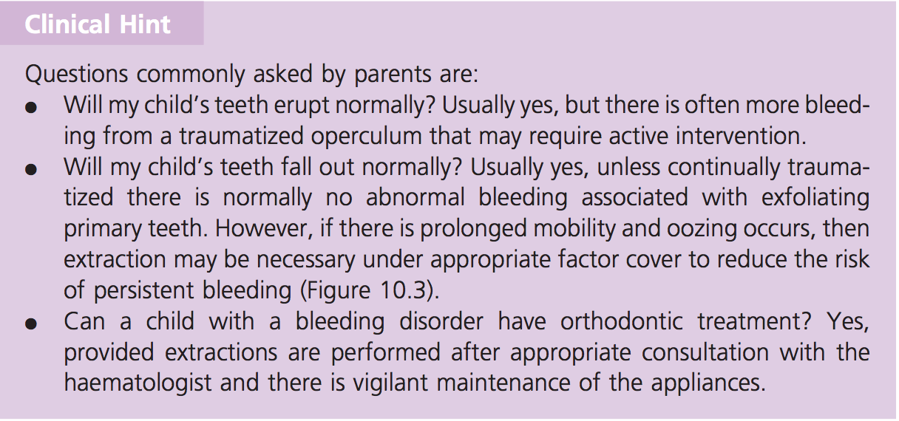

Slide 31
Leukemia
•
Malignancy is second leading cause of death in children
Acute Leukemia is the most common malignancy in children. The prognosis for a child with acute leukaemia has improved dramatically. The overall survival is not 80%.
•
•
Leukemia is characterized by abnormal white blood cells in the bone marrow.

Slide 32
Leukemia
•
Oral Manifestations:
Oral signs have been reported in up to 75% of adults and 29% of children.
More frequent reported oral abnormalities:
  Regional lymphadenopathy
  Mucous membrane petechiae and ecchymoses
  Gingival bleeding
  Gingival hypertrophy
  Nonspecific ulcerations

Slide 33
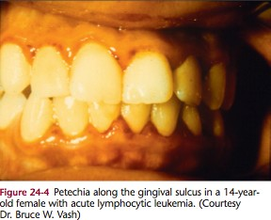
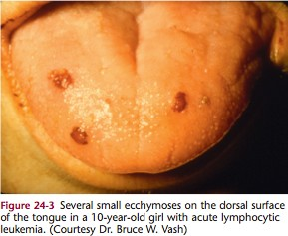
McDonald and Avery: Dentistry for the Child and Adolescent. 9th Edition

Slide 34
Leukemia
•
Dental Management
Before any treatment is administered, the child’s oncologist must be consulted
For a child whose first remission has not yet been obtained, or one who is in relapse, all elective dental procedures should be deferred
Potential sources of systemic infection within the oral cavity must be controlled or eradicated as soon as recognized

Slide 35
Leukemia
•
Dental management:
Routine preventive, restorative, and surgical procedures can be provided if the patient is in complete remission yet is undergoing chemotherapy.
Pulp therapy on primary teeth is contraindicated in any patient with a history of leukemia
Prior to the appointment (with consultation with physician, of course!) a complete blood count and platelet count should be taken to ensure the patient is not at risk for bleeding / infection.

Slide 36
Asthma
•
Asthma is an obstructive respiratory disease that causes breathlessness, coughing and wheezing.
•
Allergens and stress could trigger acute episodes
•
A dental procedure constitutes an acute irritant to the airways and may precipitate an attack
Notes:
Affects 1 in 10 children
Breathlessness, coughing and wheezing
Highly prevalent in children
Severity deceases with age
Allergens and stress could trigger acute episode

Slide 37
Asthma
•
Important questions to ask:
Frequency and severity of attacks?
What are triggering agents?
When was the last attack?
What medications does the patient take?
Does the patient carry medications with them (AKA at the dentist office)?
Does the patient have limitations on activity?

Slide 38
Asthma
•
Warning signs…
Patients taking systemic corticosteroids
  Prednisone.
  Used in treatment after attack or if asthma is not under control.
Patients who were hospitalized or in the ER in the last year.

Slide 39
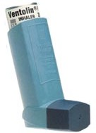
Asthma
•
Dental treatment on the Asthmatic patient:
If using bronchodilator (“puffer”), take a dose before appointment and bring to appointment as well.
  Salbutamol (called Albuterol in US) AKA Ventolin

Slide 40
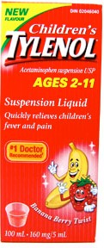
Asthma
•
Dental treatment of the asthmatic patient:
Reduce anxiety that may precipitate attack
  Nitrous oxide could be used for mild to moderate asthma not for Severe Asthmatics
  Oral sedation with antihistamines and benzodiazepines
Avoid NSAIDS as they may cause wheezing in some patients.
Acetaminophen is recommended
Avoid narcotics and and barbiturates as they may cause bronchospasm ( potential of stimulating histamine release)

Slide 41
The following steps should be taken to manage an
acute asthmatic attack in the dental office:
1. Discontinue the dental procedure
2. Keep the airway open and administer beta 2-agonist with inhaler or nebulizer
3. Administer oxygen via face mask nasal hood,
or cannula
4. If no improvement takes place,administer epinepherine
(1:1000 solution, 0.01 mg/kg of body weight to a maximum dose of .3 mg)

Slide 42
Epilepsy
•
Definition: “Epilepsy includes disorders or syndromes with widely variable pathophysiologic findings, clinical manifestations, treatments, and outcomes. It is not a specific diagnosis but rather a term that refers to a group of disorders characterized by chronic and recurrent, paroxysmal changes in neurologic function, altered consciousness, or involuntary movements caused by abnormal electrical activity in the brain.” (From Dental Management of the Medically Compromised Patient).

Slide 43
Epilepsy
•
Most common chronic neurologic condition
•
Peak incidence is in childhood and old age

Slide 44
Epilepsy
•
Important information to gather:
What type of seizure?
When was the last seizure?
Medications? Does patient take medications?
What provokes seizures?
Any pre-indications of seizure activity (aura)?

Slide 45
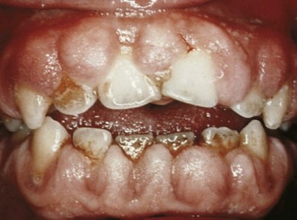
Epilepsy
•
Medically managed with long term drug therapy. Phenytoin (Dilantin) is one long term drug.
•
Dental implication: gingival overgrowth.
Meticulous oral hygiene is imperative
Gingivectomy may be required

Slide 46
Epilepsy
•
What if patient has seizure in the chair?
Primary task is to protect the patient and prevent injury.
Do NOT move patient to the floor
Clear instruments away
Place patient in supine position
Passive restraint to prevent injury
If possible, turn patient to side to avoid possible aspiration

Slide 47
Epilepsy
•
After the seizure:
Grand mal seizure does not last longer than a few minutes
Patient may fall into deep sleep and may not be a rousable.
Provide 100% oxygen, maintain airway, suction if possible
Within a few minutes patient should regain consciousness.
If the seizure lasts longer than 15 minutes (status epileptics), activate EMS.

Slide 48
Diabetes
•
Type 1 and Type 2
•
Type 2 generally a disease of adulthood (sadly some children are developing)
•
Type 1 characterized by lack of insulin production from the pancreas.
Supplement with insulin injection
Notes:
In recent years, the incidence of type 1 DM has been steadily increasing, probably due to rapid changes in the environment, the modern lifestyle, and its harmful effects. In the USA, the incidence of type 1 DM in children is about 1.9/1000,
Type 1 DM is the result of a deficiency in insulin production due to the autoimmune destruction of pancreatic ß-cells, mediated by T-cells

Slide 49
Diabetes
•
Dental management:
Determine if Type 1 or Type 2
How often do they take medication?
How well is blood sugar controlled?
  Do you test your blood sugar?
Recent hospitalizations due to condition?

Slide 50
IMPORTANT CONSIDERATIONS
Increased incidence of dental caries due reduced salivary flow and reduced buffer capacity.
2. Dental Growth
Sometimes due malfunction of the pituitary gland, and their dental growth is affected.
If diabetes is diagnosed before the age of 7, changes concerning the age of exfoliation of primary dentition as well as the early eruption of the successor permanent teeth can be observed
Enamel Hypoplasia
3.Recurrent infections
  Candidiasis

Slide 51
Diabetes
•
Consult with physician if unsure about control of diabetes
•
Major goal is to prevent insulin shock during treatment (severe hypoglycemia).
Take usual insulin dosage in the morning.
Eat breakfast before appointment
Morning appointments
Have source of sugar available (juice box)
Local anesthetic with 1:100 000 Epi is well tolerated.

Slide 52
Organ Transplant
•
Common procedure, may transplant heart, liver, kidney, lung, pancreas, bone marrow, other organs.
•
Major issues pre-transplant:
Immunodeficiency
Delayed Healing
Bleeding
Major issues post-transplant:
Medication side effects:
  Leukopenia (decrease in white blood cells)
  Thrombocytopenia (low platelets)
  Anemia (decrease red blood cells)
•
Notes:
Immunodeficiency and bleeding – main management problems
Azathiprine
Immunosuppressive medication
Leukopenia, thrombocytopenia, anemia
Patient more prone to infections and hemorrhage
Cyclosporin
Immunosuppressive medication
Liver and kidney changes
Hypertension and hemorrhage
Gingival hyperplasia
Bone marrow transplant patients more susceptible to infection, bleeding, delayed healing due to leukopenia and thrombocytopenia

Slide 53
Organ Transplant
•
Pre-transplant:
All candidates are referred for a dental evaluation prior to organ transplant.
Must eliminate dental disease prior to transplantation.
CONSULT PHYSICIAN prior to performing dental work

Slide 54
Organ Transplant
Pre-transplant treatment planning:
Remove all teeth with doubtful prognosis (deep caries). Avoid pulpotomy.
Remove primary teeth soon to exfoliate
Implement METICULOUS ORAL HYGIENE PROGRAM
•

Slide 55
Organ Transplant
•
Post-transplant:
Patients taking immunosuppressant drugs to prevent rejection. More prone to infection.
If routine oral hygiene procedures become difficult, suggest rinsing with chlorhexidine.
Consult physician prior to performing dental treatment.

Slide 56
Basic Take Home
- Accurate medical and family history
- Consider the underlying systemic condition and coordinate dental treatment with medical consult
- Preventative measures
- MD consult
- Rx list
- Refer

Slide 57
The end!

