Slide 1
Pulp Therapy in Primary and Young Permanent Teeth
DR ABDULHALIM ABDULRAHMAN
BDS, MDS (PEDIATRIC DENTISTRY), DDS
FELLOW IDSF PROGRAM
UNIVERSITY OF MANITOBA

Slide 2
OBJECTIVES
To classify pulp therapy in primary and young permanent teeth
Clinical and radiographic assessment of pulp status
Candidate teeth for vital pup therapy
Candidate teeth for non-vital pulp therapy
Vital pulp therapy for primary teeth
Non-vital pulp therapy for primary teeth
Vital pulp treatment in young permanent teeth
Non-vital pulp therapy for young permanent teeth
Materials used for pulp therapy

Slide 3

WHY PRESERVE THE PRIMARY TOOTH SINCE IT WILL EVENTUALLY FALL OUT?

Slide 4
Why preserve the primary tooth since it will eventually fall out?
Reduce the likelihood of mesial drift and the resultant malocclusion.
Aid in mastication.
Preserve a pulpally involved primary tooth in the absence of a succedaneous tooth.
Prevent possible speech problems.

Slide 5
Why preserve the primary tooth since it will eventually fall out?
Maintain esthetics.
6. Prevent aberrant tongue habits
7. Prevent the psychological effects associated with early tooth loss.
8. Maintain normal eruption time of the succedaneous teeth.

Slide 6
EVALUATION OF TREATMENT PROGNOSIS BEFORE PULP THERAPY
1. The level of patient and parent cooperation and motivation in receiving the treatment
2. The level of patient and parent desire and motivation in maintaining oral health and hygiene
3. The caries activity of the patient and the overall prognosis of oral rehabilitation
4. The stage of dental development of the patient
5. The degree of difficulty anticipated in adequately performing the pulp therapy (instrumentation) in the particular case
6. Space management issues resulting from previous extractions, preexisting malocclusion, ankylosis, congenitally missing teeth, and space loss caused by the extensive carious destruction of teeth and subsequent drifting
7. Excessive extrusion of the pulpally involved tooth resulting from the absence of opposing teeth
(McDonald and Avery’s Dentistry for the child and Adolescent 9th Ed)

Slide 7
Types of pulp therapy?
The type of pulp therapy depends on:
1. Vitality of the pulp
2. Clinical diagnoses of the pulp
3. Normal (symptom free and responsive to vitality testing
4. Reversible pulpitis (pulp is capable of healing)
5. Irreversible pulpitis (inflammed pulp is incapable of healing)
6. Necrotic pulp

Slide 8
Clinical and radiographic assessment of pulp therapy
Carious lesion producing pain
Irreversible pulpitis
Extraction
Non-vital pulp therapy
Thermal
Chemical
Reversible pulpitis
Vital pulp therapy
Spontaneous
Prolonged
Nocturnal

Slide 9
Candidate teeth for vital pulp therapy
Tooth with deep carious lesion without pulp exposure
Carious or traumatic pulp exposure
Transitory thermal and/or chemical stimulated pain
Physiologic mobility
Normal soft tissue
No percussion sensitivity
Intact continuous periodontal ligament space
Intact periapical and/or furcal bone
Less than 1/3 physiologic root resorption
Tooth is restorable

Slide 10
Candidate teeth for non-vital pulp therapy
Carious or traumatic pulp exposure presenting with one or more signs/symptoms below
Spontaneous pain
Persistent thermal and/or chemical stimulated pain
Pathologic mobility
Inflamed soft tissue
Percussion sensitivity
Widened and/or discontinuous ligament space
Furcation and/or periapical radiolucencies
External and/or progressive internal resorption
Dystrophic intrapulpal calcification

Slide 11
Classification of pulp therapy
The various forms of pulp therapy can be classified as
Vital pulp therapy: 1) Protective base
2) Indirect pulp treatment (IPT),
3) Direct pulp capping (DPC)
4) Vital pulpotomy –a)Partial/Cvek, b)Total
Apexogenesis
Non vital pulp therapy:
1) Pulpectomy
2) Apexification
3) Root canal treatment(RCT)

Slide 12
Vital Pulp Therapy for Primary Teeth
Treatment objectives:
Eradicate potential for infection
Maintain tooth in a quiescent state
Preserve space for underlying permanent tooth
Primary molar vital pulp therapy outcomes are superior when restored with stainless steel crowns

Slide 13
Vital Primary Tooth Pulp Therapy -Protective Base
Indication :
Tooth with deep exposed dentine after caries removal
Objectives:
Preservation of vitality, minimize injury to pulp
Minimize postoperative sensitivity

Slide 14
Vital Primary Tooth Pulp Therapy- Indirect Pulp Treatment
Indications:
Asymptomatic tooth with deep carious lesion
Vital pulp
Objectives:
Preservation of vitality
Arrest of caries advance
Formation of tertiary dentine
Materials for indirect pulp capping:
Traditional materials: calcium hydroxide, Zinc Oxide eugenol,
New materials: Dentin bonding agent, resin modified GIC, Calcium silicate liners, MTA, Biodentine.

Slide 15
Vital Primary Tooth Pulp Therapy- Indirect Pulp Treatment (IPT)
Technique:
Local anesthesia
Rubber dam isolation
Establish cavity outline
Remove superficial debris and majority of soft necrotic dentin with slow hand piece and round bur
Stop excavation as soon as the firm resistance of sound dentin is felt

Slide 16
Vital Primary Tooth Pulp Therapy- Indirect Pulp Treatment (IPT)
Flush cavity with saline and dry with cotton pellet
Cover residual caries with calcium hydroxide
Fill the rest of the cavity with reinforced ZOE
Final restoration with SSC

Slide 17
Vital Primary Tooth Pulp Therapy- Direct Pulp Capping (DPC)
Indications :
Small mechanical exposures in primary teeth
Small traumatic exposures in primary teeth
Contraindications:
Carious exposure in primary tooth
Persistent inflammation
Internal resorption
Calcific metamorphosis

Slide 18
Vital Primary Tooth Pulp Therapy- Direct Pulp Capping (DPC)
Objectives:
Preserve pulp vitality under tertiary dentine bridge
Ca(OH)2 may produce internal resorption
Pulpotomy is preferred due to predictable outcomes
Materials for DPC:
Mineral trioxide Aggregate
Zinc oxide eugenol

Slide 19
Vital Primary Tooth Pulp Therapy- Direct Pulp Capping (DPC)
Caries process or pulp capping materials may stimulate odontoblastic cells---internal resorption
High cellular content, fast inflammatory response and poor localization of infection are some reasons why DPC may be contraindicated in primary teeth
Location of pulp exposure is important for good prognosis
If exposure is on the axial wall of the pulp, a pulpotomy is preferred to a pulp cap.

Slide 20
Vital pulpotomy
Pulpotomy is the surgical amputation or extirpation of a vital inflamed coronal pulp (or part of it) followed by placement of medicament over the radicular pulp stumps to fix (mummify) or stimulate repair of the remaining vital radicular pulp.
Indications:
Carious exposure of pulp
Reversible pulpitis
Iatrogenic pulp exposure
When the marginal ridge is already destroyed in the first molar
When radiographic evidence of caries extends more than 2/3rds in depth through dentine
Inflammation limited to coronal pulp with vital radicular pulp

Slide 21
Vital pulpotomy
Objectives :
To maintain tooth in symptomless state until exfoliation and no harm to
succedaneous tooth
Contraindications
Spontaneous pain
Swelling/fistula
Tenderness to percussion
Pathologic tooth mobility
external
Internal root resorption

Slide 22
Vital pulpotomy
Periapical/radicular radioluscency
Uncontrolled bleeding from amputated pulp stump
Root resorption more than 1/3rd of root length
Pulp calcification
Pus or exudate from exposure site
Large carious lesion with non-restorable crown
Medical contraindications such as heart disease

Slide 23
Vital pulpotomy
Pharmacologic agents:
- Formocresol
- Calcium hydroxide (not used for primary teeth)
- Glutaraldehyde
- Ferric sulphate
- Mineral trioxide aggregate (MTA) ,
-Bioactive glass,
-BMP Bone Morphogenic Protein
Non pharmacologic agents:
- Laser
- Electrosurgery

Slide 24
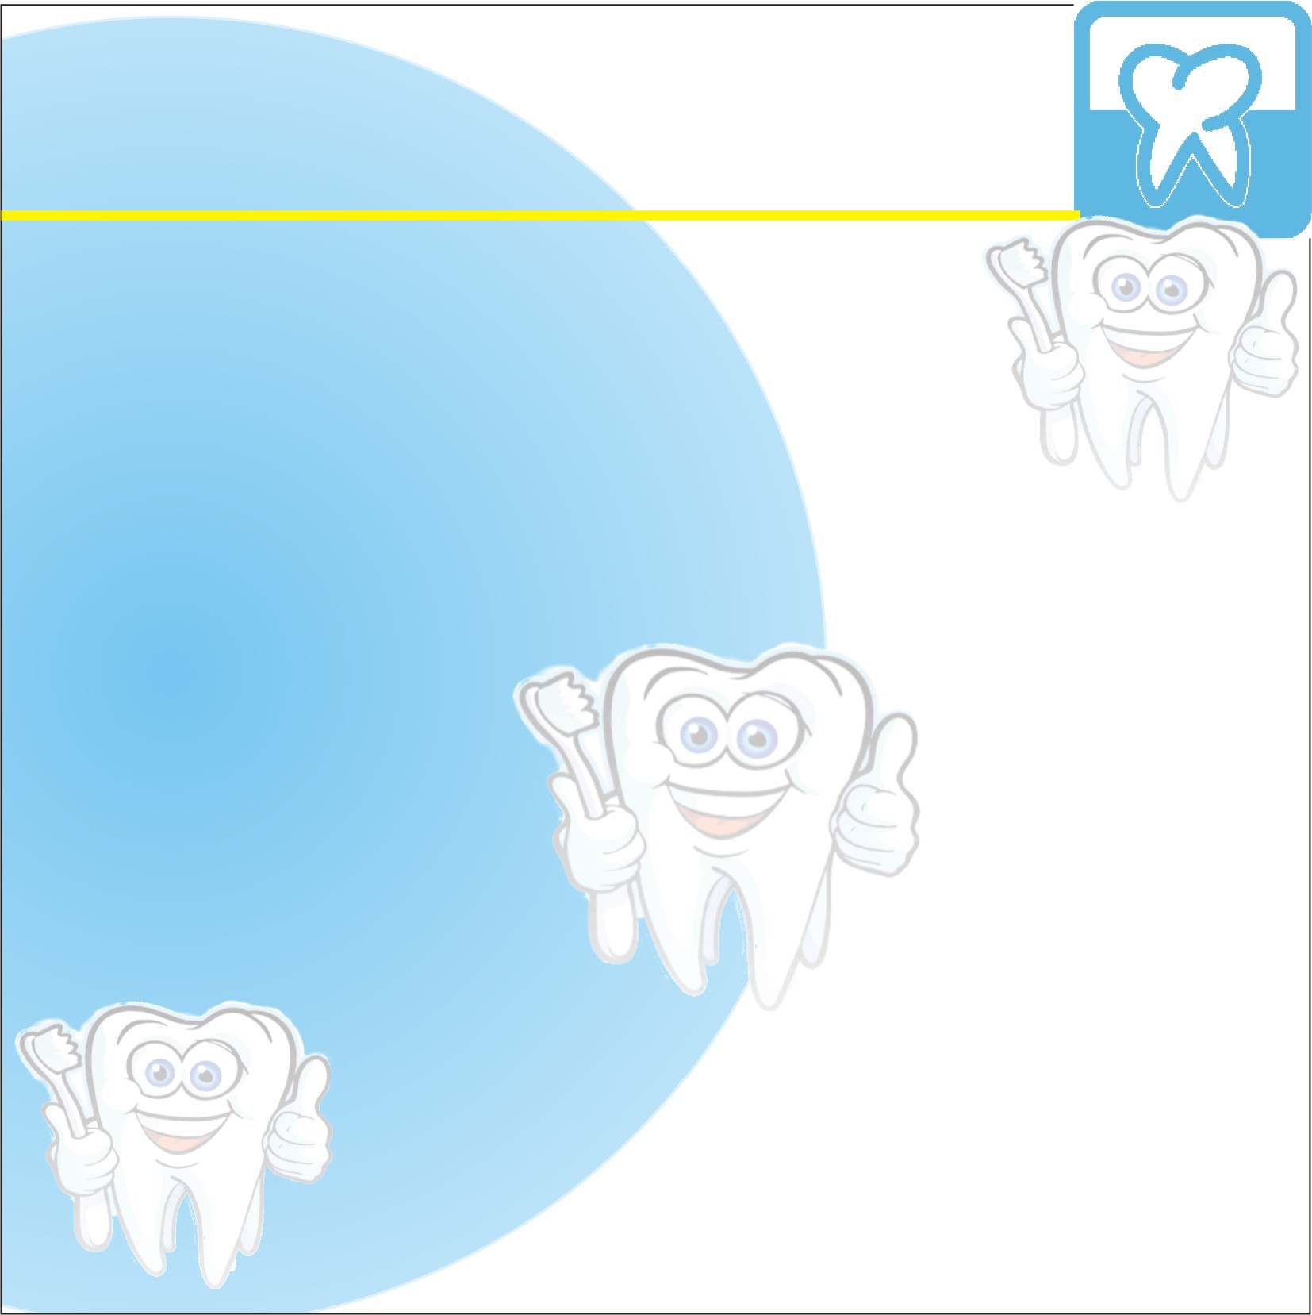
VITAL PULPOTOMY MEDICAMENTS
Types | Other names | Features | Examples
Devitalization | Mummification Cauterization | Destroys or mummify vital tissues | Formocresol Electrosurgery Laser Paraformaldehyde devitalizing paste
Preservation | Minimal devitalization noninductive | Maintains vital tissue, with no induction of reparative dentine | ZnO Eugenol Glutaraldehyde Ferric sulphate Ledermix
Regeneration | Inductive reparative | Formation of Dentin bridge | Ca(OH) Bone morphogenic protein, MTA

Slide 25
Formocresol Pulpotomy
Formocresol has been the ‘gold standard’ for many decades it was introduced by Buckley 1904
Clinically emphasized by Sweet in 1930
19% formaldehyde, 35% cresol, 15% water and glycerin
Buckley formocresol is 20% 1:5 concentration
This is done y adding 3 parts of glycerin to 1 part of distilled water, then 1 part of formocresol to 4 parts of diluent.

Slide 26
Formocresol Pulpotomy
success rate ranges from 70-97%.
Despite its efficacy, there are doubts about its safety.
Mutagenic, cytotoxic, carcinogenic and poses threat to humans.
IACR(International Association of Cancer Registries) 2004 classified formaldehyde as carcinogenic to humans.
Strong but not sufficient evidence of leukemia and cancer of the paranasal sinuses (Zarzar 2003)

Slide 27
Formocresol Pulpotomy
This findings have led to a search for a suitable alternative to replace formocresol
This replacement must be equally effective but without the side effects of formocresol
Such materials include MTA, Glutaraldehyde,
ferric sulfate, BMP, Osteogenic protein, bioactive glass etc.
non-pharmacologic haemostatic techniques e.g Laser and electro surgery.

Slide 28
Formocresol Pulpotomy
Mechanism of action:
Prevents tissue autolysis by binding to protein. This binding is a reversible process accomplished without changing the basic structure of protein molecules
Histological zones in FC treated radicular pulp
acidophilic zone: fixation (coronal)
Pale staining zone: atrophy (middle)
Broad zone of inflammatory cells (apical)
Bactericidal
No dentinal bridge but calcific changes evident
Persistent chronic inflammation

Slide 29
Formocresol Pulpotomy
Adverse effects:
Succedaneous tooth damage
Exfoliation accelerated
Cellular toxicity
Immune sensitization risk
Humoral and cell-mediated responses (controversial)
Mutagenic and carcinogenic potential (controversial)

Slide 30
Formocresol Pulpotomy-Technique
Give LA
Isolate with rubber dam
Use No 330 bur to create your cavity outline
Remove all carious dentine and the roof of the pulp chamber with a slow speed round bur.
Amputate the coronal pulp with a slow speed round bur or a spoon excavator
Irrigate gentle with normal saline
Place a moisten cotton pellet on the orifice of the canals to achieve haemostasis this should be between 3-5 minutes

Slide 31
Formocresol Pulpotomy-Technique
Place cotton pellet moistened with formocresol (squeeze out excess) on pulp stump for 3-5 minutes
The pulp stump should appear blackish brown
If there is bleeding check for residual pulp tissue or pulp may be exhibiting signs of irreversible pulpitis
Remove the formocresol moistened cotton pellet
Fill the pulp chamber with zinc oxide eugenol
Restore with stainless steel crown
Follow up

Slide 32
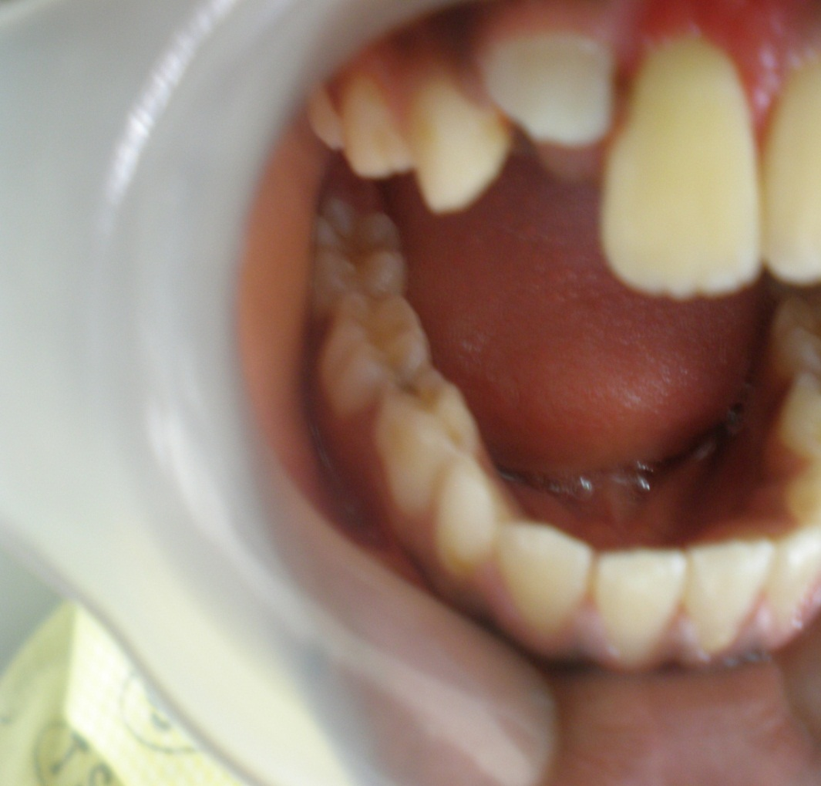
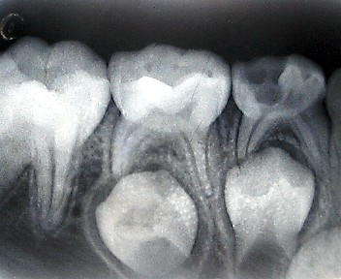
Pre-operative radiograph and clinical picture of carious lower right 1st primary molar

Slide 33
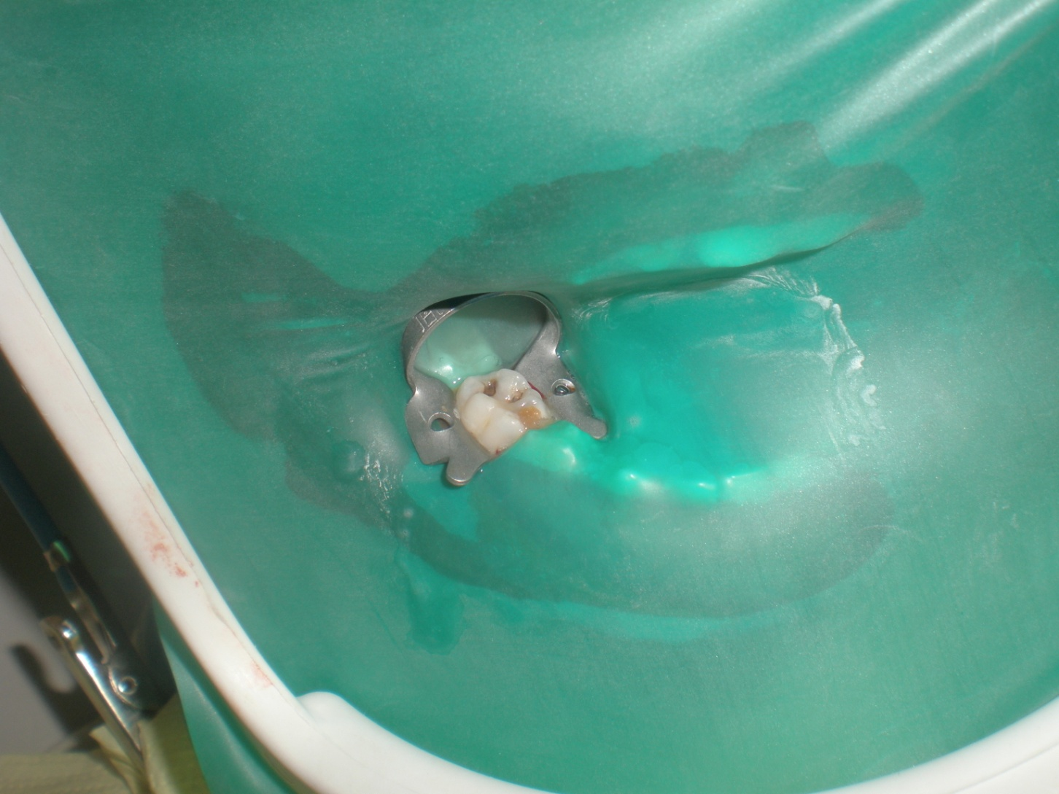
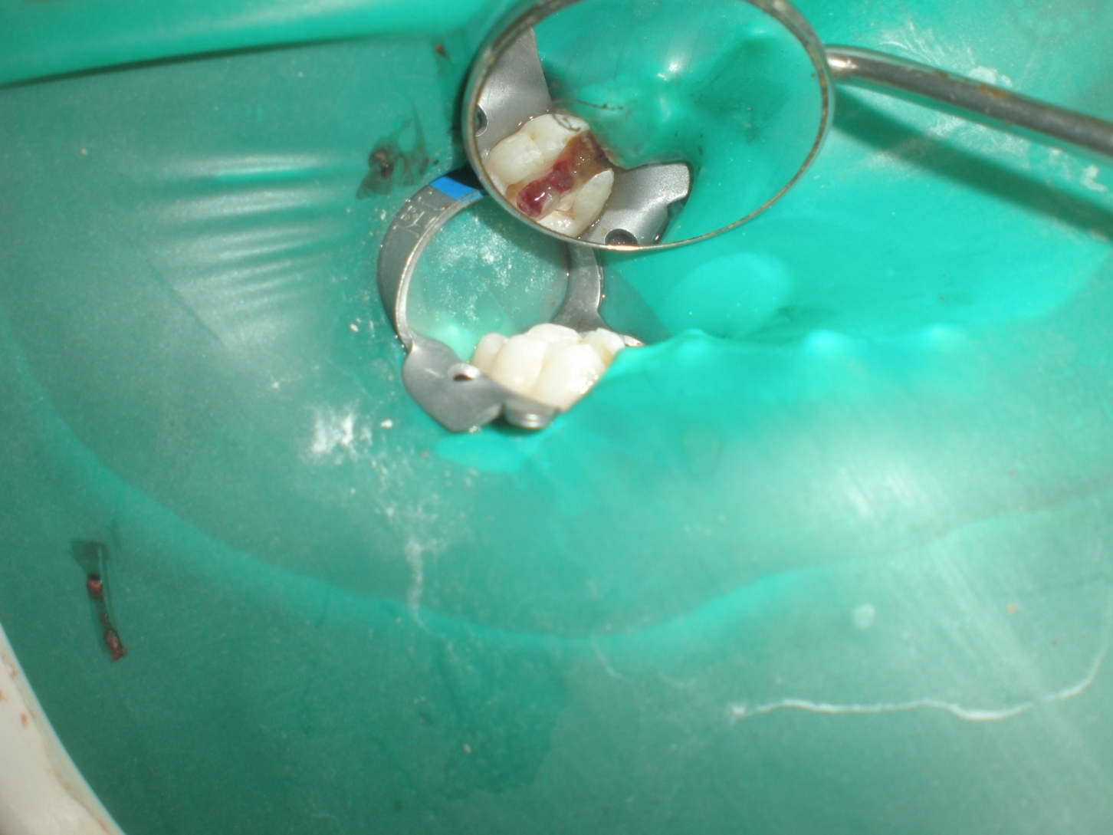
CLINICAL PROCEDURE FOR PULPOTOMY
Isolate with rubber dam
Canal orifice following amputation of the coronal pulp

Slide 34
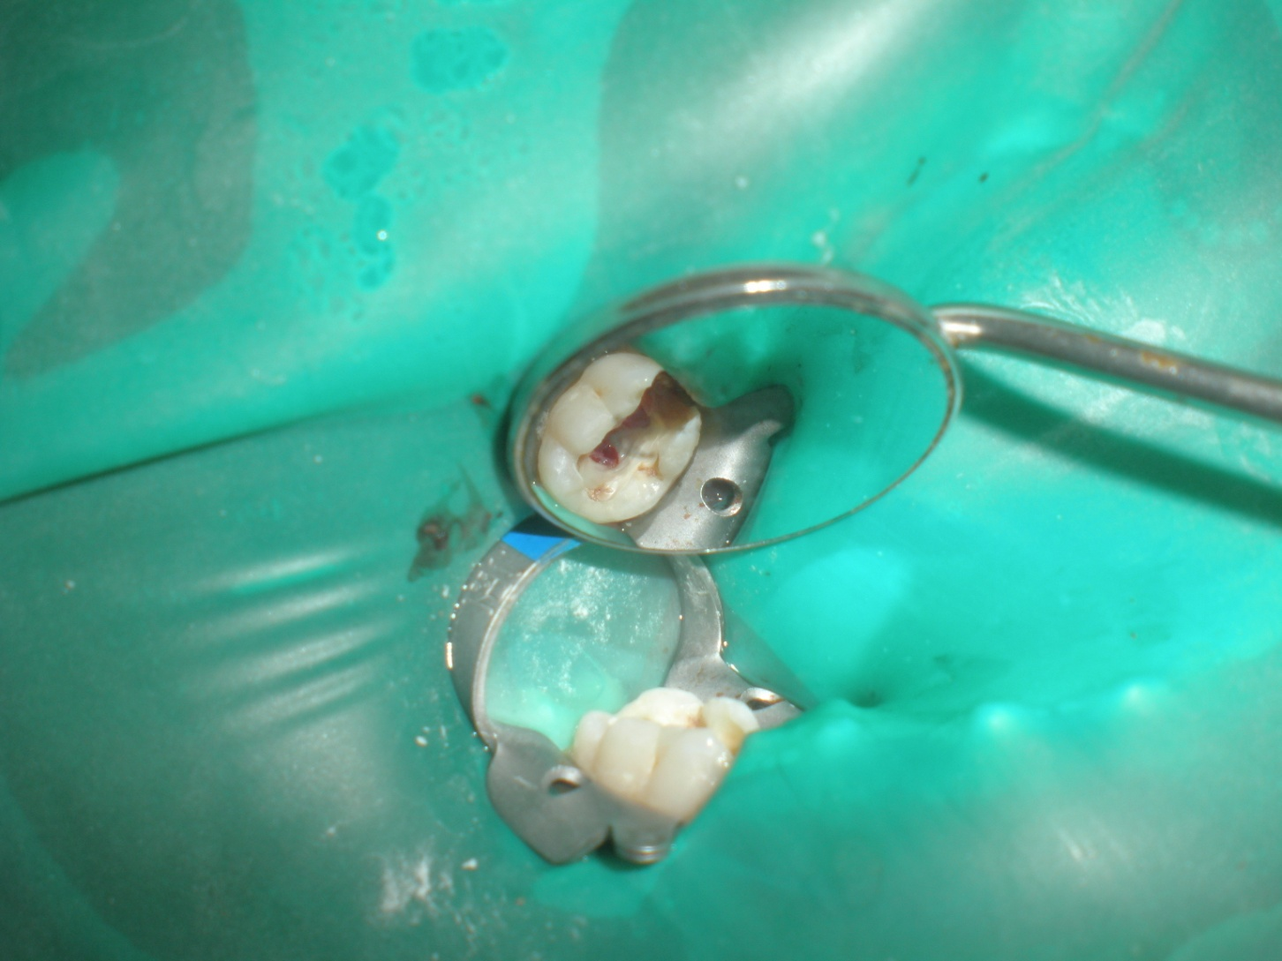
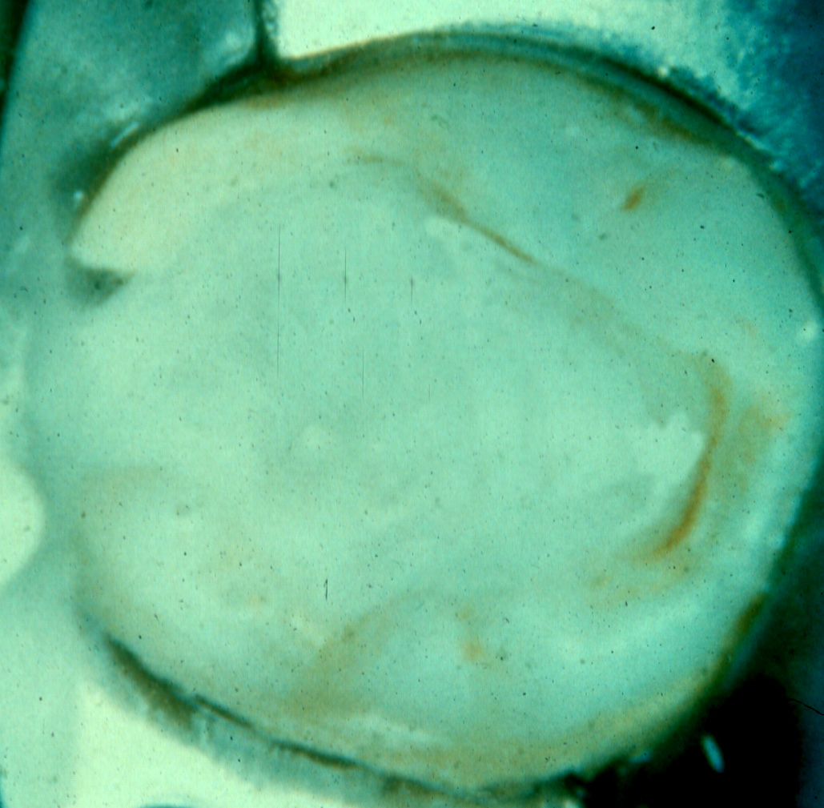
CLINICAL PROCEDURE FOR PULPOTOMY
Place formocresol on pulp stump for 3-5 minutes
Make sure there is no bleeding

Slide 35
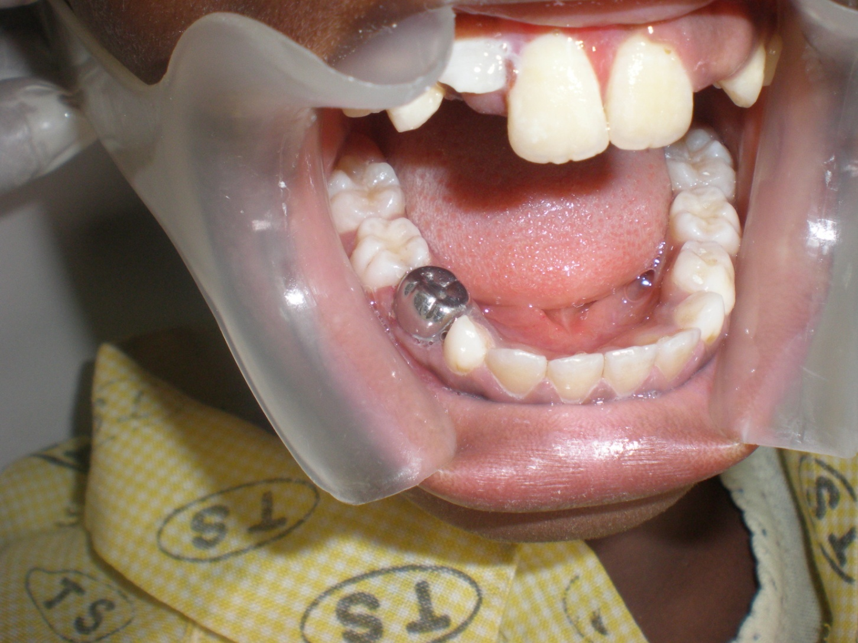
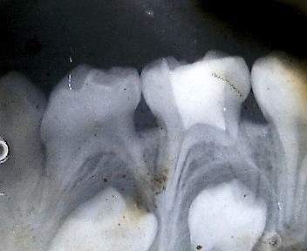
CLINICAL PROCEDURE FOR PULPOTOMY
Post-op radiograph showing ZNO eugenol in pulp chamber
Restore tooth with Stainless steel crown

Slide 36
FERRIC SULPHATE
An Astringent 15.5% in aqueous base pH= 1
Less application time than FC (10-15 seconds).
Mechanism of action- forms a ferric ion protein complex that mechanically occludes cut blood vessels
It has been used as a hemostatic agent for crown and bridge impression.
Proposed as a pulpotomy agent in 1988 (Landau & Johnson).
Causes less inflammation than formocresol when used as a pulpotomy agent.
Ferric sulfate is not a fixative but it is bacteriostatic in nature
It is not toxic.
Self limiting internal resorption has been reported

Slide 37
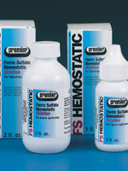
Ferric Sulphate
Same procedure as formocresol but should be placed for 10-15 sec (shorter application time) on pulp stump.
Ibricevic and Aljame 2000 100% clinical success for FC and FS 97.2% radiographic success for FS and FC.
Good alternative for formocresol.

Slide 38
Glutaraldehyde
Has larger molecules than formaldehyde, and as a result diffusion through the tissues is reduced.
ADVANTAGES OVER FORMOCRESOL
Superior fixation by cross linkage of 2 aldehyde rings
Diffusibility is limited. Hence; there is less chance of causing pulp necrosis.
15 – 20 times less toxic than formocresol Jeng 1987
Does not stimulate a significant immune response
Minimal systemic distribution because of larger molecular size and less chance of penetrating the apical foramen
It is readily metabolized, 90% of the drug is metabolized within 3 days.

Slide 39
Glutaraldehyde
Procedure:
Give LA and isolate with rubber dam
The operative procedure is in principle the same as formocresol
Cotton pellets are soaked in 2% buffered freshly prepared glutaraldehyde solution
Placed over pulp stump for 3-5 mins
Adenubi (1999), 61 primary teeth. Clinical success of glutaraldehyde 96.5% ca(OH) 89.2%, radiographic 75.5% & 71.4% respectively.
Reports on the mutagenicity of GLY have given mixed results.
Thus, the search for a replacement for FC continues.

Slide 40
Mineral Trioxide Aggregate (MTA)
Developed by Torabinejad 1995 Loma Linda University.
Composition of MTA
Tricalcium silicate (CaO)₃.SiO_{2,}
Dicalcium silicate (CaO)₂.SiO₂
Tricalcium aluminate (CaO)₃.Al₂O₃ ,
Tetracalcium aluminoferrite (CaO)₄.Al₂O₃.Fe₂O₃
Gypsum CaSO₄ · 2 H₂O,
Bismuth oxide Bi₂O₃

Slide 41
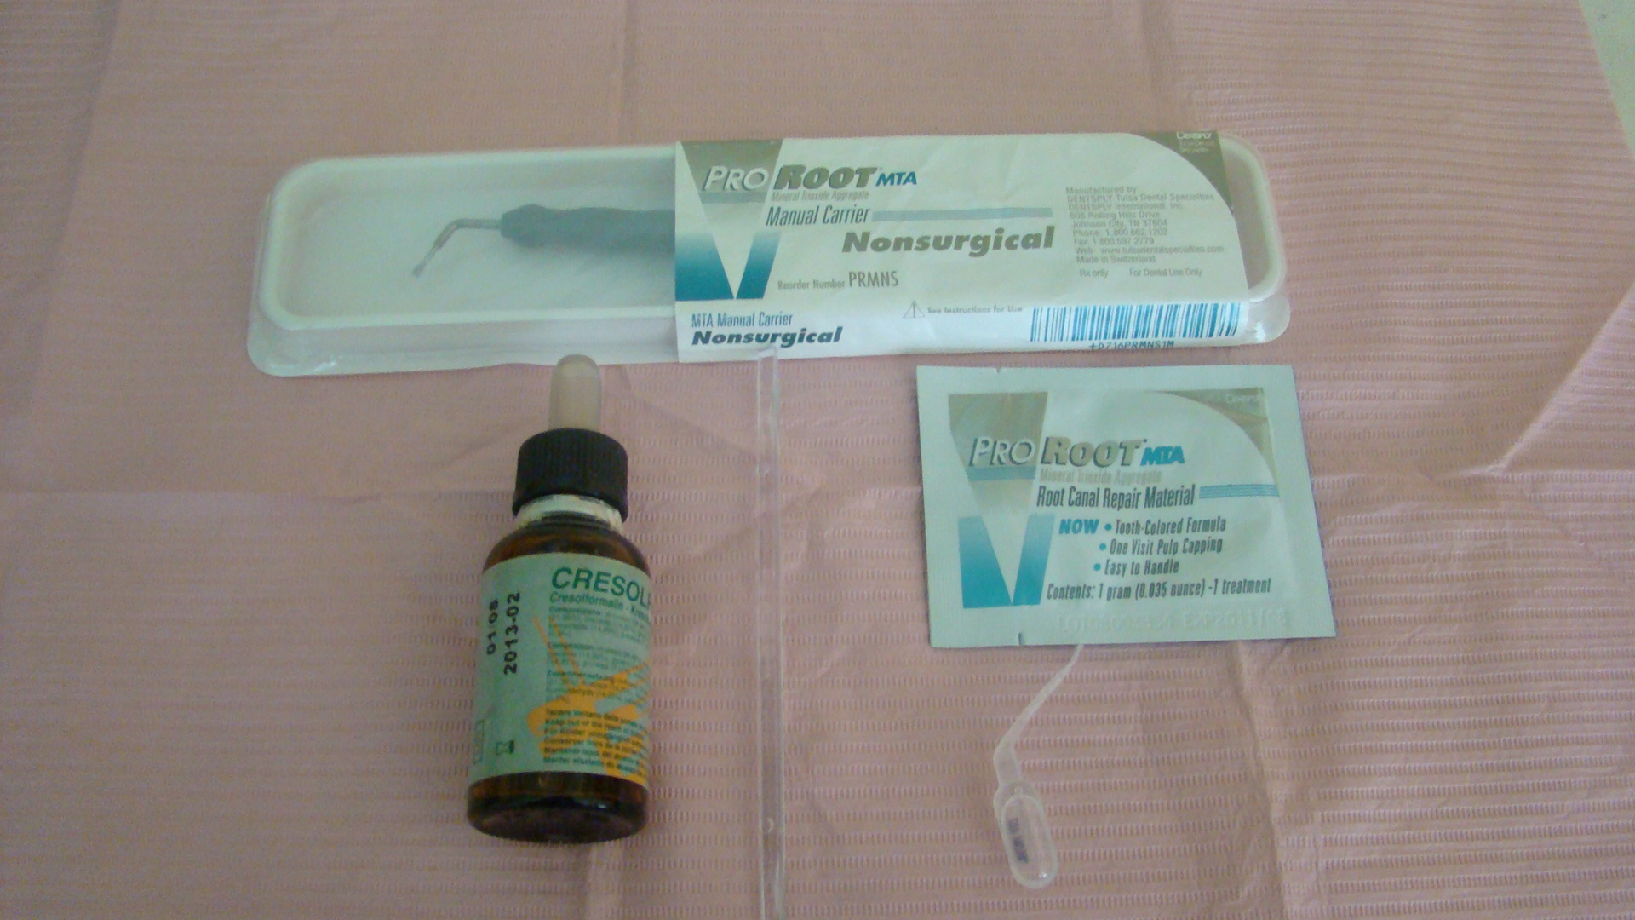
Mineral Trioxide Aggregate (MTA)
Types :Gray and White MTA
Similar to Portland cement
Biocompatible
Non toxic.
Minimal or no marginal leakage.
Very alkaline pH 12.5
It promotes regeneration of tissues
Long setting time 1-2 hours

Slide 42
Mineral Trioxide Aggregate (MTA)

Slide 43
Mineral Trioxide Aggregate (MTA
Mechanism of Action:
Stimulates synthesis of cytokines and interleukin products from bone cells.
This allows the attachment of osteoblast
Stimulated hard tissue formation- release calcium in form of calcium hydroxide
Stimulates the formation of “dentinal bridge” and preserve the vitality of the remaining pulp tissue

Slide 44
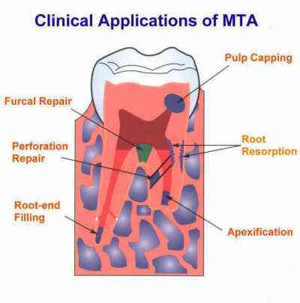
Mineral Trioxide Aggregate (MTA)

Slide 45
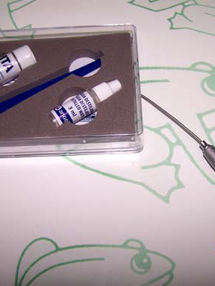
Mineral Trioxide Aggregate (MTA)
The commercial products with MTA are:
ProRoot MTA (Dentsply Tulsa Dental, Tulsa, OK USA);
White ProRoot MTA (Dentsply Tulsa Dental);
MTA-Angelus (Solucoes Odontologicas, Londrina, Brazil);
MTA-Angelus Blanco (Solucoes Odontologicas);
MTA Bio (Solucoes Odontologicas)

Slide 46
Mineral Trioxide Aggregate (MTA)
Procedure:
Same procedure and steps in vital pulpotomy
After haemostasis has been achieved,
The pulp stump is covered with an MTA paste which is prepared by mixing MTA powder with sterile saline using 3:1 powder/saline ratio.
Fill pulp chamber with ZNOE
Restore tooth to function with SSC
Follow-up

Slide 47
Mineral Trioxide Aggregate (MTA)
Disadvantages
It is very expensive
ProRoot MTA 5 Dose pack (USD 363)
MTA-Grey 2G 14 application MTA Angelus (USD 121)
It is hydrophilic and can cause air setting when exposed to moisture.
This can be prevented by placing it in an Eppendoff tube after opening.

Slide 48
MTA VS FORMOCRESOL
Eldeman 33 children with 62 teeth
Follow-up ranged between 4 and 74 months
The success rate of pulpotomy was 97% for MTA and 83% for formocresol.
Farsi et treated 74 primary molars with formocresol and MTA
After 24 months follow up
The success rate of MTA was 100% while that of formocresol was 92.7%.
In LUTH Olatosi, Sote and Orenuga treated 50 primary molars, 9 months follow-up, clinical success rate MTA 100% FC 81%. Radiographic MTA 96% FC 81%.

Slide 49
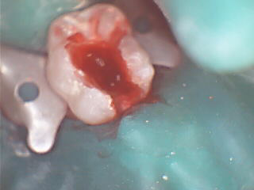
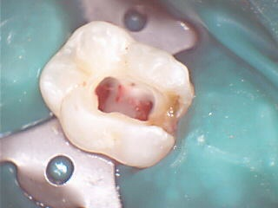
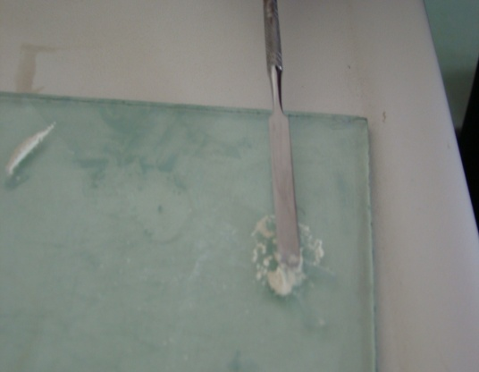
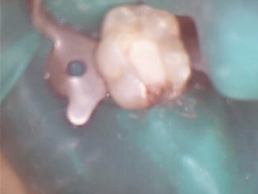
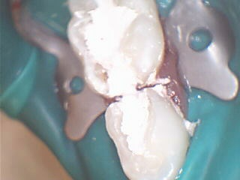
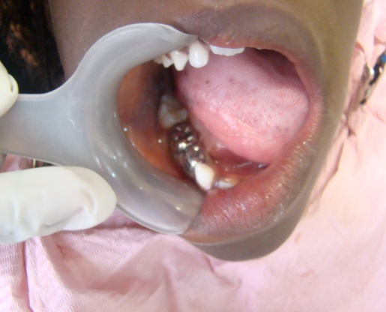
MTA Pulpotomy

Slide 50
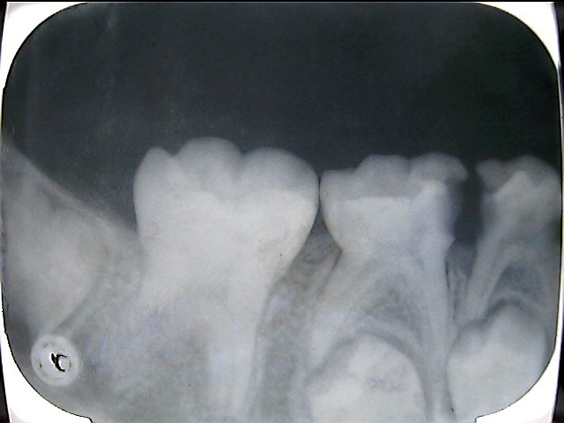
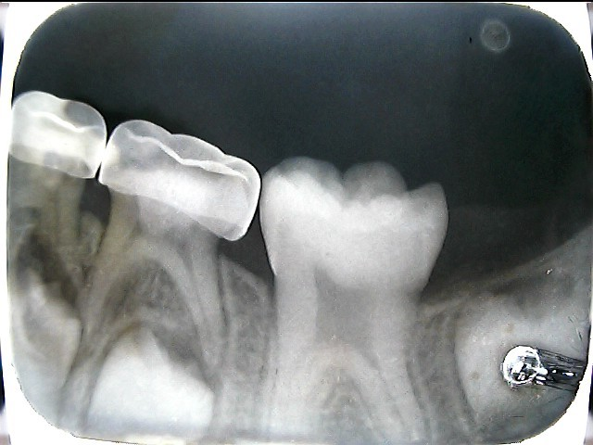
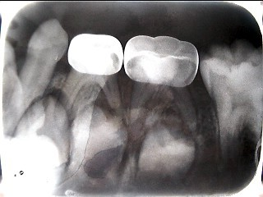
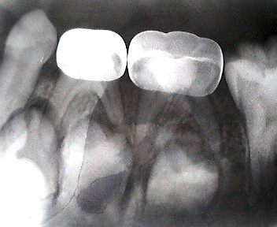

Slide 51
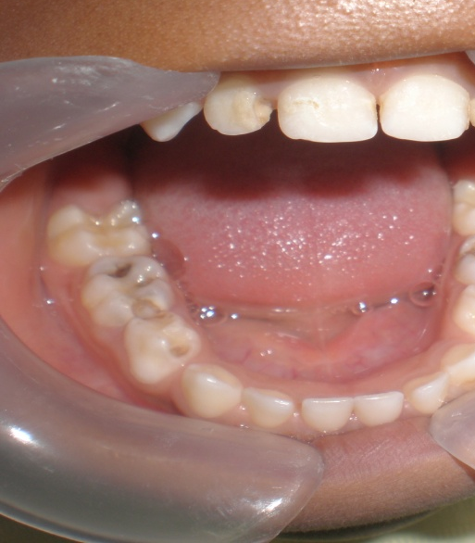
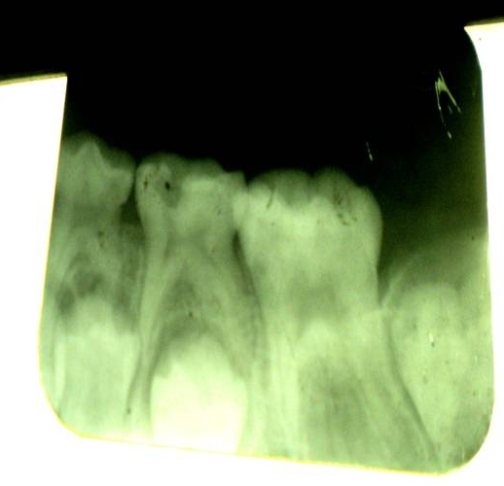
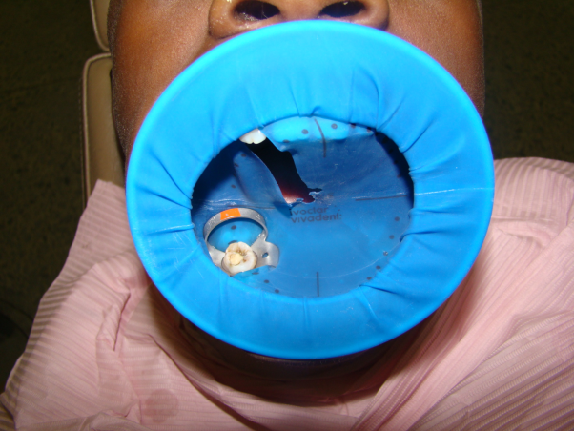
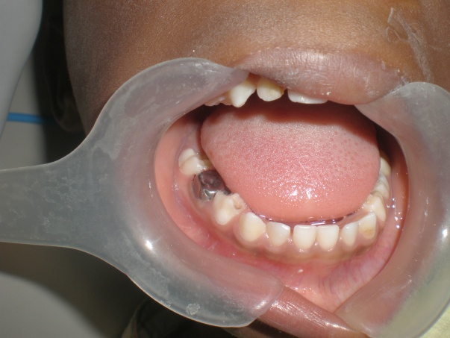
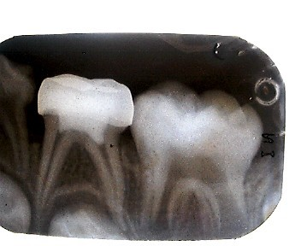
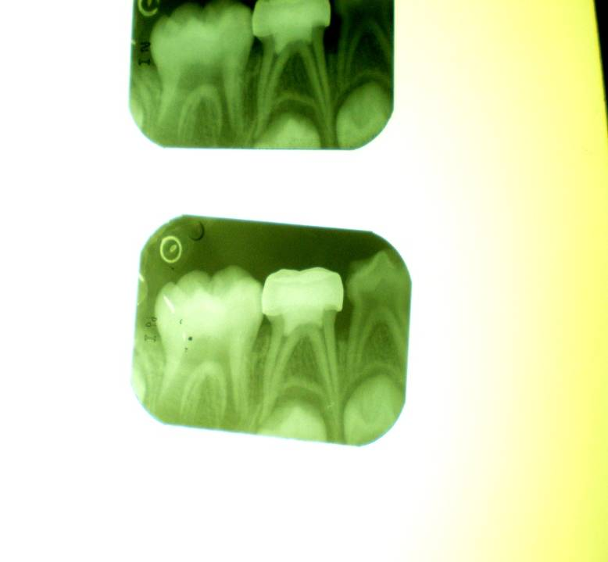
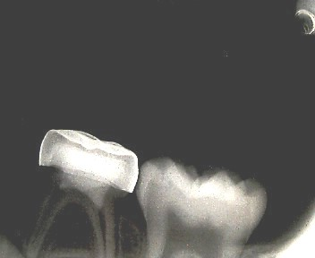
MTA VS FORMOCRESOL

Slide 52
Bone Morphogenic Protein (BMP)
Bone Morphogenic Protein (BMP):
BMPs initiate endochondral bone formation
Mechanism of Action:
BMP stimulates undifferentiated pluripotent cells to differentiate into cartilage and bone forming cells. BMP’s are abundant in bone and dentin and they help promote osteogenesis and reparative dentin formation.

Slide 53
Laser
Light Amplification by the Stimulated Emission of Radiation.
transforms light of various frequencies into chromatic radiation.
capable of mobilizing immense heat and power when focused at close range
First used in dentistry by Stern and Sognnaes (1964) .
a reduction in permeability to acid demineralization of enamel .
coagulation necrosis and degeneration of the odontoblastic layer without damage to the radicular portion of the pulp.

Slide 54

Laser
First used in dentistry by Stern and Sognnaes (1964) .
a reduction in permeability to acid demineralization of enamel .
coagulation necrosis and degeneration of the odontoblastic layer without damage to the radicular portion of the pulp.
The pulp’s microcirculation after irradiation with the Er:YAG laser, shows an instant, reversible decrease of blood flow for 3 to 6 min, but with no signs of hyperaemic reaction that might be caused by heat.

Slide 55
Electrosurgery
Electrocoagulation is a nonpharmacological hemostatic method and has been suggested to give favorable results in pulpotomy procedures.
Electrocoagulation is generally termed as electrosurgery, which includes several types of electrical equipment producing a variety of electrical currents.
The steps in the electrosurgical pulpotomy technique are basically the same as those for the formocresol technique; it involves the removal of the coronal pulp tissue.
Large sterile cotton pellets placed in contact with the pulp, and pressure is applied to obtain haemostasis

Slide 56
Electrosurgery
Dental electrode is used to deliver the high frequency electrical current.
This is applied to the pulpal stump for 1 second, followed by a cool-down period of 5 seconds.
Thus heat and electrical transfer are minimized by keeping the electrode as far away from the pulpal stump and tooth structure as possible
When the procedure is then properly performed, the pulpal stumps appear dry and completely blackened. The chamber is filled with ZOE placed directly against the pulpal stumps.
Electrosugery is fast.
It has no undesirable local or systemic effects

Slide 57
Non-vital pulp therapy for primary teeth
Treatment Options
Pulpectomy
Extraction

Slide 58
Non-vital pulp therapy for primary teeth- Pulpectomy
Pulpectomy is a procedure that is performed in primary teeth when both the coronal and the radicular pulp tissue show clinical evidence of infection.
Indications
Clinical
- History of spontaneous pain generally occurring at night
- Presence of intraoral swelling or sinus
- Excessive hemorrhage at site of amputation

Slide 59
Non-vital pulp therapy for primary teeth- Pulpectomy
Mild to moderate tooth mobility
- Clinically evident carious exposure
Radiographic
- Deep carious lesion extending to the pulp
- periapical/interradicular radioluscency evident on radiograph
- Pathologic root resorption not involving more than 1/3 of the root

Slide 60
Non-vital pulp therapy for primary teeth- Pulpectomy
Technique:
- Anesthetize the area
- Tooth isolation with rubber dam
- Access cavity preparation and caries removal
- Pulp chamber is debrided
- Radicular pulp is removed with fine barbed broaches or files
- Cleaning and shaping of the canals is done preferably with K files
- Working length is kept 1 -1.5mm short of the radiographic apex starting with a small file (size 10) and progressing sequentially to a larger file (size 35).

Slide 61
Non-vital pulp therapy for primary teeth- Pulpectomy
Continuous irrigation using sodium hypochlorite during cleaning must be maintained.
After canal debridement with instruments, the canals are again irrigated with sodium hypochlorite and are then dried with sterile paper points.
The canals are filled with zinc oxide eugenol paste ( a resorbable material) using a pressure syringe or in increments using lentulo spiral or reamer
- An intraoral pericipical radiograph is taken to evaluate the quality of filling.
- The tooth is restored to function.

Slide 62
Non-vital pulp therapy for primary teeth- Pulpectomy
Criteria for ideal pulpectomy root filling material:
Antiseptic
Resorbable
Harmless to adjacent tooth germ
Radiopaque
Easily inserted
Easily removed
biocompatible

Slide 63
Non-vital pulp therapy for primary teeth- Pulpectomy (Root filling materials )
1) Zinc oxide Eugenol; most commonly used
2) Calcium hydroxide Ca(OH)2: biocompatible
3) Kri 1 paste
Formula
- Chlorophenol 2.02%
- Camphor 4.86%
- Menthol 1.215%
- Iodoform 80.80%
Action
- Highly resorbable
- Bactericidal
- Healthy tissue ingrowth at apex
- Success rate kri 1 84% vs. ZOE 65%

Slide 64
Non-vital pulp therapy for primary teeth- Pulpectomy
4)Vitapex
Iodoform
Ca(OH)2
6)Endoflas
Iodoform
Ca(OH)2
Zinc oxide
5)Maisto’s paste
Iodoform
Parachlorophenol
Camphor-methol
7)Ledermix
Dimethylchlorotetracycline
triamcinolone

Slide 65
Vital pulp therapy for young permanent teeth
Protective base
Indirect pulp therapy
Direct pulp capping
Pulpotomy
Partial pulpotomy (Cvek pulpotomy)
Apexogenesis

Slide 66
Vital pulp therapy for young permanent teeth
Pulpotomy
Same procedure as vital pulpotomy in primary teeth
Materials used are Ca(OH)2, MTA
Apexogenesis
Removal of coronal portion of vital pulp
Placement of material to preserve radicular vitality
To encourage continued root development
Same procedure as pulpotomy
Material Ca(OH)2, MTA

Slide 67
Vital pulp therapy for young permanent teeth
Cvek Pulpotomy:
Cvek 1978 proved that the depth of inflammation in traumatic exposures does not exceed 2mm by experimenting on monkey pulps.
Histological examination revealed that none of the pulps had inflammation deeper than 2mm.
it is not necessary to remove more than 2mm of vital pulp tissue to promote healing. The exposed vital pulp has strong powers of resistance.
Advantages of the Cvek pulpotomy include the following:
Increased healing potential due to preserved pulp
It allows continuation of normal development of tooth.

Slide 68
Vital pulp therapy for young permanent teeth
The tooth retains its natural colour and translucency.
It preserves cell rich coronal pulp tissue with better healing potentials than total pulpotomy.
Maintains pulp test response
Allows physiologic apposition of cervical dentin
Procedure:-
A no 330 bur is used to amputate 2mm of coronal pulp.
Continuous irrigation of amputated pulp with normal saline to achieve haemostasis
Calcium hydroxide dressing is placed
Restore to function.
Follow -up

Slide 69
Non-vital pulp therapy for young permanent teeth
Apexification
RCT

Slide 70
Non-vital pulp therapy for young permanent teeth- Apexification
Apexification is a method of inducing apical closure in a young permanent tooth by the use of a suitable medicament.
Objectives:
Promote continued apical root development
Achieve apical closure

Slide 71
Non-vital pulp therapy for young permanent teeth- Apexification
Procedure
Ca(OH)2 Frank technique
Administer L.A and isolate the tooth with rubber dam
Gain straight access to canal orifice
Extirpate the pulp tissue remnant and irrigate with sodium hypochlorite
Establish the working length
Dry the canal with paper points

Slide 72
Non-vital pulp therapy for young permanent teeth-
Apexification
Apply non setting calcium hydroxide into the canals incrementally keeping it 2 -3mm short of the radiographic apex.
Temporize the tooth with composite resin, or GIC
Recall a week after followed by every 6 weeks recall and 3 months to replace Ca(OH)2 until apical closure is achieved
Evidence of root development can be observed on radiograph and also by passing an instrument through the apex

Slide 73
Non-vital pulp therapy for young permanent teeth-
Apexification:
Frank described four successful results of apexification treatment
Continued closure of the canal and apex to a normal appearance
A dome shaped apical closure with the canal retaining a blunderbuss appearance
No apparent radiographic change but a positive stop in the apical area
A positive stop and radiographic evidence of a barrier coronal to the anatomic apex of the tooth

Slide 74
Non-vital pulp therapy for young permanent teeth- Apexification
Final obturation can be done, when there is;
Absence of any symptoms
Absence of fistula or sinus
Absence or decrease in mobility
Evidence of firm stop clinically as well as radiographically

Slide 75
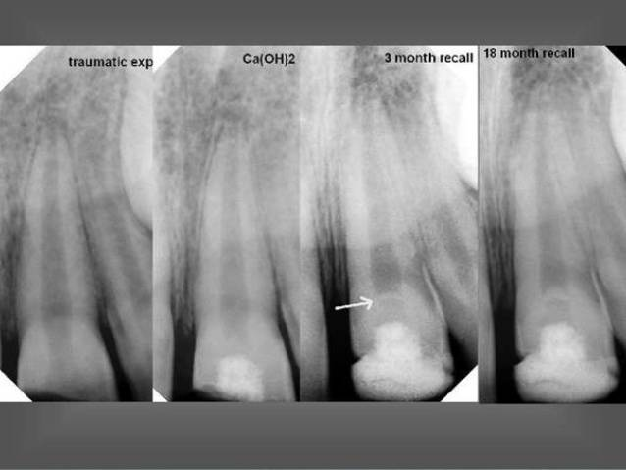

Slide 76
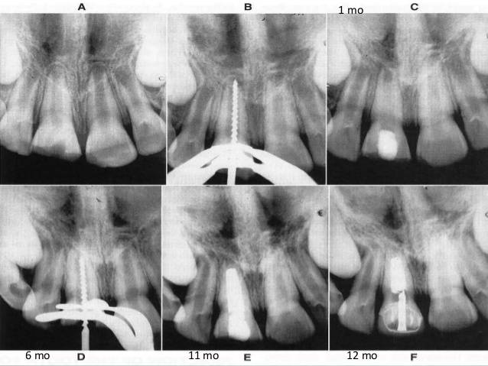

Slide 77
Non-vital pulp therapy for young permanent teeth- Apexification
Disadvantages of Ca(OH)2 Apexification
Long treatment period, usually takes 6-9months and may extend up to 21 months
Ca(OH)2 must be replaced at monthly intervals before final restoration
Multiple visits by patient which may lead to poor patient compliance
Possible recontamination may occur

Slide 78
Non-vital pulp therapy for young permanent teeth- Apexification
MTA Apexification
The rationale is to establish an apical stop that would enable the root canal to be filled immediately
There is no attempt at root end closure, rather an artificial apical stop is created
Saves time
Usually a one-visit procedure after all infection has been removed
Can induce formation regeneration of dentin, cementum, bone and periodontal ligament
Biocompatible
Produces an artificial barrier which an obturating material can be condensed
More radiopaque than Ca(OH)2
Hardens in the presence of moisture

Slide 79
Non-Vital pulp therapy for young permanent teeth- Apexification
MTA Apexification technique
Administer L.A and isolate the tooth with rubber dam
Gain straight access to canal orifice
Extirpate the pulp tissue remnant and irrigate with sodium hypochlorite
Establish the working length
Dress canal with non-setting Ca(OH)2 for one week
Remove Ca(OH)2 at following visit, clean, irrigate and dry canal
Mix MTA and place 1-1.5 mm short of the working length

Slide 80
Non-vital pulp therapy for young permanent teeth- Apexification
Place moisten cotton pledget till next day
Obturate canal with gutta-percha
Place zinc oxide eugenol dressing
Restore tooth to function
Follow up

Slide 81
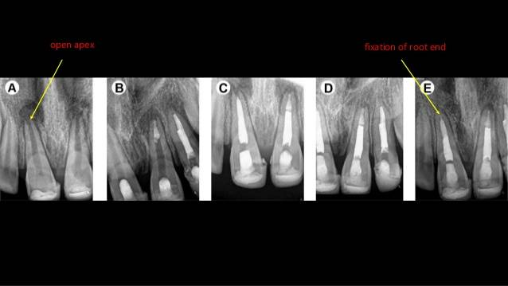

Slide 82
Non-vital pulp therapy for young permanent teeth- Apexification
RCT involves the removal of microbial contaminants and organic substrates from the root canal system in conjunction with the total closure of the system.
Usually indicated in non-vital permanent tooth
3 main phases of RCT
- Biomechanical preparation of the root canal (cleaning and shaping)
- Disinfection
- Obturation

Slide 83
One of the following statements is true regarding formocresol pulpotomy
Is not indicated for young permanent teeth
Is indicated for young permanent teeth
Does not cause fixation of apical tissues in permanent teeth
Does not cause discontinuance of root formation in permanent teeth
It is more biocompatible than mineral trioxide aggregate

Slide 84
2. Which of the following statements is not true concerning formocresol
Introduced by Buckley 1904.
Clinically emphasized by Sweet in 1930
Consists of 19% formaldehyde, 35% cresol
Formaldehyde has bigger molecules than glutaraldehyde
Buckley formocresol is 20% 1:5 concentration

Slide 85
Thank You

