Slide 1

Restorations In Primary Dentition

Slide 2
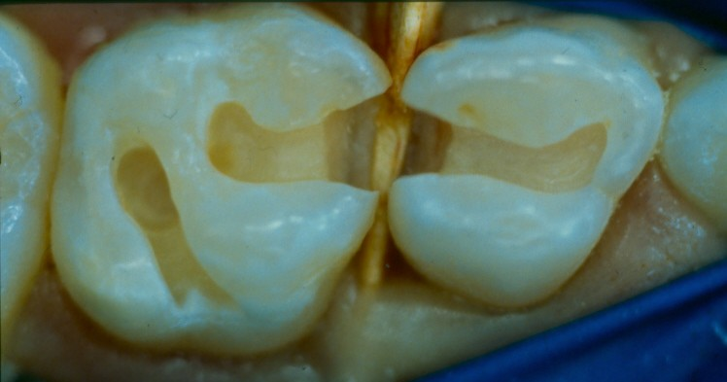

Lecture Outline
Characteristics of Primary teeth
General Considerations for cavity preparation
Cavity preparations for
Amalgam and Composite
Class I
Class II
Class III
SDF

Slide 3
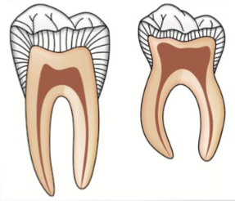
Characteristics of Primary Teeth (a review)
Thinner enamel and dentin layers
Larger pulps than permanent teeth
MB pulp horn closest to surface (especially lower D’s)
Enamel rods of gingival third extend in an occlusal direction from DEJ (Perm teeth- rods extend in cervical direction)
Notes:
https://goo.gl/images/5BysoA

Slide 4
Characteristics of Primary Teeth (a review)
Shorter anatomical crowns
Greater constriction of the crown at cervical
Narrower occlusal surfaces
Broad and flat proximal contact areas

Slide 5
General Considerations in Cavity Preparation
All preps should have:
Slightly rounded line angles
Sharp (90 degree) cavo-surface angle with lateral walls parallel to external surfaces
Slightly rounded pulpal floor

Slide 6
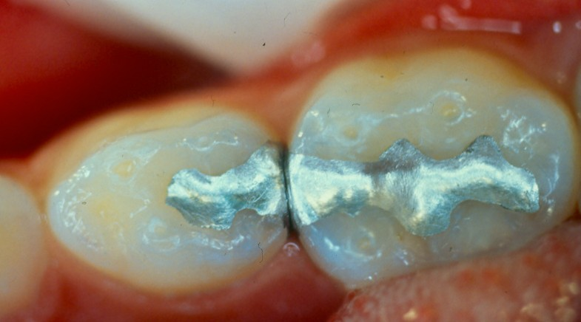
Amalgam

Slide 7
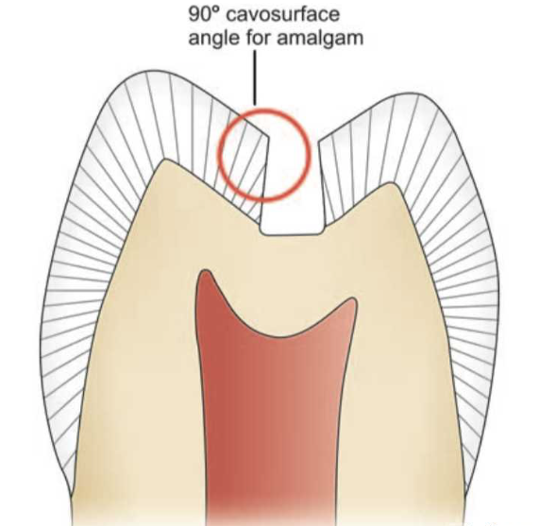
General Considerations in Amalgam Cavity Preparation
All preps should have:
Slightly rounded line angles
Accounts for bulk of amalgam restoration
For the strength of restorative material
conserves tooth structure
Sharp cavo-surface angle with lateral walls, parallel to external surfaces.
Slightly rounded pulpal floor
Notes:
https://goo.gl/images/Usc9fb

Slide 8
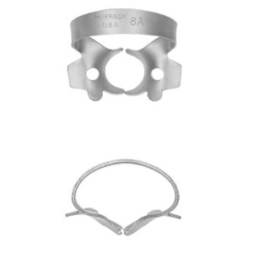
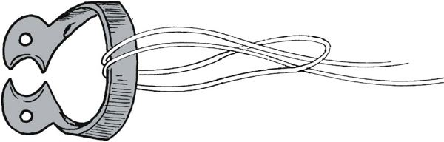
Amalgam Cavity Preparations
Class I
1. Anesthesia and Rubber Dam
8A Rubber Dam Clamp

Slide 9
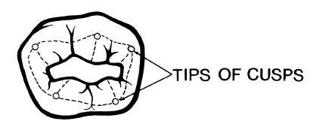
Amalgam Cavity Preparations
Class I
2. External Outline form: #330 bur (1.6 mm length), penetrate occlusal surface at distal pit, just into dentin (0.5 mm), then cut across to mesial pit

Slide 10
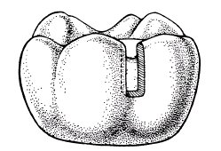
Amalgam Cavity Preparations
3. Remove carious dentin using large round bur in slow speed
4. If Buccal groove extension is present in 2nd Mand Molars (E’s), carry out occlusal prep into the groove with pulpal floor at DEJ and width of extension 1mm

Slide 11
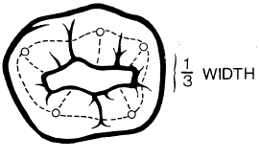
Amalgam Cavity Preparations
5. If Lingual groove in 2nd Max molars (E), carry out same principles as with Buccal groove extension
6. Blend external outline form to produce smooth flowing arcs and curves. Final width of prep should be between 1-1.2 mm’s (check with 1mm hatchet) or approx. 1/3rd width of occlusal table

Slide 12
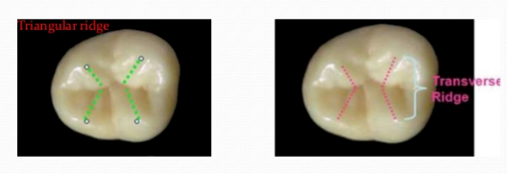
Amalgam Cavity Preparations
Follow occlusal grooves when removing caries, and let areas of decay dictate tooth removal. Do not drill away the transverse ridge unless its already damaged.
Notes:
https://goo.gl/images/zVzvBk

Slide 13
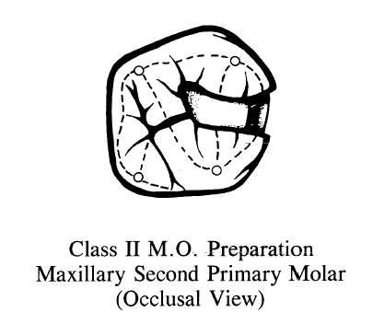
Amalgam Class II Preparation
Occlusal Outline Form:
Isthmus
Is 1/3 the width of occlusal table (1-1.2 mm’s)
Connects the proximal with occlusal dovetail
Proximal portion curves gently so that produce 90 degree angle to axial surfaces of tooth

Slide 14
Amalgam Class II Preparation
Proximal box
Begin at marginal ridge, brush bur in a buccolingual direction (pendulum motion) and in a gingival direction following the DEJ (caution with deep gingival removal – cervical constriction of Crown)
Buccal/lingual walls should diverge cervically
Round the axiopulpal angle slightly

Slide 15
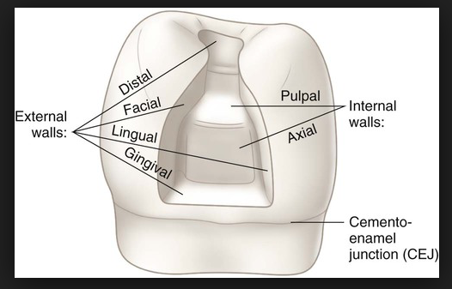
Amalgam Class II Prep
Proximal box
4. Gingival seat should be roughly 90 degree to inter-proximal surface. Will run perpendicular to long axis of the tooth
Gingival prep is determined by caries, and is slightly below gingival papilla

Slide 16
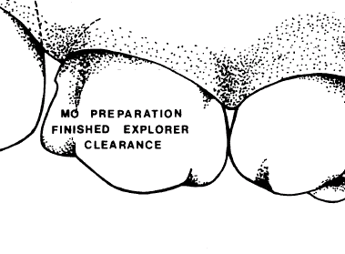
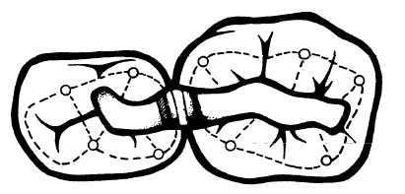
Amalgam Class II Prep
Proximal box
5. Proximal extensions are governed by the adjacent tooth (clearance of tip of explorer)

Slide 17
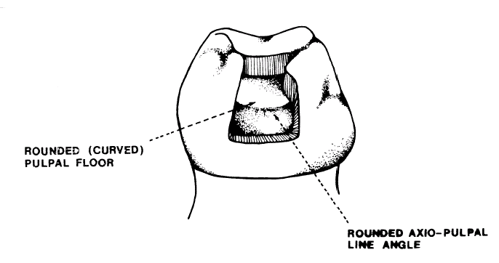
Amalgam Class II Prep
Proximal box
Line angles and point angles at gingival floor rounded with #330 bur
Final width of gingival floor should be 1mm (check with 1mm hatchet)

Slide 18
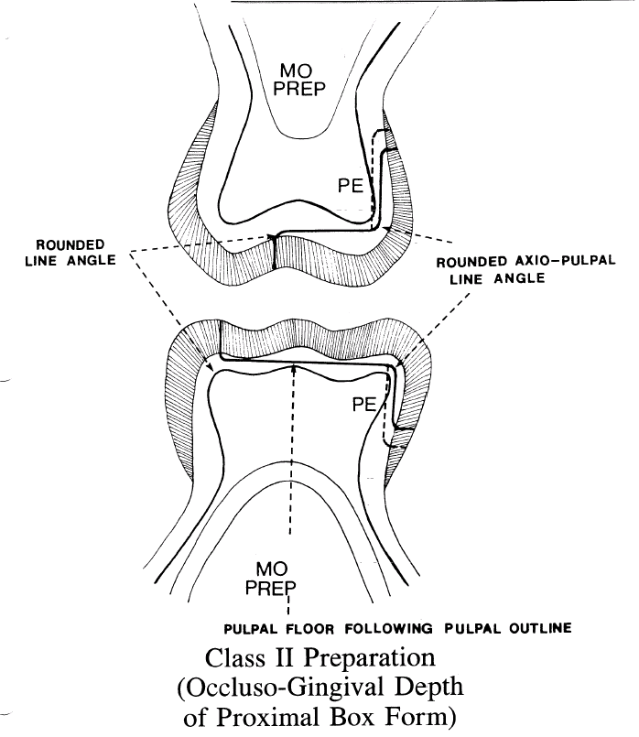
Amalgam Class II Prep

Slide 19
Matrix Application
Use for interproximal restorations to help restore normal contour and contact and to prevent extrusion of material into gingival tissues
2 main types available for use in pediatric dentistry:
T-Band - allows multiple matrices, no specific equipment needed, easy to use, inexpensive
Tofflemire - does not always fit primary tooth contour and difficult to place as multiple matrices, easier to create open contacts

Slide 20
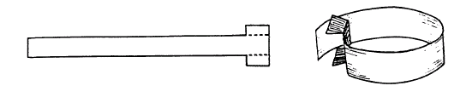
Matrix Application
T-Band Adaptation
Formed by folding the band back on itself in the form of a circle and by folding the extension wings of the T
Band is contoured and positioned onto the tooth with extension wings on Buccal, free end drawn mesially or distally to pull band tight against tooth

Slide 21
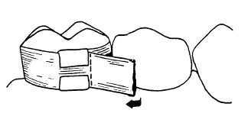
Matrix Application
Extension folds are grasped firmly and band removed, then tighten band an additional 0.5-1.0 mm’s.
Free end is either bend back or cut to a length of 5-6mm’s
Band is then reseated and wedged, should be at least 1mm above marginal ridge of adjacent tooth

Slide 22
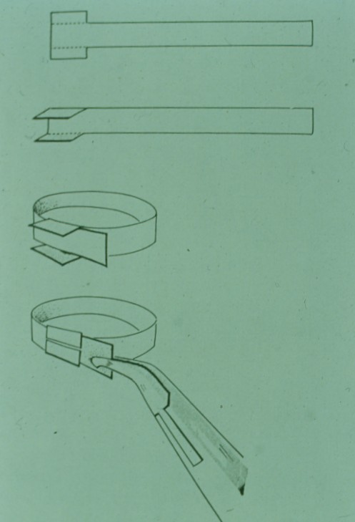
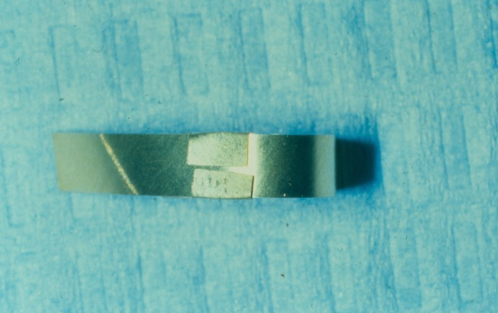
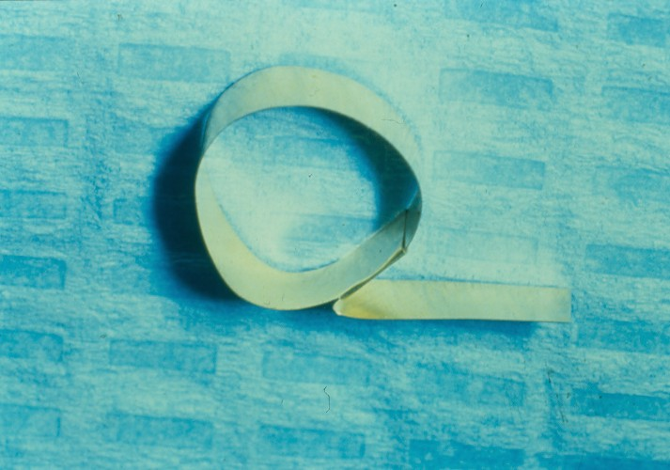
Matrix Application

Slide 23
Matrix
T-Band removal- open extensions with explorer, cut with scissors at one end of band (close to restored surface)
Remove wedge, and draw band bucally or lingually through contact

Slide 24
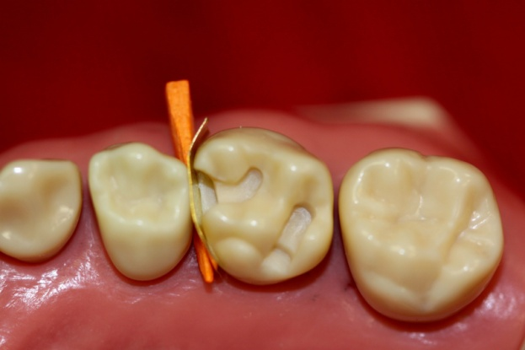
Matrix
made sectional matrix” : easy, inexpensive, use by many pediatric dentist

Slide 25
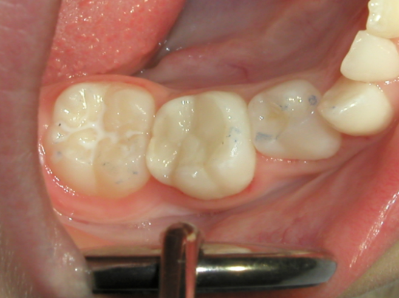
Composite
Notes:
https://goo.gl/images/XsqHww

Slide 26
Composite restorations in primary dentition
Advantages
1. Elimination of mercury in the dental environment
2. Improved appearance and aesthetics
3. Reduced thermal stimulation to the pulp
4. Ability to bond to the walls of the cavity preparation (more conservative prep)
5. Longevity (with the proper technique should last at least 10 years)

Slide 27
Composite restorations in primary dentition
Disadvantages
1.Increased tendency to extensive abrasion of functional occlusal surfaces when used as a posterior restorative material.
2. Possible open interproximal contacts
3. Possible appearance of microscopic voids that can cause recurrent caries
4. Shrinkage during polymerization, affecting marginal adaptation
5. Increased cost to the patient/parent

Slide 28
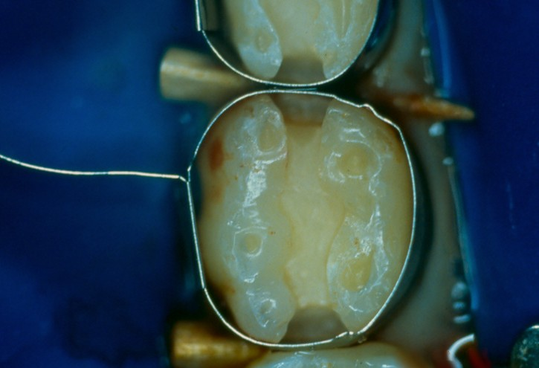
Composite restorations in primary dentition
Operative Procedures
Apply principles for cavity preparation
Wedge a T-matrix band. With a suitable instrument, burnish the matrix band to the adjacent tooth. As it is difficult to obtain tight contacts, restore cavity preparations individually.
Etch, rinse and dry, leaving cavity slightly moistened.

Slide 29
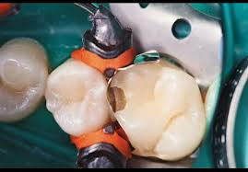
Compositite 3D matrix
Sectional matrix system
Can by used to do back to back restorations

Slide 30
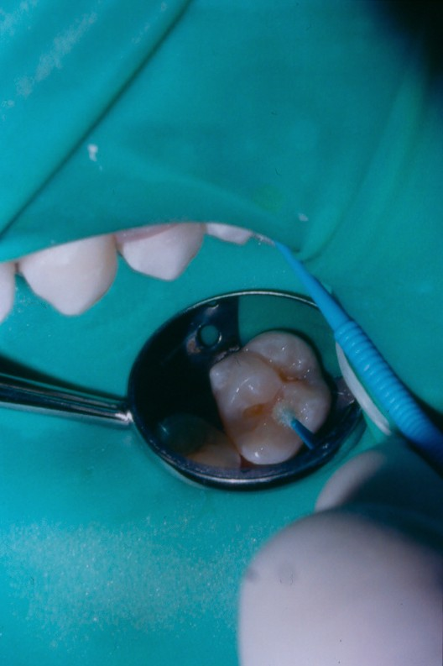
Composite restorations in primary dentition
Operative Procedures
4. Apply bonding agent. With an air syringe gently spread the bond over the cavity preparation and light cure.

Slide 31
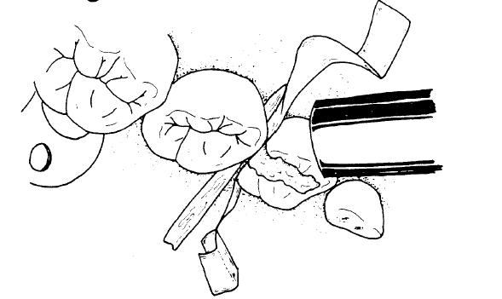
Composite restorations in primary dentition
Operative Procedures (Cont’d)
5. Place resin material with a plastic instrument into the cavity preparation. Light cure the composite resin to a depth of 5 to 6 mm (i.e. may take more than one layer of material).
6. Partially remove the matrix band and light cure the resin 20 sec on the buccal and then 20 sec on the lingual surface.

Slide 32
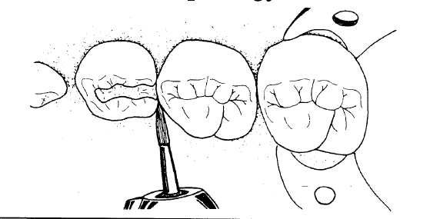
Composite restorations in primary dentition
Operative Procedures (Cont’d)
7. Remove the matrix band and with the flame-shaped finishing bur, contour the interproximal areas. Remove any excess, maintaining normal tooth morphology.

Slide 33
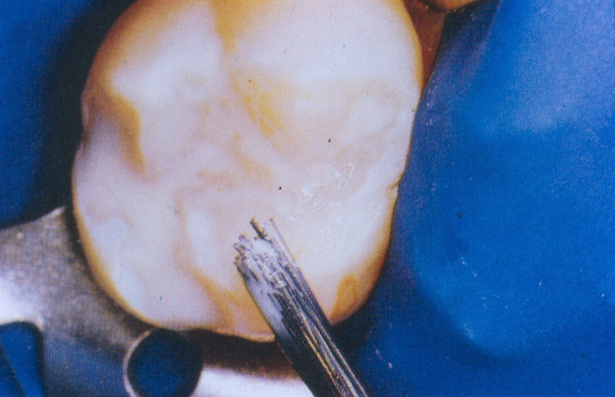
Composite restorations in primary dentition
Operative Procedures (Cont’d)
8. For a better seal. Apply sealant to close enamel cracks which may occur with polymerization shrinkage.

Slide 34
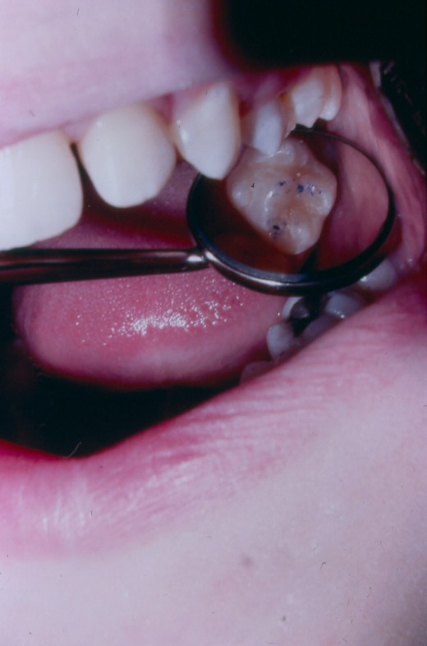
Composite restorations in primary dentition
Operative Procedures (Cont’d)
9. For Class II cavity restorations floss the interproximal areas to check the contact and for the presence of overhang.
10. Remove the rubber dam and with the articulating paper, check for premature contacts. Contour and polish the occlusal surfaces.

Slide 35
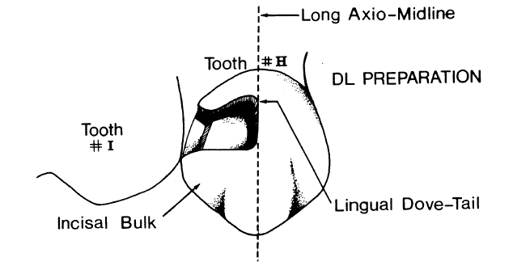
Modified Class III Prep
Lingual Outline Form:
Mesial or distal wall is placed along midline of tooth & parallel to long axis of tooth using #330 bur
Depth to the DEJ (1 mm, check with perio probe)
Contour of pulpal-lingual wall corresponds to external lingual surface of tooth
If extensive caries undermining incisal- consider SSC
Prepare gingival wall parallel to and 1-2mm’s above CEJ and to follow gingival margins

Slide 36
Class III Prep
Interproximal Outline Form
Labial wall should be parallel to external labial surface & extension governed by adjacent tooth and adequate clearance for carving (explorer tip to pass)
Incisally, extend prep to clear contact point, leaving adequate bulk of tooth structure
Gingival wall just below gingival crest and follows contour of gingival margins
Pulpo-proximal wall to be placed just into dentin and follows contour of proximal external surface
Width of gingival floor must not exceed 1mm

Slide 37
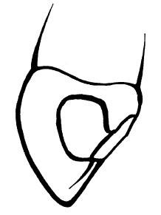
Class III Prep

Slide 38
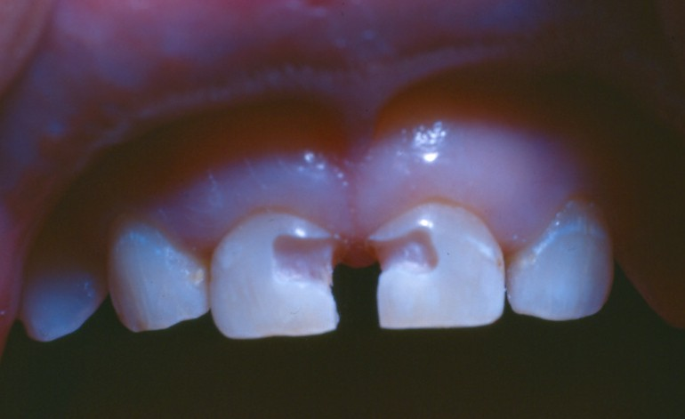
Composite restorations in primary dentition
Class III Cavity Preparation for Primary teeth
When the carious process is minimal or does not extend to the incisal angle, a Class III composite resin restoration is indicated. For more extensive caries, a "strip crown”, zirconia porcelain, or veneered stainless steel crown (possibly open faced or kinder crowns) can be considered.

Slide 39
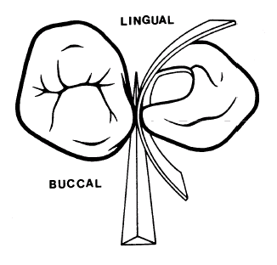
Composite restorations in primary dentition
Use a strip matrix (mylar srtip) and insert a wedge into embrasure opposite direction of condensation

Slide 40
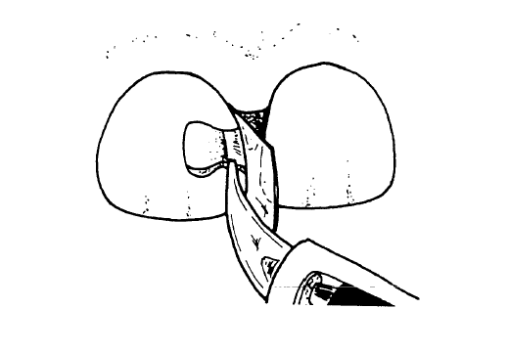
Composite restorations in primary dentition
Operative Procedures
1. Prep accordingly
Place Mylay stip and wedge and then apply etch to enamel margins.
Rinse and dry until a slightly moistened look would appear. Apply bond and light cure.
Hold the strip matrix in place with a wedge and inject the composite resin into the cavity preparation. A plastic instrument can be used to shape and contour the restoration.

Slide 41
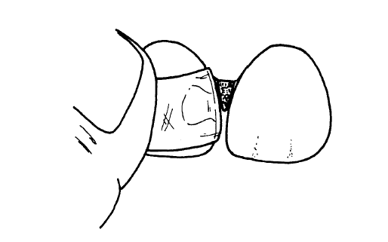
Composite restorations in primary dentition
Operative Procedures (cont’d)
5. Hold the matrix on the lingual surface with one hand, pull the strip tightly, and fold it over on the labial surface. Light cure the labial surface and the lingual surface for 20 seconds each.

Slide 42
Composite restorations in primary dentition
Operative Procedures (cont’d)
6. After removing the matrix check for voids and overextensions. A sharp instrument can be used to remove any flash. Follow the manufacturer's instructions for finishing (i.e. discs, fine tapered diamonds, white stones, carbide finishing bur).
7. When the incisal edge of anterior primary tooth is destroyed, a complete coverage composite restoration is recommended (strip, open face crown or kinder krown).

Slide 43
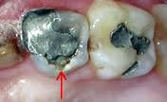
There are limits to how big a filling can be
Don’t Be Scared to consider an SSC

Slide 44
Decision Making
The best practice provides clinicians with guidance to form decisions about restorative dentistry, including when treatment is necessary and which techniques and materials are appropriate for restorations in pediatric patients.
Not every caries lesion requires restoration, and restorative treatment of caries alone does not stop the disease process.

Slide 45

1.Incipent/ Non Cavitated Lesions | Monitor Arresting Protocols (SDF)
2. Cavitated Enamel Lesions a) >18 months until exfoliation 1) Low Risk Good Isolation Good Behavior 2) High Risk Poor Isolation Poor Behavior b) < 18 months until exfoliation 1) Low Risk Esthetics 2) High Risk Esthetic | Composite,RMGI,ITR,Disking Composite/Amalgam, RMGI, SDF, Defer Tx Defer Tx ,SDF ,ITR 2.Composite,RMGI,SDF
Cavitated Enamel/Dentin Lesion a) Moderate Size(1 or 2 surfaces) 1) Low Risk,good isolation 2) High Risk ,>18 months until exfoliation,poor isolation,poor behavior b) Large Size 1. > 18 m until exfoliation 2. < 18 m until exfoliation - Low Risk - High Risk | 1.Composite,Amalgam,RMGI 2.RMGI,Amalgam,SSC Strip Crowns,SSC 2. - Defer Tx,SDF ,Exo, ITR - Exo,ITR ,RMGI
Cavitated Enamel /Dentin/Pulp Lesion > 18 m until exfoliation 2. <18 m until exfoliation | After appropriate pulp therapy 1.Strip Crowns/Zirconia/SSC, Exo 2.Exo

Slide 46
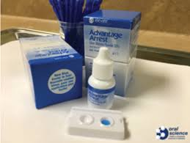
Silver Diamine Fluoride
umanitoba.ca/dentistry

Slide 47
Introduction
The American Academy of Pediatric Dentistry (AAPD) recognizes that dental caries continues to be a prevalent and severe disease in children.
Dental caries as an acute disease condition requiring surgical debridement, cavity preparation, and mechanical restoration of the tooth to restore form and function of the tooth, but increasingly, especially for the infant and child population, practitioners are utilizing individually tailored strategies to prevent, arrest, or ameliorate the disease process based on caries risk assessment.
One of these strategies employs application of SDF as an antimicrobial and remineralization agent to arrest caries lesions

Slide 48
Background
Silver topical products, such as silver nitrate and SDF have been used in Japan for over 40 years to arrest caries and reduce tooth hypersensitivity in primary and permanent teeth.
During the past decade, many other countries such as Australia and China have been using this compound with similar success
The AAPD (2018) supports the use of SDF as part of an ongoing caries management plan with the aim of optimizing individualized patient care consistent with the goals of a dental home.

Slide 49
Benefits
Low cost
Ease of application, less invasive nature
Effective and short procedure time make it an alternative in some situations
Arrest of caries in children and adults
38% SDF to inhibit demineralization and promote preservation of collagen of demineralized dentin by forming a protective layer on and within the dentinal tubules
Notes:
SDF may be a preferred option to arrest caries in deciduous teeth, older individuals, when physical limitations do not allow more extensive treatment or when access to conventional restorative techniques, such as resin composite or amalgam restorations, are not available. Because conventional caries treatment in young children and/or individuals with special care needs may require advanced sedation techniques, SDF may be a viable treatment option when sedation is either not be desirable or available.

Slide 50
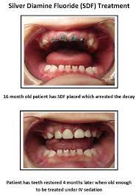
Adverse Effects
Metallic/bitter taste.
Temporary staining to skin which resolves in 2-14 days.
Mucosal irritation/lesions resulting from inadvertent contact with SDF, resolved within 48 hrs
A visible dark staining that is a sign of caries arrest on treated dentin lesions

Slide 51
Other Considerations:
Pretreatment of dentin with SDF does not adversely
-affect bond strength of resin composite to dentin
- or impair GIC bonding

Slide 52
Composition
- Colorless liquid
- PH 10
- 24.4% to 28.8% (weight/volume) silver and 5.0% to 5.9% fluoride

Slide 53
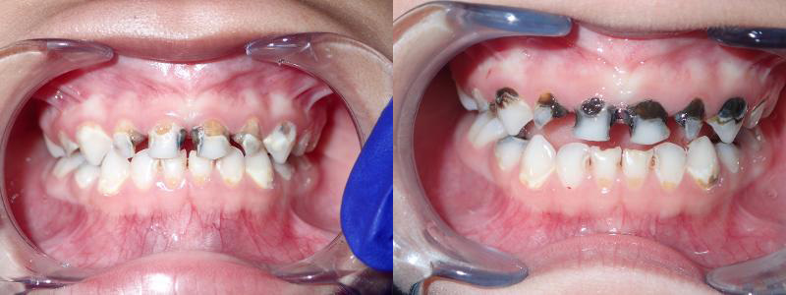
Mechanism of Action
Silver Antimicrobial
Fluoride Remineralization
Ammonia (NH₃ ) Stabilizes the solution
The formation of silver compounds results in striking tooth structure color change.

Slide 54
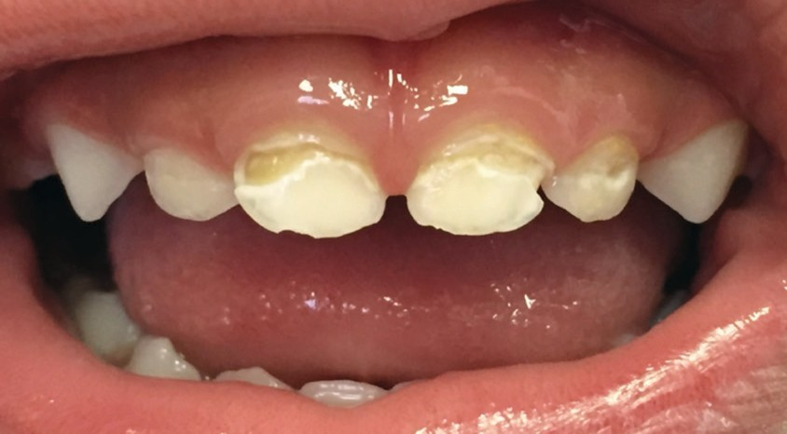
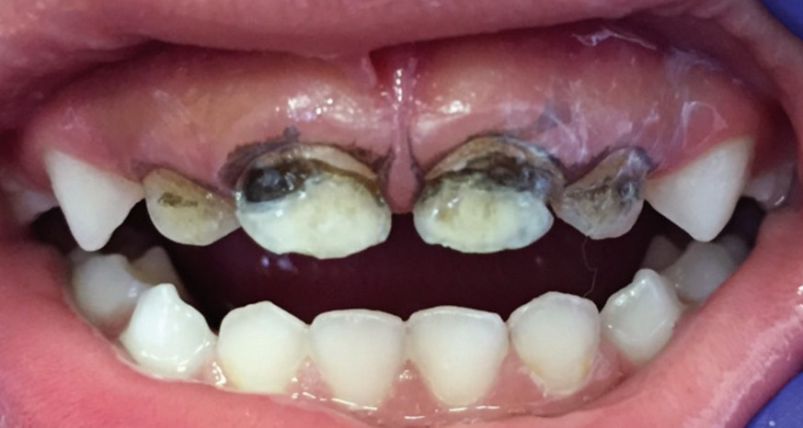
Case Selection
SDF may be helpful in managing caries among individuals who:
• Are at high caries risk and have active cavitated caries lesions in anterior or posterior teeth, whether coronal or root;
• Present with behavioral or medical management challenges and caries lesions;
• Have multiple caries lesions that may not all be treated in one visit;
• Have no access/limited access or difficulty accessing dental care
• No clinical signs of pulpal inflammation / spontaneous pain.
Active cavitated caries lesions before application of SDF
SDF-treated lesions with temporary gingival staining

Slide 55
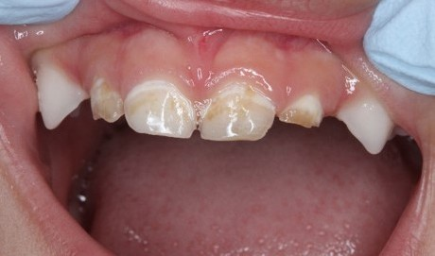
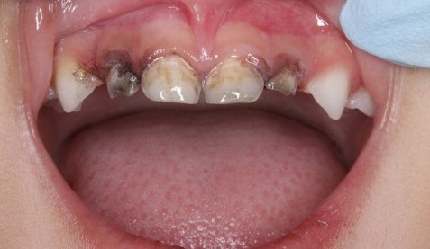
Consent
Clinic staff must explain the benefits of SDF vs. traditional restorative or surgical approaches (fillings, crowns, extractions, etc.).
• Informed consent is recommended, particularly highlighting the expected staining of treated caries lesions, skin and clothes, and the need for reapplication to sustain the arrest of caries.
• Complete the SDF Consent Form

Slide 56
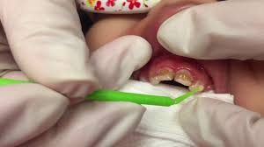
Clinical Steps for the Application of Silver Diamine Fluoride
1. Apply a protective coating of petroleum jelly (i.e. Vaseline) to the lips and skin
2. Excavate gross decayed dentin to allow better SDF contact with the denatured dentin.
3. Isolate and dry the caries lesions
One drop of SDF is generally sufficient to treat 4 or 5 lesions.
4. With the micro-brush apply the SDF directly to the caries lesion to be treated and leave it there for a minimum of 1 minute.
5. 5% sodium fluoride varnish to be applied to the entire dentition, including the SDF-treated area(s) as an additional preventive step.
Notes:
• Measure the size of the caries lesion (in mm) to be treated with a probe, assess the hardness of the lesion with a ball ended probe (e.g. soft, moderate, hard), and assess the colour of the lesion (e.g., yellow, brown, black). These are important factors to consider in order to assist in future determination that the treated lesions have actually arrested.

Slide 57
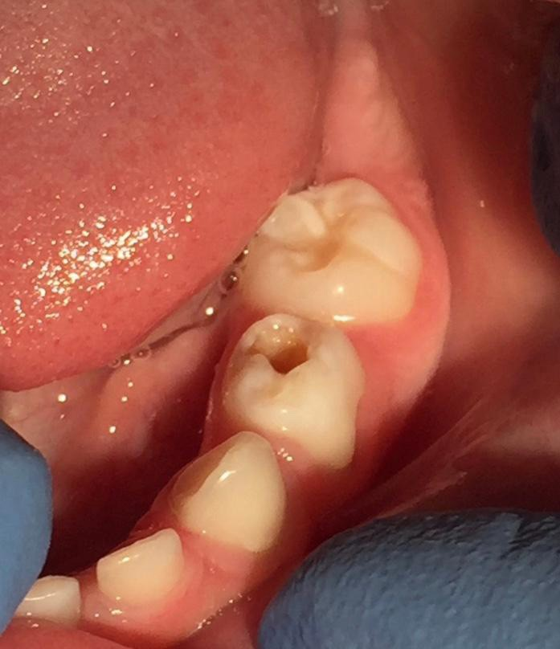
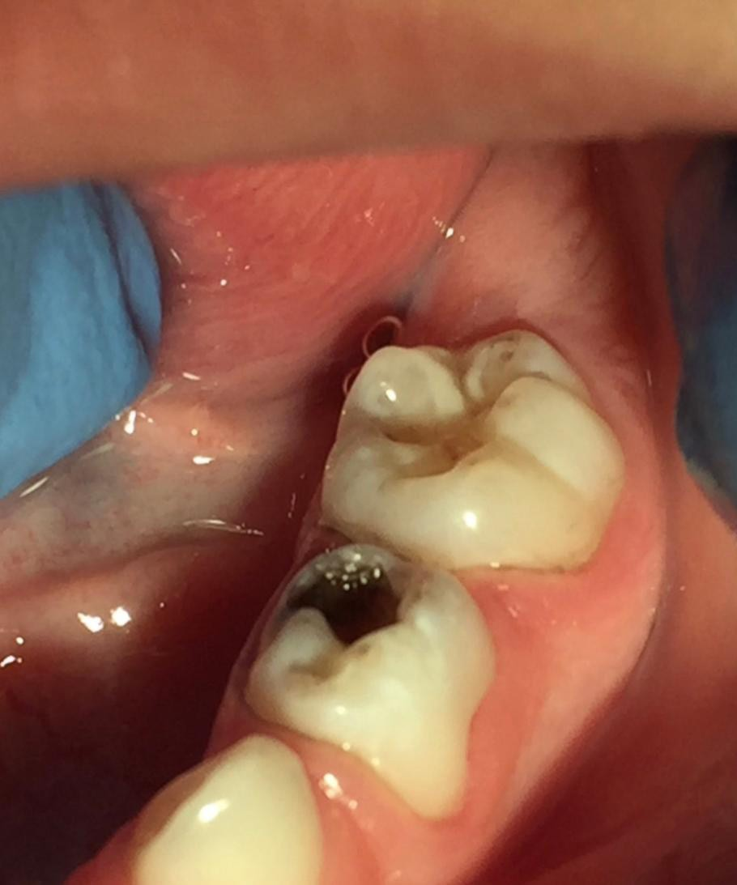
Follow-up
SDF has been shown to arrest dental caries lesions anywhere from 47% to 90% following one application, depending on size of the cavity and the tooth location.
Anterior teeth have higher rates of arrest than posterior teeth.
Therefore, follow-up for evaluation of caries arrest is advisable at 2-4 weeks after initial treatment
American Dental Association is now recommending SDF twice a year for cavitated caries lesions on coronal surfaces in primary and permanent teeth
Caries lesions can be restored after treatment with SDF, to restore form, function, and esthetics.

Slide 58


Slide 59
Questions???? THANK YOU ☺

