Slide 1
New Computer Account User Information
April 2019

Slide 2
Security and identification
Shared Health takes very seriously the need to protect your computer account along with the confidential data and health-care client information you have access to through your account.
Now that you have a computer account, it is important you provide identification and authentication information to Shared Health so the Service Desk is able to validate your identity when you call for an account password reset or submit a service request.
Neglecting to provide this information may result in the inability for the Service Desk to reset your password. Your service requests may also be delayed or denied.

Slide 3
Security and identification
Now that you have been provided with a Computer Account User ID, it is crucial you complete the Authentication Questions Form (click on link below to access the form): https://home.sharedhealthmb.ca/services/digital-health/services-catalogue/business-services/service-desk/account-management/
Include your User ID and Site information on the form, along with two security question answers, and send the completed form to the Service Desk. servicedesk@sharedhealthmb.ca

Slide 4
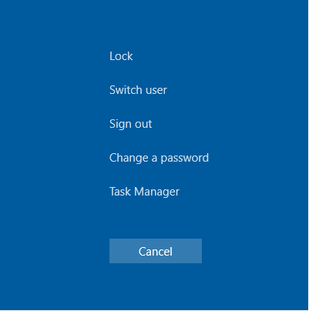
How to change your password
The first time you log in, you should immediately change the temporary password provided to you. On your keyboard press the “Ctrl”, “Alt” and “Del” keys at the same time. You’ll see something like this:

Slide 5
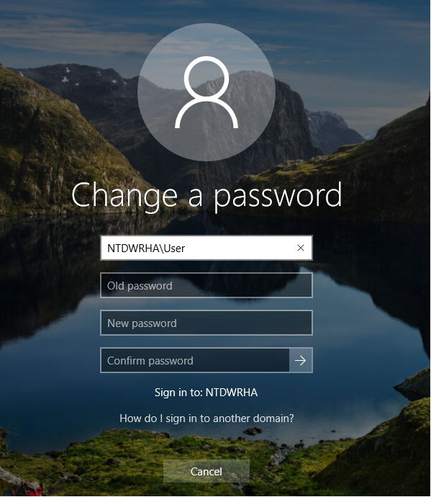
How to change your password
Click on the change password button. You will be asked for your old password, which is what you used to login initially, and for a new password. After typing in your old password, type in a new password, and then again to confirm it. Click on the “Arrow” when you are done.

Slide 6
Your shared folder access
When you log onto the Network you are granted access to shared data based on your site, program and your role, or based on what was specifically requested by your Manager. You will access these shares by opening the “This PC” icon or navigating through “Windows Explorer”.
Your personal share space is your Home Directory or Folder; this is where you store files that do not need to be shared with others. Co-workers do not have access to your Home Directory.

Slide 7
Your shared folder access
Avoid saving files to your C: drive (i.e. Desktop, My Documents). The C: drive is not included in the Organizational Backup plan. Data stored on the Network in your Home Directory and Shared folders is more secure than the C: drive. Data stored on C: can also slow down the log in process.
Store draft mode files or other data not required to be shared with others in your Home Directory and store all other data in your department’s data shares.
For security reasons, remember to log off or lock your workstation when you step away from the computer.

Slide 8
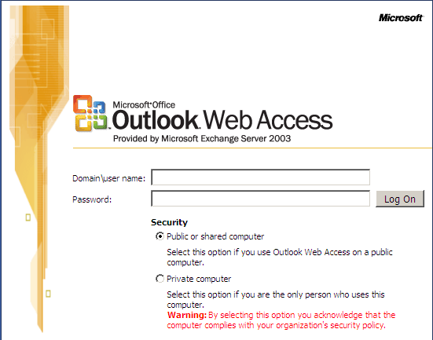
Email and email storage
Email is accessed through the Microsoft Outlook client that is installed on the computers. The icon looks like this:
Email can also be accessed through the Internet client at the address https://webmail.manitoba-ehealth.ca

Slide 9
Email and email storage
Your Outlook email account does not have unlimited space. Please delete messages you do not need to save and sent items you no longer need. Remember to regularly empty your deleted items folder.
Another way to organize your messages and free up space is to create PST containers and save your messages there.
Create your PST files in your Home Folder on the network.

Slide 10
The Service Desk
Shared Health customers are supported by the Service Desk. The Service Desk is available 24x7 all year long.
The Service Desk assists with password resets for network accounts and most application accounts, setting up email, routing service requests, and troubleshooting various computer related issues. If they cannot directly assist you, they will appropriately re-route your service or incident request.

Slide 11
The Service Desk
The Service Desk can be contacted through the following methods:
- Phone: 204-940-8500 1-866-999-9698
- Fax: 204-940-8700
- Email: servicedesk@sharedhealthmb.ca

