Slide 1
OR Conduct Session
Candace Ashton RNBN
Perioperative Nurse Educator
Adult OR

Slide 2
Did you Know?
In Canada, 1 in 9 nine hospital patients contracts a healthcare-associated infection.
There are 200,000 cases of hospital-acquired infections in Canadian hospitals each year
Results in at least 8000 deaths annually
Hand hygiene is THE most important activity for controlling the spread of infectious diseases

Slide 3
Four Moments of Hand Hygiene
1. Before…initial patient/patient environment contact
2. Before…an aseptic or clean procedure
3. After…body fluid exposure
4. After…patient/patient environment contact
Artificial nails, gel tips or nail extenders should not be worn with direct patient contact
Remove watches and bracelets
Remove rings

Slide 4
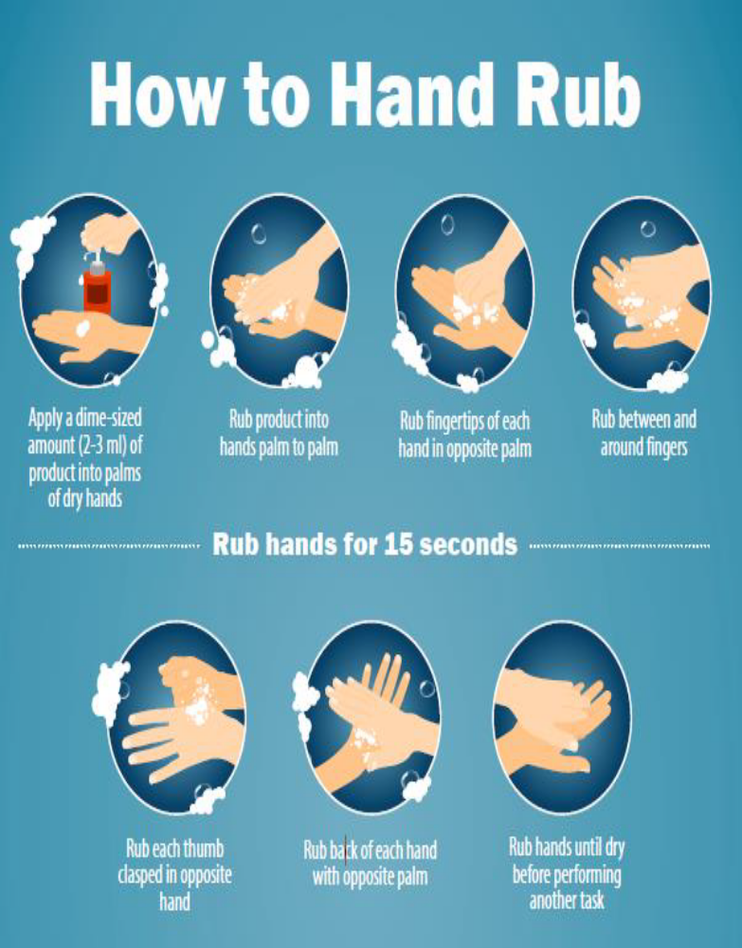
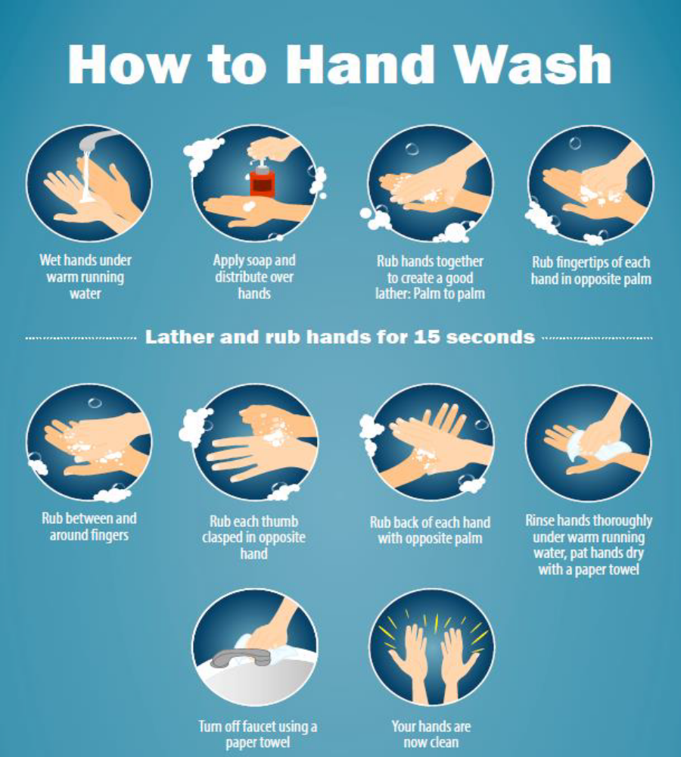

Slide 5
Aseptic Technique
The goal is to protect the patient by preventing or minimizing postoperative infection by creating conditions and following procedures to prevent the introduction of microbial contamination to sterile fields, sterile equipment and the operative site.
Aseptic practices include:
Routine practices
Dress codes
Skin preparation techniques
Sterile technique

Slide 6

Routine Practices
Routine Practices are basic infection prevention and control measures expected for the care of all patients at all times in any healthcare setting.
Routine Practices recognize germs are always present and can be transmitted from one person to another directly or indirectly.
Consistently following Routine Practices reduces the risk of transmission.

Slide 7
Routine Practices
Why use them?
Surgical Site Infections (SSI) can occur:
Within 30 days of surgical procedure (no implants)
Within 1 year if an implant left in place
Most SSI are related to contamination of the incision.
The most frequently isolated pathogens are:
Staphylococcus aureus – 20%
Coagulase-negative staphylococci – 14%
Enterococcus – 12%
Escherichia coli – 8%
For most surgical site infections, the source of pathogens is skin flora.

Slide 8
Routine Practices
Why use them?
40%-60% of SSI are preventable.
Patients with SSI stay in hospital 7 days longer.
60% more likely to be admitted to ICU.
5 times more likely to be readmitted within 30 days of discharge.
Twice as likely to die.
Notes:
SSI’s can cause:
Tissue destruction
Prolonged would healing
Incisional hernia’s
Recurrent pain
Disfigurement and disabling scars
Increased use of antibiotics- puts patients at risk for developing antibiotic resistant organisms

Slide 9
Patient Risk Factors
Patients who have any of the following are at a greater risk for developing a SSI:
Inflammatory arthritis
diabetes
Malnutrition
Smokers
Overweight/ obesity
Poor hair removal techniques
Over-use of antibiotics

Slide 10
Wound Classification
There are 4 wound classes:
Class I- Clean- expected infection rate is 1% -5% (Total hip arthroplasty
Mitral valve replacement, Breast biopsy).
Class II- Clean-contaminated- expected infection rate is 8%-11% (Tonsillectomy, Non-perforated appendectomy, Hysterectomy, Thoracotomy).
Class III- Contaminated- expected infection rate 15%-20% (Traumatic penetrating wound such as a stab to the chest involving the lung, Inflamed, non-perforated Appendectomy).
Class IV- Dirty- expected infection rate 27%-40% (Ruptured appendectomy, Pressure Ulcers, Gas Gangrene).
Notes:
System the OR uses to rate wounds and their expected infections rates.
Helps collect data on how and why patients get surgical site infections.

Slide 11
How to Prevent SSI’s
Administration of Prophylactic Antibiotics:
Administration within 60 minutes of surgical incision time.
Discontinuing antibiotics within 24 hours after surgery end time. This helps prevent development of AROs.
Prevention of Hypothermia:
A drop in temperature of 1.5°can result in:
increased risk of wound infection;
decreased oxygen in tissues
increased mortality
Notes:
Hypothermia-defined as a reduction in core body temperature below 36 C

Slide 12
Prevention of SSI’s
Hair Removal:
Recommendation to remove hair only if necessary.
Do not remove hair prior to the day of surgery.
Use a clipper vs a razor. Razors may cause nicks in the skin leading to increased risk of SSI.
Glucose Control:
Hyperglycemic episodes in Diabetic patients.

Slide 13
Personal Protective Equipment (PPE)
Personal Protective Equipment (PPE) includes:
Gowns
Gloves
Facial protection
Masks (N95 respirators as indicated for Additional Precautions)
Eye protection

Slide 14
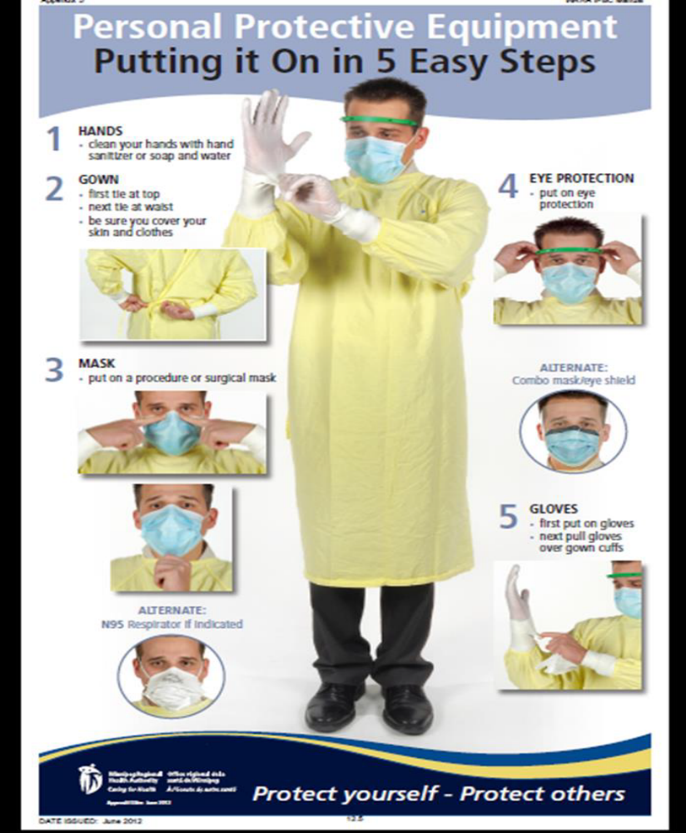

Slide 15
Perioperative Environment
Know Your Zone!
Unrestricted Zone:
includes entrance and exit sites for personnel, patients, materials, and equipment into and out of Semi-restricted zones.
Street clothes are permitted and traffic flow is more liberal although it is monitored to prevent individuals entering the Semi-restricted and restricted zones without proper attire.

Slide 16
Perioperative Environment
Know Your Zone!
Semi-Restricted Zone:
Includes storage area for sterile supplies, scrub sinks, and access to corridors that provide entrance to the restricted zone.
Surgical attire is worn consisting of head and facial hair covering.
Masks are not required unless entering the restricted zone.
Restricted to authorized personnel and patients.

Slide 17
Perioperative Environment
Know Your Zone!
Restricted Zone:
is where surgical invasive procedures are performed.
Restricted to OR personnel and patients.
Surgical attire, head and facial covering Must be worn as well as masks required if there are open sterile supplies or team members are completing a surgical hand scrub.
HVAC ventilation and filtration systems must be in place.

Slide 18
Back to Basics
3 Original Rules
Surgical attire should not be worn outside the facility. (ORNAC, 2023, 2.7.9)
All personnel entering the semi-restricted or restricted zones shall don surgical attire that is laundered and issued by the healthcare organization upon entry into the unit. ( ORNAC, 2023, 2.7.2)
Surgical attire shall be changed daily and whenever it becomes visibly soiled, contaminated or wet. (ORNAC, 2023, 2.7.10)

Slide 19
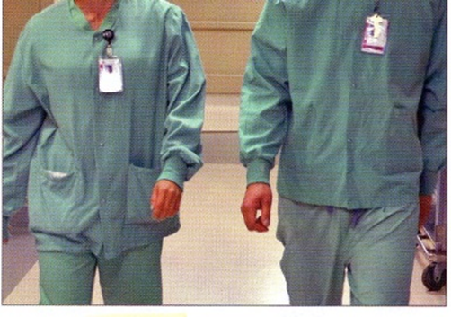
Dress Code: OR Scrubs and Identification
Two-piece pantsuit with top tucked into pants or shall be close fitting. Drawstrings should be tucked into pants. (ORNAC, 2023, 2.7.4)
Personal clothing shall be completely covered by scrub attire. (ORNAC, 2023, 2.7.7)
Warm-up jackets shall be close fitting, completely fastened at the front and changed daily. (ORNAC, 2023, 2.7.6)
Secure your badge in a visible spot on the scrub attire top or jacket. (AORN, 2016)
Don’t wear a lanyard to hold your badge. (AORN, 2016)
Notes:
Purpose:
Reduce the risk of cross-contamination during patient care.
Promote a safe environment for patients and OR personnel.
Standards of care are developed from scientific evidence-based practice. OR Standards of Practice identify where surgical attire should or should not be worn.
Personnel and proper surgical attire is each team members personal responsibility.

Slide 20


Dress Code: Head Covering
Head covering shall consist of a clean disposable lint-free surgical hat or hood that confines all head and facial hair. (ORNAC, 2019, 2.9.10)
Reusable head coverings should be laundered in a health care-accredited laundry facility after each daily use. (ORNAC, 2019, 2.9.11)
Personnel who wear cloth hats should wear a disposable bouffant cap over the cloth hat. (ORNAC, 2019, 2.9.11)

Slide 21
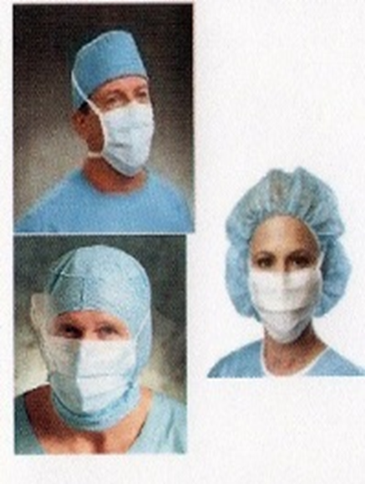
Dress Code: Masks and Eye Protection
Masks shall be worn in the presence of open sterile supplies, scrubbed personnel, and during sterile procedures. (ORNAC, 2019, 2.9.16)
Masks shall be well fitting, cover nose and mouth and tied so that it doesn’t vent at sides. (ORNAC, 2019, 2.9.16)
Do not wear mask hanging around neck.
Remove and discard mask by handling the ties only.
Wear eye protection and clean reusable eye wear after each use. (ORNAC, 2019, 2.9.15)
Notes:
If you go for break, throw out old mask and grab a new one on your way back into the OR.
If you get blood on your mask- need to change it before you start the next case.

Slide 22
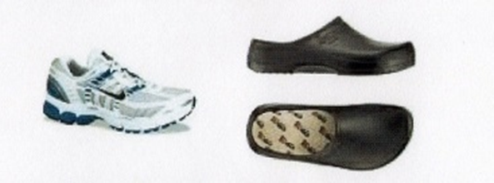
Dress Code: Surgical Footwear
Wear clean shoes that are only used for work in the OR.
Footwear shall have enclosed toes and
backs that provide protection from
injury due to items, sharps,
and fluids. (ORNAC, 2019, 2.9.9)
Footwear should be comfortable, supportive, and minimize fatigue as well as meet provincial labour codes and Occupational Health and Safety guidelines.
Cover shoes with single-use shoe covers if exposed to gross contamination from blood and body fluids. (ORNAC, 2019, 2.9.9)

Slide 23
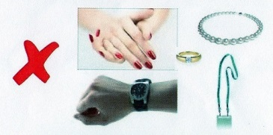
Dress Code: Nail Care and Jewelry
Fingernails shall be clean, short, natural, and appear healthy. (ORNAC, 2019, 2.7.18)
Nail polish should not be worn.
Chipped or peeling polish may provide a harbor for microorganisms. (ORNAC, 2019, 2.7.19)
Nail polish cannot be worn for more than 4 days and must be removed when it becomes chipped. (WRHA, 2019, IP&C)
Confine and remove all jewelry within scrub attire. (ORNAC, 2019, 2.7.21)
All Jewelry on hands and wrist shall be removed prior to entering the semi and restricted areas (watches, Fitbit, rings, bracelets).
Research has not demonstrated any association between covering ears and SSI rates.
Notes:
Mention- Make-up should be kept to a minimum.
ORs are designated as scent-free zones. Fragrance or scented products should not be worn in the OR environment.
False eyelashes should be confined within a face shield mask to prevent them from falling into the sterile field or wound.

Slide 24
Dress Code: Personal Items
Brief cases, backpacks, fanny packs should not be taken in to the semi restricted or restricted areas of the surgical suite.
Cell phones, tablets, and other hand-held electronic devices should be cleaned with disinfectant before these items are brought into the OR.
Notes:
Unclean items brought into the OR can be highly contaminated with microorganisms and may harbor dust, pathogens, and bacteria.
Items shall never be placed on the floor

Slide 25
Surgical Attire: Laundering
Surgical attire (including cloth hats) shall be laundered by the laundry facilities used by the healthcare facility for other surgical textiles
Approved laundering facilities use recommended detergent and temperature settings to launder linen. (ORNAC, 2019, 2.9.8)
Do Not home launder surgical attire.
Home laundering may not reliably kill all pathogens. They may survive in the form of biofilms within the washing machine.

Slide 26
OR Theaters
What you need to know
Keep movements in and out of the OR theatre to a minimum.
Do not eat or drink in areas where patient care is provided, especially in the OR environment.
All OR doors shall remain closed at all times except to allow for the procurement of supplies, receiving patients and admittance of personnel.
The number of air exchanges must adhere to provincial codes (15 –20 per Hour).
The ambient temperature should be between 20 –23 degrees C.
The humidity should be between 30% and 60%.
Notes:
Unnecessary OR traffic increases the rate of infections.

Slide 27
Sterile Technique
Sterile Technique:
Manipulation of sterile items within and around sterile field.
Includes:
Creating and maintaining a sterile field.
Transferring items onto sterile field.
Draping the surgical patient.
Movement of personnel around the sterile field.
Notes:
Breaks in technique shall be monitored and corrective action taken as soon as possible!

Slide 28
Surgical Hand Scrub
Why and how we do it…
Surgical hand antiseptic/scrub agent should have the ability to:
kill organisms immediately upon application,
provide antimicrobial persistence to reduce regrowth of microorganisms and have a cumulative effect over time.
A surgical hand antiseptic/scrub agent shall be approved by the facility’s infection control team.

Slide 29
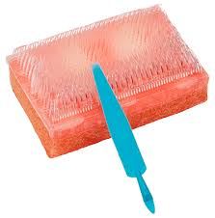
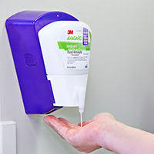
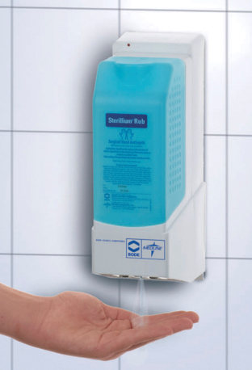
Surgical Hand Scrub
Sterile team members shall perform surgical hand scrub prior to donning sterile gown and gloves.
Counted/Timed surgical hand scrubs are accepted.
Waterless surgical hand scrubs are also accepted
Special attention should be given to nails, underneath finger nails, between fingers and between thumb and index finger.

Slide 30
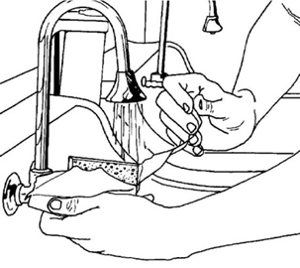
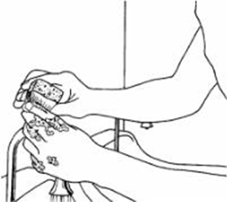
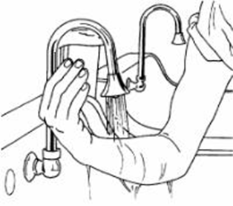
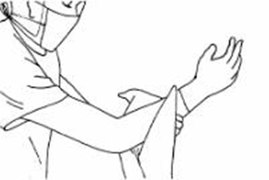
Wet/Water Hand Scrub
Counted Hand Scrub
Hands above the elbows and away from surgical attire at all times.
The direction of the scrubbing procedure is from the hands to the elbows, without returning to the cleaned hands.
20 strokes at the finger tips, then 10 strokes for every 4 sides.
Hands and arms shall be dried with a sterile towel prior to gowning.
Notes:
Every finger, palm, forearm, and upper arm is separated into 4 sides- 10 strokes per side.

Slide 31
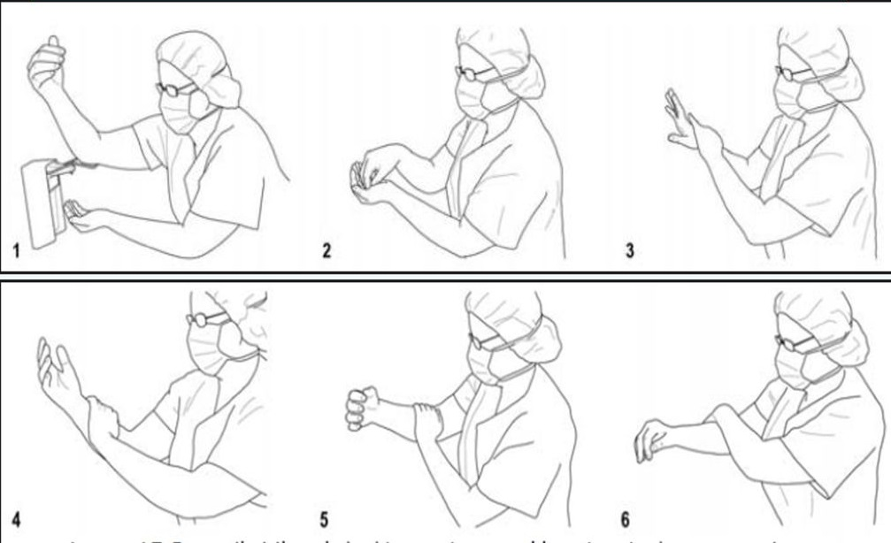
Dry/Waterless Hand Scrub
Notes:
prewash hands and arms with Chlorhexidine soap and water and clean under nails using nail file. Completely dry hands and arms
The direction of the scrubbing procedure is from the hands to the elbows, without returning to the cleaned hands.
First pump:
Dispense first full pump (2 ml) into the palm of one hand;
Dip the fingertips of the opposite hand into alcohol rub and work it under the nails; and
spread the remaining amount from that palm, from the wrist to the elbow of the opposite arm, covering all surfaces.
Second pump:
Place another full pump (2 ml) into the dry palm, and repeat the above procedure with the other hand;
Third pump:
Dispense final full pump (2 ml) into either hand and reapply to all aspects of both hands up to the wrist;
Rub hands until dry before donning sterile gown and gloves

Slide 32
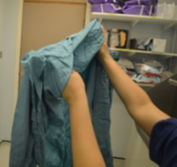
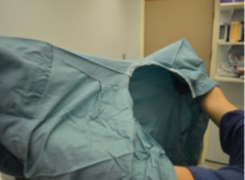
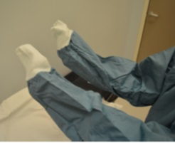
Sterile Gowning
Grasp the folded gown at the neckline and lift it directly upward from the sterile package.
Step back from the table into an unobstructed area.
Let the gown unfold keeping the inside of the gown facing the body without touching the sterile exterior of the gown.
Hold the hands at shoulder level
Slip both arms into the sleeves of the gown until the hands reach the nearest edge of the cuff

Slide 33
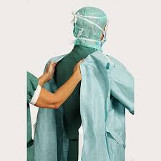
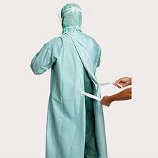
Sterile Gowning
Circulating nurses will assist the scrubbed person by:
Reaching inside the gown and adjusting the inside shoulder seam to bring the gown over the scrub person’s shoulders.
Touching only the ties and fasteners securing the back of the gown at the neck and the waist.
Take the paper tab from scrubbed person and hold it while scrubbed person makes a ¾ turn to wrap the back panel of the gown.

Slide 34
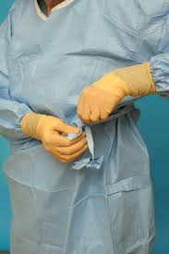
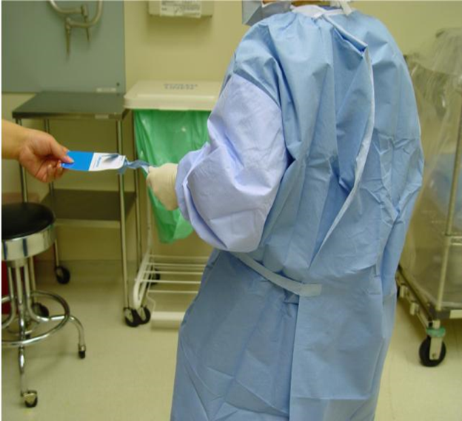
Sterile Gowning
Scrubbed person carefully retrieves the tie by pulling it out of the tab held by the circulator.
Scrubbed person secures gown by tying the tie to the short end of the waist tie.

Slide 35
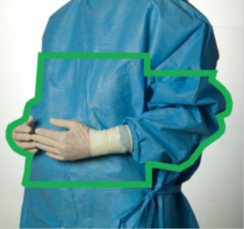
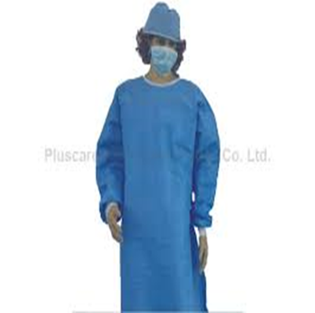

Sterile Gowning
Gown is sterile in front from 2 inches below neck to table level of sterile field.
Sleeves are sterile from 2 inches above the elbow to the stockinette of cuffs.
Keep hands and arms above waist level at all times.

Slide 36
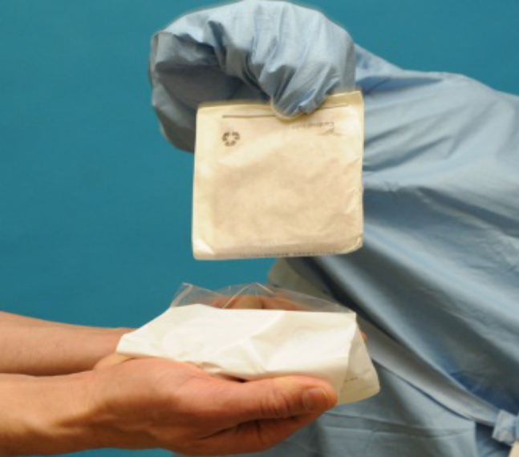
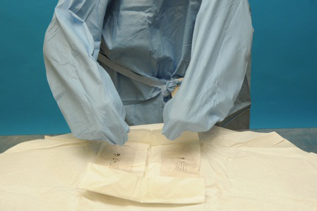
Sterile Gloving
Scrub should use closed gloving technique.
Keep hands covered by gown sleeves to prevent gloves from becoming contaminated.
Place gloves on separate sterile surface/keeping away from main instrument table.
Notes:
Sterile gloves shall be opened and resented to the scrub nurse. Sterile gloves shall never be flipped onto the sterile field.

Slide 37
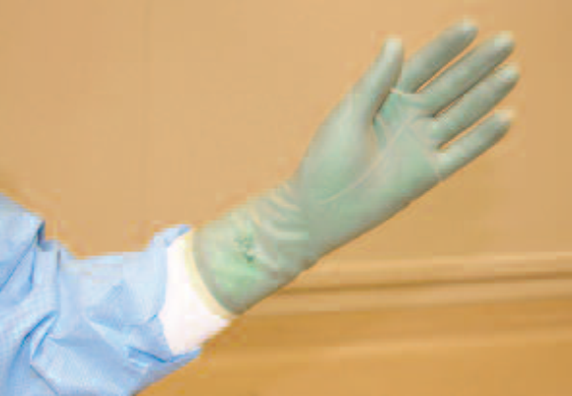
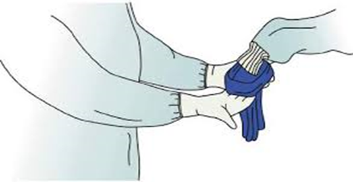
Sterile Gloving
Fingertips remain inside gown cuff in closed assisted gloving.
After hands pass through the cuff, gown cuff is considered contaminated.
Sterile gloves must cover gown cuffs at all times.
Inspect integrity of gloves, check for holes and defects before touching sterile field.
Notes:
If gloves need to the changed during procedure, open assisted gloving shall be used.
This leaves the hand exposed as the gown sleeve is pulled up so the cuff sits at wrist level.

Slide 38
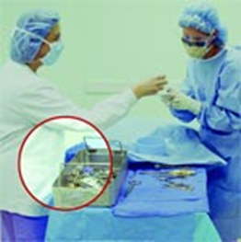
Moving Within or Around a Sterile Field
Scrubbed Personnel:
Keep a direct view of the sterile field at all times.
Remain close to the sterile field.
Do not leave sterile field to retrieve items.
Never turn back on sterile field.
Unscrubbed Personnel:
Should always be facing sterile field when approaching it.
Allow a minimum of 12 inches between sterile field and sterile team members.
Never walk between scrub team or tow sterile fields.
Notes:
Should NOT be wandering around the room.

Slide 39
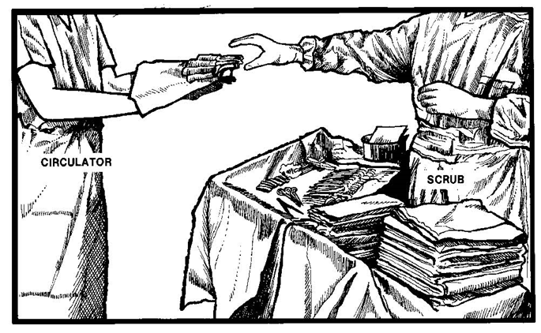
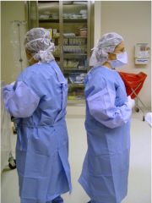
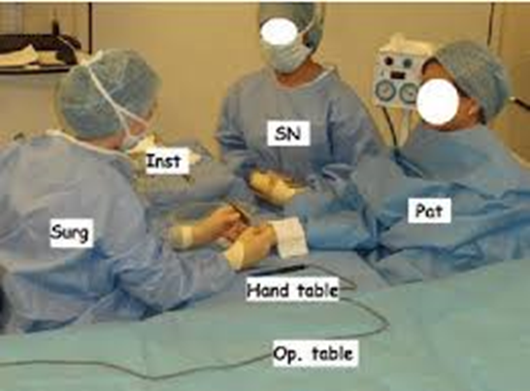
Moving Within or Around a Sterile Field
General Rules
Unsterile persons shall not reach over the sterile field.
Sterile persons shall not reach over unsterile areas.
Move Back to Back (unsterile to unsterile) while maintaining distance from each other and sterile field.
OR
Move Face to Face (sterile to sterile) without turning backs to sterile field.
Do Not Change Levels: only sit down when entire procedure will be performed sitting.

Slide 40
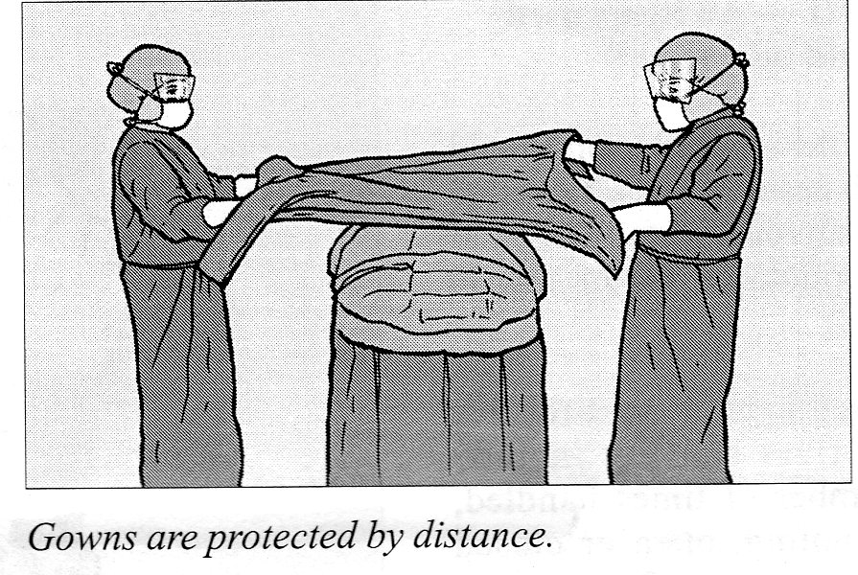

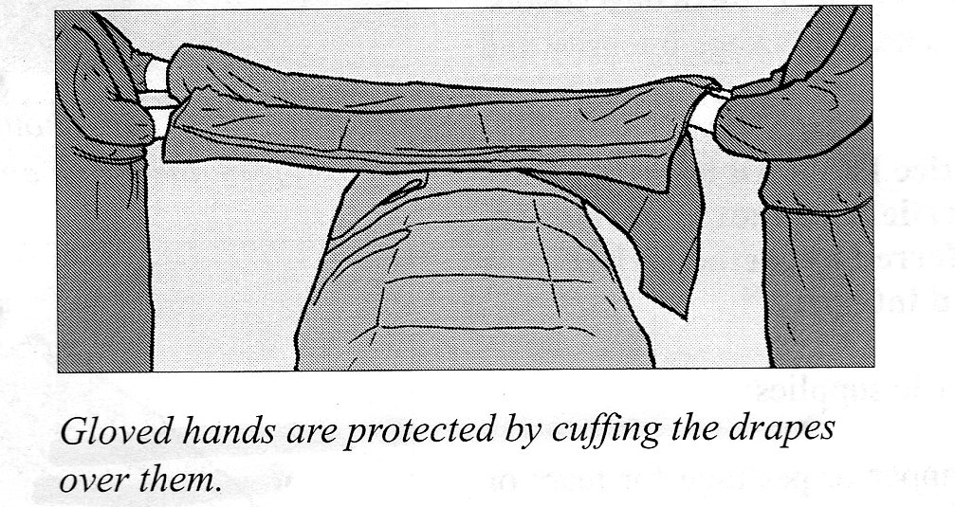
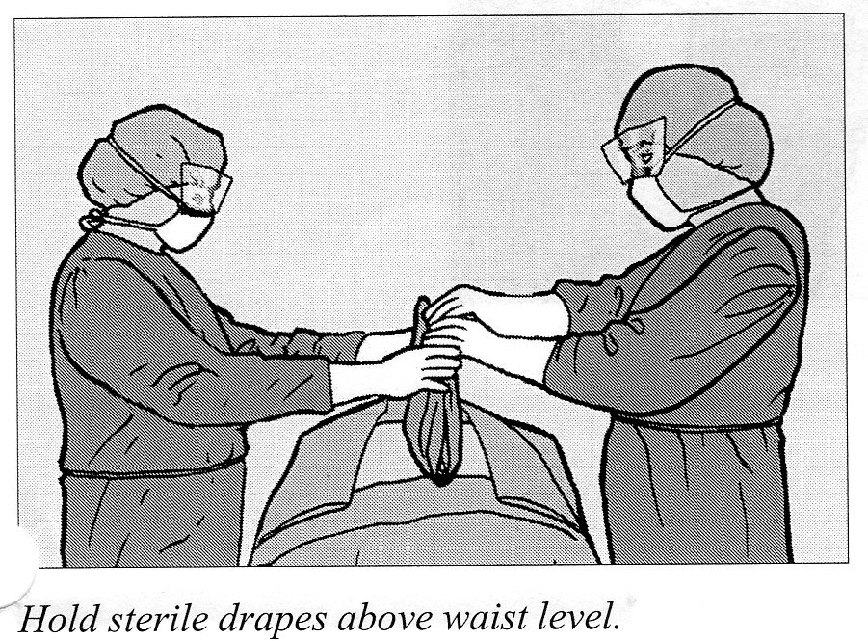
Principles of Draping
Sterile drapes shall be impermeable to liquids.
Handle draping as little as possible.
Drape from incision to periphery.
Shield the sterile gloved hands by cuffing the drape over the gloved hands.
When draping hold drapes above waist level or higher then the OR table until properly placed.
Once drapes are in place they should not be re-positioned.

Slide 41
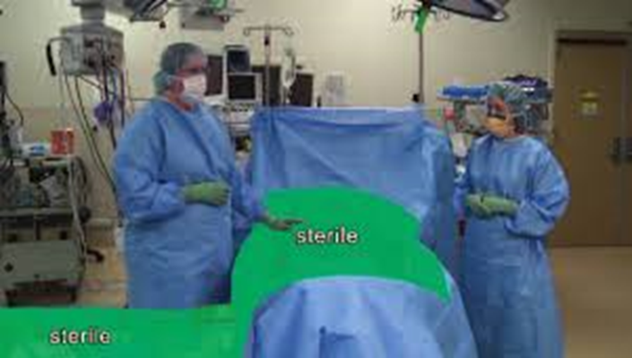
Principles of Draping
Only top surface of the draped tables, and the patient are considered part of the sterile field.
Items extending beyond the boundary of the sterile field are considered contaminated.
Items cannot be returned to sterile field.
Sterile drapes which fall below the level of the table shall not be brought up to table level.

Slide 42
Breaks in Sterile Technique
Perioperative personnel should attentively observe and recognize when a break in sterile technique occurs.
Swiftly recognizing and rectifying a break in technique will assist in minimizing risk of microbial exposure to patient.
The Practice of Conscientious Sterile Technique in an OR is an Ethical Responsibility of Each Individual.

Slide 43
Questions?

