Slide 1

SCORE & SCOPE Exchanges
Global Health Portfolio
Jun Kim (Global Health Liaison Sr.)
kimj25@myumanitoba.ca
Brandon Kim (Local Exchange Officer Sr.)
kimkm@myumanitoba.ca
Global Health Liaison Jr. to be elected and LEO Jr. AND Social Committee Liaison Jr. to be recruited start of October

Slide 2
About
International Federation of Medical Students’ Associations
139 national member organizations (NMOs) representing a network of 1.3 million medical students in more than 130 countries
Founded in 1951 in Denmark
Notes:
IFMSA is one of the largest & oldest students-run organization in the world

Slide 3
Vision
“IFMSA envisions a world in which medical students unite for global health and are equipped with the knowledge, skills and values to take on health leadership roles locally and globally”
Notes:
IFMSA Vision Statement

Slide 4
CFMS-IFMSA Exchanges
Organized by CFMS, as opposed to individual medical schools
Available to any medical student from a CFMS member university
Partner countries vary each year, but include a range of geographical locations
A great opportunity to meet international medical students, learn about another healthcare system, and explore a different country
English is the only language requirement

Slide 5
SCORE

Slide 6
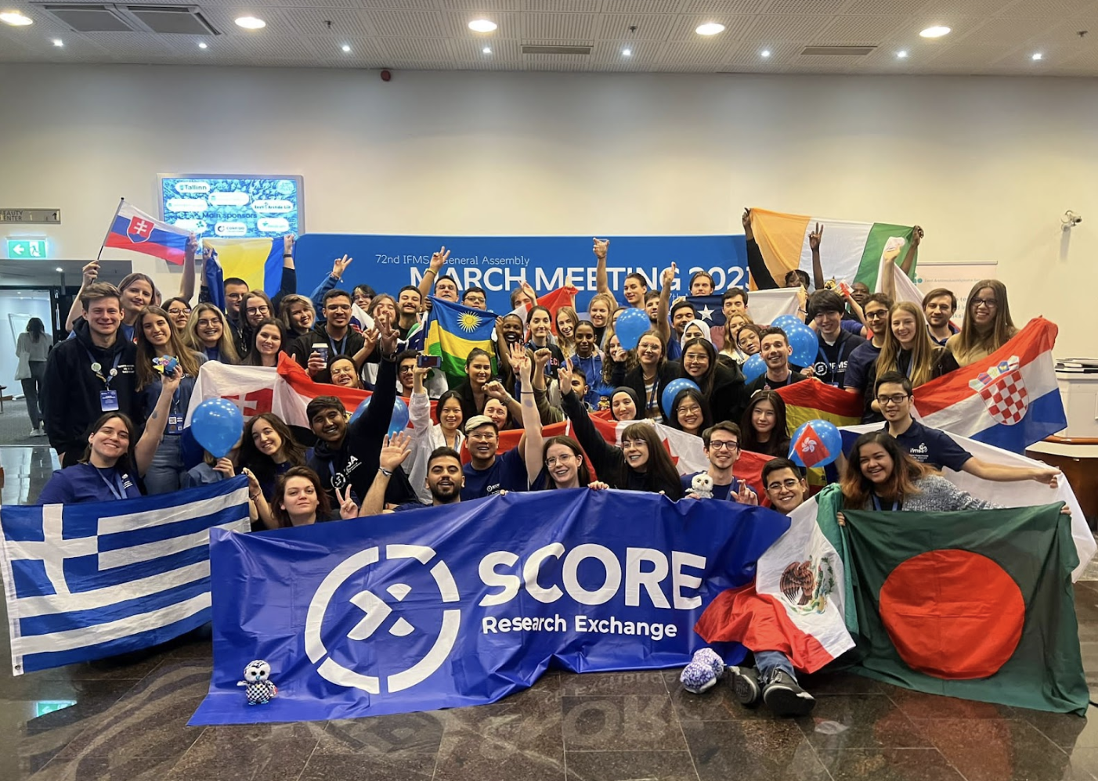
What is SCORE?
Standing Committee on Research Exchanges (SCORE)
Involves 65+ active NMOs, offering over 3000 research projects to over 2400 medical students worldwide
Notes:
Slide 1 - Yvette
SCORE’s objective of giving students an opportunity of improving their research skills in other learning settings. Presently, SCORE involves more than 65 active NMOs, offering over 3000 research projects to provide over 2400 medical students worldwide the opportunity to participate in IFMSA research exchange program and learn the basic principles of medical research such as literature studies, collecting data, scientific writing, lab work, statistics and ethical aspects related to the medicine. It is important to mention that all exchanges are initiated and coordinated entirely by medical student volunteers.

Slide 7
SCORE Mission
To offer future physicians an opportunity to experience research and diversity in countries all over the world. This is achieved by providing a network of locally and internationally active students that globally facilitate access to research exchange projects. Through our programming and opportunities, we aim to develop both culturally sensitive students and skilled researchers intent on shaping the world of science.

Slide 8
SCORE Objectives
Enable students to take responsibility for their own learning according to their personal interests.
Introduce them to the basic principles of medical research
Widen their horizons and provide the opportunity to experience different approaches to health care, ethical research standards, medical research, education, and treatment.
Enhance the academic quality of the medical student curricula and achieve educational benefits of practical and theoretical knowledge in the field of medical research.
Facilitate collaboration and partnership between medical universities, research institutions and allied medical students across the globe in order to share and spread new achievements in medical research.

Slide 9
SCORE Project
4 week exchange to work on a supervised basic sciences or clinical research project. Majority of opportunities are 4 weeks.
Students are guided through basic principles of research such as literature studies, collecting data, scientific writing, as well as statistics.
Students might be expected to write a short report or presentation about their results and achievements.
At the end of the exchange, students send a scientific report (Introduction, Methods, Results, Conclusion, Discussion) to the sending and hosting NOREs
Notes:
Slide 2 - Ali

Slide 10
SCORE Partnerships
Country - number of spots for Canadian outgoing students – LAST YEAR
Czech republic - 4
Korea - 2
Egypt - 3
Brazil - 3
Italy - 2
Thailand - 3
Serbia - 2
Mexico - 3
Notes:
Slide 4 - Ali

Slide 11
NORE Contacts
Anumita Jain, Yaseen Abbas (NORE Srs)
nore@cfms.org

Slide 12

What is SCOPE?
The Standing Committee on Professional Exchanges allows medical students to participate in a 4 week supervised clinical placement.
Each National Member Organization (eg. CFMS Canada) of the International Federation of Medical Student Associations can send and host students according to pre-arranged contracts.
The preclerkship specialites vary depending on the host country, but some have options to rank your preferences
Notes:
SCOPE focuses on giving medical students clinical experience in another country. Students are given the opportunity to shadow and learn clinical skills in another medical center and different medical systems in a select specialty.
The specialties available vary depending on the host country, but provide students with valuable patient interaction and application of medical knowledge prior to clerkship.
This opportunity, like research exchanges, will be open to students for Summer 2024!

Slide 13
Our Values
Fostering intercultural solidarity and cooperation between medical students globally.
Incorporating EDI principles to make exchanges more ethical and equitable.
Ethical and respectful navigations of cross-cultural experiences.
Challenging colonial power dynamics and creating partnerships that are reciprocal, sustainable and minimize potential harms to the host community.
Notes:
This year, we are striving to approach exchanges through an EDI lens. We want to make exchanges an accessible opportunity for medical students across Canada by creating an application process that reflects this value.
We are also carefully choosing which countries we partner with, being conscious that partnerships are reciprocal and that medical students, both incoming and outgoing, will walk away from the experience with valuable learnings.
Through initiatives such as pre-departure and upon-arrival training for exchange participants, we hope to incorporate aspects of EDI and cross-cultural understanding.

Slide 14
SCOPE Partnerships (2024)
Brazil - 1
Czech Republic - 6
Egypt - 1
Greece - 1
Indonesia - 2
Italy - 1
Malta - 1
Northern Cyprus - 1
Oman - 2
Poland - 12
Romania - 3
South Korea - 2
Taiwan - 2
Turkey - 4
Notes:
In the past, CFMS has partnered with countries across the world. With exchanges being offered again after a hiatus, many countries were eager to sign contracts with us, and we are pleased to offer a wide geographical range of countries for Canadian students to do exchanges this Summer.
These are the countries that we have partnered with for SCOPE exchanges this Summer, with the exception of Ukraine which are reserved for incoming students to Canada.. Spots vary depending on the country.

Slide 15
Outgoing Exchanges
Canadian preclerkship students are eligible for this program
Students finishing their second year can go to any partner country, students finishing first year please check individual country conditions (some prefer students have more clinical experience first)
Students can specify department(s) they would prefer
Usually one department for the 4 weeksStudents spend time in a hospital and/or clinic and become familiar with a different healthcare system and center
Social activities and accommodation are coordinated by the hosting exchange officers
Notes:
Mention eligibility: As summer breaks are typically only given to year 1 and 2 students, exchange participants from Canada have traditionally been pre-clerkship students. However, if schools’ elective office allows, clerkship students may go on exchange as an international elective. Please be aware that these exchanges do not have official academic recognition for credit with any Canadian medical school.
Mention applications open Sept 25th and close Oct 23
Clinical exchanges are offered to Canadian medical students during the Summer (May to August), with there being bilateral and unilateral options (explain what each is)
If you are selected for a clinical exchange, the local exchange officers at the host country/city will help you find housing and transportation.
Mention how the exchange works with selecting departments and what students do during the exchanges (hospital/clinic + social activities)

Slide 16
Academic Recognition
SCOPE exchanges do NOT count for credit towards any clerkship rotations in Canadian medical schools. This is why they are done in Summer months before clerkship.
While you may get international elective credit at some schools, this is dependent on the school and must be discussed with elective or global health coordinators.
This exchange experience qualifies for Summer Early Exposure if you fill out the forms by all the deadlines.

Slide 17
NEO Contact
Dean Chiong (NEO Senior)
neo@cfms.org

Slide 18
Exchanges Summer 2025

Slide 19

Timeline – Last Year
September 25: applications open
October 13: applications due
October 14: application review begins
October 27: results released for first iteration
There may be second and third iterations depending on how the first cycle goes.

Slide 20
Exchange Timing
Outgoing exchanges occur in the Summer months (May-August). You can specify the months you are available based on your school’s Summer break.
Host country’s have different times that exchanges are available. Most countries we have signed with have an unspecified time for accepting incoming students, but details are listed on the exchange conditions page for each country.
Exact dates of an exchange will be determined after you confirm your country match. The NEO/NORE will then coordinate with the host country NEO/NORE. Generally exchanges start at the beginning of each month.

Slide 21
Application
Evaluation will be done by exchange committee members (excluding those who have applied), NEOs, and NOREs.
Applications will be anonymized and scored. Those with the highest scores will get matched to countries.
Preference may be given to students who know a second language in the country they are applying for. Although second languages are not mandatory, it may be helpful especially in a clinical setting.
Bonus points will given to students from schools with existing SCOPE/SCORE contracts

Slide 22
Finances
Students pay a flat fee of $1350 to CFMS for a 4 week exchange
This covers accommodation, transportation and social activities in the host country, as well as CFMS administrative fees. Payment will be made through the CFMS online payment portal once a student accepts their country match.
Students are responsible for arranging and covering their own flights to/from the exchange destination, as well as food and extra pocket money. Some countries require you to purchase health/travel/malpractice insurance (details in exchange conditions).
There is no exchange-specific stipend or coverage available through CFMS this year, but you may have funding through your individual schools.

Slide 23
Role of LEOs
LEOs will be your main point of contact leading up to your exchange departure. There is at least one at every school.
They also find accommodation, transport, plan social activities, and support incoming exchange students throughout their exchange experience.

Slide 24
Next Steps
Visit the CFMS Exchanges webpage: https://www.cfms.org/what-we-do/global-health/international-exchanges
Reach out to your LEO or the NEO/NOREs with further questions

Slide 25
Questions?
You can contact me Jun Kim at associatepresident@cfms.org

