Slide 1

Clinical skills 1
Quinlan Richert MD FRCPC (GIM, critical care)
Dr. Richert/Quinn/he/his/him
Quinlan.Richert@umanitoba.ca

Slide 2
About me
General Internal Medicine
Critical Care
Medical Education, Simulation, Physical Examination, Ultrasound, Clinical Decision-Making
Health Sciences Centre
Grace Hospital
SBGH?

Slide 3
Afternoon outline
Overview of the course
History and Physical
Communication Skills
Questions

Slide 4
Objectives
Describe the structure, broad learning objectives, and assessment methods for Clinical Skills.
Discuss why clinical skills are important ​
Locate resources on ENTRADA and in the Toolkit.​
Explain how you will be assessed and evaluated in this course.
Describe the components of the patient-centered clinical method.​
List three advantages of the patient-centered clinical method.​
Contrast the definitions of "disease" and "illness".​
Describe the purpose of the medical interview.​
Differentiate between the doctor's agenda and the patient's agenda.

Slide 5
Objectives (continued)
State the phases of a medical interview using the Calgary-Cambridge Model.​
Discuss ways to establish rapport and demonstrate empathy in an interview.​
Discuss the theory behind obtaining a medical history while remaining 'Patient-centered', following the Calgary-Cambridge Model.​
Discuss physician factors which may create a barrier to establishing a therapeutic relationship.​
Describe the SOAP format for recording the history in the medical record.

Slide 6
Clinical Skills Course reps
Abby Woytowich – woytowi1@myumanitoba.ca
Caroline Caswell – caswell1@myumanitoba.ca

Slide 7
Clinical Skills Course Administrator (CS 1&2)
Stephanie Morin – Clinical Skills Coordinator
csugme@umanitoba.ca
204-789-3686

Slide 8
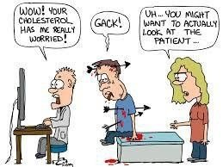
Clinical skills

Slide 9
What are “Clinical skills”
Medicine is learned by the bedside and not in the classroom. (Sir William Osler – 1849-1919)
Foundation of clinical medicine – particularly nuanced history taking and physical examination.
A “good” medical history is indispensable to making the correct diagnosis
“In most cases, a good history and physical examination will lead you to make the correct diagnosis and this is critical – your diagnosis will more often than not seal the fate of your patient...” Talley and O Connor 8th edition.

Slide 10
Our goals…
“ The goal of the Clinical Skills Program is to create a learning environment that facilitates the acquisition of a skill set that includes communication, physical examination, and procedural skills. During the undergraduate program, these skills will be integrated with cognitive skills, clinical reasoning, and medical humanities, contributing to an evidence-based approach to diagnosis and treatment and a patient-centered approach to care.”
Training skilled clinicians who derive intrinsic joy from achieving excellence in patient care.

Slide 11

Your goals
Pass the OSCE!
1
Pass the OSCE!
2
Pass the OSCE !
3
Learn clinical skills
4

Slide 12

Why learn clinical skills?

Slide 13
Why clinical skills are (still) relevant?
The bulk of medical diagnoses are made with a combination of history taking and physical examination, not investigations.
Tests ordered blindly or referrals made without an adequate history can lead to misdiagnosis
Referrals for investigations made without an adequate history can be miscoded (e.g. ischemic colitis) or not read with the right “frame” in mind.

Slide 14
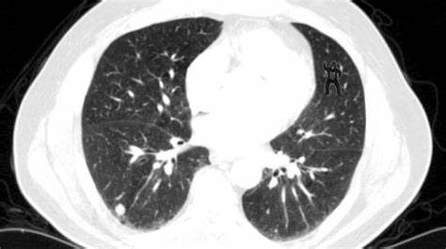

Slide 15
What I learned from my toddler
You see what you know, and you find what you’re looking for.

Slide 16
Why clinical skills?
Communication skills are fundamental to what makes this job best done by human beings
The scientific method
Fun
Intrinsic motivation

Slide 17
Clinical Skills
Communication Skills
The ‘Medical’ Interview
Physical Assessment
Procedural Skills
Lab Medicine
Medical recording and reporting

Slide 18
Clinical Skills M0
Foundational Interviewing Skills
Medical History Taking
Variable afternoons (groups will alternate)
SP 1 and SP 2
-Standardized Patients (SPs) will portray patients to help refine communication skills
SP 3
- integrates communication skills while obtaining a medical history

Slide 19
Clinical Skills Module 1
Pediatric Communication Skills
Lab Medicine
Procedural Skills
Physical Examination Skills
Communication Skills
Nutritional Assessment
Community Geriatrics
Adolescent Communication Skills
Male Urogenital Examination
Obstetric History and Prenatal Form completion
Community Exposures

Slide 20
Clinical Skills Module 2
Ward-based teaching
Procedural Skills
Lab Medicine
Transplant and Organ Donation (Lecture)
Clerking Physical Examination
Patient Volunteers
Physical Examination Skills
Communication Skills
Assigned Studies
CPA (Comprehensive Patient Assessments)
Community Exposures

Slide 21
Clinical Skills Module 3
Experiencing Disabilities
CPA (Comprehensive Patient Assessments)
sCPA (standardized Comprehensive Patient Assessments)
Communication Skills

Slide 22
Learning Environment
College of Medicine and other University resources
Clinical Learning and Simulation Facility (CLSF)
Community Resource Agencies
Winnipeg Regional Health Authority’s (WRHA) hospitals and community-based facilities
Urban and rural private practice clinics
Rural and remote settings throughout Manitoba

Slide 23
Community Exposures
2 half-day placements in community clinics in both first and second year
Ms. Debi Prysizney
Program Asst. - Pre-Clerkship, Family Medicine
Max Rady College of Medicine
204-789-3390
debi.prysizney@umanitoba.ca

Slide 24
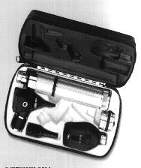
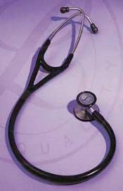
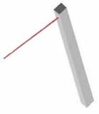

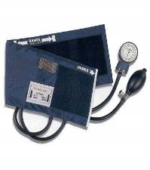
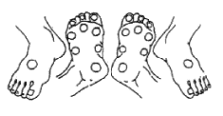
Clinical Instruments

Slide 25
Evaluation
Exam Dates
Year 1 (Class of 2029) | Date |  | Year 2 (Class of 2028) | Date
Formative OSCE – Part 1 | November 27, 2025 |  | Formative OSCE | Dec 2, 2025
Formative OSCE – Part 2 | December 4, 2025 |  | 6-Station OSCE | January 10 & 11, 2026
6-Station OSCE | February 21 & 22, 2026 |  | 6-Station OSCE | May 2 & 3, 2026
6-Station OSCE | April 18 & 19, 2026

Slide 26

OSCE
Versatile multipurpose evaluative tool that can be utilized to evaluate health care professionals in a clinical setting​
Standard mode of assessment of competency, clinical skills, and counselling sessions ​
Assesses competency, based on objective testing through direct observation​
Advantages: evidence-based, reproducible, and objective​
All students get examined on predetermined criteria on same or similar clinical scenario with marks written down against those criteria thus enabling recall, teaching audit and determination of standards

Slide 27

More on the OSCE soon….but
How to start preparing for the OSCE

Slide 28
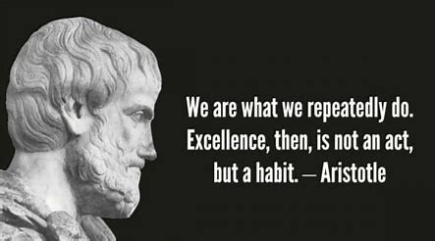

Slide 29
Resources
Physical exam videos on Entrada
Talley and O’Connor 8th edition available online through U of M libraries
Supplemental notes
Office hours

Slide 30
Resources:
Required Texts:
See syllabus for required texts – most are available through the U of M libraries website.
Talley and O’Connor “Clinical Examination A systematic guide to physical diagnosis”, 8th edition.
Bates’ Guide to Physical Examination and History Taking, 13th edition (2021). ISBN: 9781496398178

Slide 31
Resources:
Recommended (and available electronically via Toolkit)
Cole “The Medical Interview: The Three Function Approach”
Stewart “Patient-Centred Medicine Transforming the Clinical Method” 2003
The Enhanced Calgary-Cambridge Guide to Medical Interviewing
“Handbook of Clinical Skills: A Practical Method” Chapter 1. Introduction pages 3-9

Slide 32
Recommended
Shi et al. ”Essentials of Clinical Examination Handbook” 8th edition (2018)
Goldbloom “Pediatric Clinical Skills” 4th edition

Slide 33
Additional Resources
Library Toolkit:
Electronic versions of texts
Videos – locally produced (coming soon)
Other resources: online video platforms, senior colleagues
No one standard “correct” reference
  all medical students learn differently

Slide 34
Evaluation of the course
Evaluation of the Course
Clinical Skills Session Evaluation:
Session Evaluations (paper) are available for Communication and Physical Examination Sessions - completed by students after each session
Session-specific surveys available in Entrada.
Reviewed at the end of each module/year by the Course Leader and CS student representatives.
Clinical Skills Course Evaluation:
Electronic survey, available after each term (Fall/Winter) is completed. Completed by students within 5 working days.
A Program Evaluation meeting takes place between the CS student representatives and the Course Leader to discuss survey results.

Slide 35
Preceptor Evaluation
Session specific via ENTRADA
-provides feedback to the course directors
Session Evaluations (paper)
-immediate feedback on preceptor and session
Be honest BUT also respectful and pragmatic!

Slide 36
Program Evaluation
Course Survey
notified in ENTRADA when survey is open
data provides feedback to the Course Director
Clinical Skills Student Reps

Slide 37
A few words on ‘Professionalism’
Respect – communities we serve, colleagues, and above all, PATIENTS
Communication
Responsibility
Attitude

Slide 38
Teachers’ Responsibilities
Treat all learners with respect and fairness
Treat all learners equitably
Ensure that resources that supplement teaching sessions are presented in an effective format for learning
Provide timely feedback with constructive suggestions for improvement
Rarely, clinical responsibilities may cause changes in schedules at the last minute.

Slide 39
Learner’s Responsibilities
Be prepared for teaching sessions and clinical encounters
Be on time for didactic sessions, clinical encounters, and other scheduled events
Communicate concerns/suggestions regarding the curriculum, didactic methods, teachers, or the learning environment in a professional manner
Dress appropriately
No scents

Slide 40
Learner’s Responsibilities
Treat all fellow learners and teachers with respect and fairness
Treat all fellow learners and teachers equitably
Commit the necessary time and energy to your studies
Attendance at all clinical skills sessions is mandatory

Slide 41

Questions/comments/concerns?
Quinlan.Richert@umanitoba.ca

Slide 42
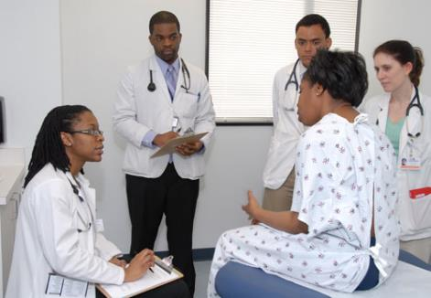
Clinical Skills, Communication Skills, and the Medical History

Slide 43
Communication Skill and the Medical History
Following this session and review of the required reading, the student will be able to discuss:
The importance of communication skills in obtaining a ‘medical history’
The components of the medical history
The SOAP format of the medical record

Slide 45
Communication Skills
Use Relationship Building Skills:
Allow patient to express self – avoid the urge to interrupt
Be attentive and empathetic both verbally and non-verbally
Use appropriate language commensurate to the encounter
Communicate non-judgemental, respectful, and supportive attitude

Slide 46
Communication Skills
Attend to Flow:
Be organized and logical
Manage time effectively in the interview
Gather information
Assess understanding!!
Develop a management plan
Provide closure

Slide 47

Components of the History
Patient Profile and Introductory Information
Chief Complaint
History of Present Illness
a. Medication History
b. Habits/Lifestyle
Past medical History
Family History
Social History
Review of Systems

Slide 48

Patient Profile & Introductory Information
Date and Time
Identifying Data:
Age
Gender identity
Race or Ethnic origin
Birthplace
Occupation
Other
Source of Referral
Source of the History
Reliability of Source

Slide 49
Those first….fateful questions
Hi, how are you?
What brought you to the hospital today?
“What has been the trouble lately”
What made you come to the emergency department today?

Slide 50
Reason For seeking Medical Attention
(Chief Complaint)
The one (or more) symptoms that
prompts the visit

Slide 51
History of Present Illness - Foreground
Clarifies the reason for seeking medical attention
A detailed description of the patient’s problem(s), delineating the presenting symptoms), and documenting the core dimensions of any complaint……..

Slide 52
Core Dimensions
Onset
Location/Radiation
Duration
Quality (character)
Aggravating/alleviating Factors
Timing/setting
Associated Symptoms
OLD CARTS or SOCRATES

Slide 53
SOCRATES
Site - where is the symptom, localized/diffuse. Some may not be (dyspnea)
Onset (acuity matters – hyperacute/acute/subacute/chronic)
Character – what does it mean when you say…sharp/dull/stabbing/boring/pressure like
Radiation – e.g. pericarditis
Alleviating factors
Timing
Exacerbating factors – what makes it worse
Severity - how bad is it ?
Associated symptoms – though one symptom may provide the clue, it is usually a constellation of symptoms that reliably suggest a diagnosis

Slide 54
History of Present Illness (cont’d)
A record of the relevant systems review
A notation of current therapy and response
Details of previous episodes
Extent of functional disability as a consequence of the illness
Assess the reason behind a patient’s visit and the specific aspect of the complaint they would like to address
A story: has a beginning, middle, and an end
  “Baseline” statement(s)
  “Then,” statements

Slide 55
History of Present Illness (cont’d)
Assess the reason behind a patient’s visit and the specific aspect of the complaint they would like to address:
FIFE mnemonic
Function – how is it affection their life?
Ideas – what do they think they have?
Fears – is there anything they are particularly afraid of?
Expectations – what do they hope this visit will achieve?

Slide 56
Medication History
A list of current medications (prescription, non-prescription) and other therapies (herbal and dietary supplements)
Past treatments that have bearings on the present(chemo/radiation/steroids)
A list of drug allergies and notation regarding the reaction

Slide 57
Past Medical History
Explore prior:
Illnesses
Injuries
Hospitalizations for medical or surgical reasons
Immunizations
Menstrual and reproductive history
Blood transfusions
Past screening tests etc.

Slide 58

Social history
Education
Occupation (recent and past)
Relationships / support systems
Religious affiliations / spiritual beliefs
Hobbies
Exercise
Diet
Supplements
Alternative therapies

Slide 59
Social history
Inquire regarding the use of:
Caffeine
Tobacco
Alcohol
Cannabis
Recreational drugs (prescription & non-prescription drugs)
Over-the-counter medications

Slide 60
Family History
The ages, state of health or cause of death of parents, siblings, partner, children
Documentation of hereditary diseases or illnesses that occur in the family
Ask tactfully about diseases like epilepsy, cancer, or mental illness

Slide 61
Review of Systems
Inquiry into the function of each major body system to identify problems that the patient may not have mentioned, or that were not elicited in the history of the present illness. See Talley and O’ Connor – Questions box 1.1 (chap 1 for details)
General: recent weight change, energy level, fever, sleep, appetite
System specific: high blood pressure, high cholesterol etc.
Special attention to systems related to chief complaint

Slide 62
Components of the History (Summary)
Patient Profile and Introductory Information
Chief Complaint
History of Present Illness (FIFE)
a. Medication History
b. Social History/Lifestyle
Past Medical History
Family History
Personal and Social History
Review of Systems

Slide 63
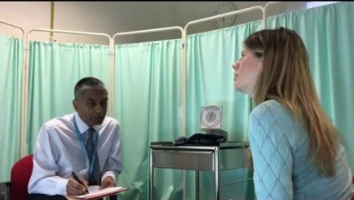
History Taking
https://youtu.be/vlfdybUCzFw

Slide 64
Physical Examination
Usually occurs after the history is complete and is either:
Focused – to the system(s) involved
“Complete” or clerking physical –performed when a patient is admitted to hospital

Slide 65
Physical Assessment
Based on knowledge of anatomy and basic sciences, observation skills and practice
Use the information gathered from the history to guide the physical examination that will allow the formation of a differential diagnosis
The differential diagnosis will then guide the plan for investigations (if required), treatment, and follow-up

Slide 66
Physical Examination
Skills Labs
Respiratory
Head and Neck
Cardiovascular
Nervous system
Abdominal examination
Musculoskeletal examination

Slide 67
Physical Examination Skills Labs
Student volunteers – this is voluntary/ you can opt out if you want.
Dress appropriately - ENTRADA
Respect your classmates
Observation*
Draping –handout, video, reviewed with physical examination labs
Preparation – review reading and videos
Practice

Slide 68
Physical Examination Skills Labs
Surface anatomy
Demonstration of technique
Observation and feedback
Session Notes and required textbook references are the standard –
preceptors bring their clinical expertise
- each group will have a slightly different experience
Heterogeneity is okay; but we will take steps to mitigate it too

Slide 69
Elements of the Physical Examination
Inspection
Palpation
Percussion
Auscultation

Slide 70
Reporting and Recording
Gathering information throughout the patient encounter yields a variety of information that is usually organized after the interview and examination are complete
  Take scratch notes during the encounter and record vital signs as you are obtaining them
  Later in your career/training: develop the skills to internalize and reproduce this information without taking notes – but don’t worry about this just yet
Information gathered becomes the patient record

Slide 71
SOAP Format for Focused Visits
S – Subjective- (what the patient describes)
Chief complaint, pertinent ROS, medications, allergies, lifestyle factors, past, family, and social history
O – Objective (what you find on examination)
A – Assessment (what you think Dx, DDx)
P – Plan
* date, name, and signature

Slide 72
SOAP Note - Sample
August 30, 2017. *
11:05 *
Cardiology Ward A Medical Student Note
S: No chest pain (CP) overnight. No events, new issues or concerns.
O: Vital signs: BP 126/84 mm Hg. HR 65 bpm, RR 16 bpm, Sat. 98% on RA, Weight 98 kg
Alert, awake, oriented x3, in NAD, euvolemic, JVP 3 cm ASA at 30 degrees, clear to auscultation bilaterally, regular rate and rhythm, normal S1 and S2, no murmurs, rubs or gallops, abdomen soft, bowel sounds present, no clubbing, cyanosis or edema.
A: 53-year-old-man admitted with acute coronary syndrome (ACS): Non-ST-segment Myocardial Infarction (NSTEMI). CP free. No new issues.
P: 1. Continue aspirin, heparin, statin and ACE inhibitor.
2. For angiogram later today.
3. ACP- R.
4. Disposition: remain in the ward until completes treatment.
Jon Snow, MS 3*

Slide 73
OSCE – Opportunity to review
Communication Skills and the Medical History
Clinical Skills – Patient Centered Method

Slide 74
I hear and I forget
I see and I remember
I do and I understand
Confucius 551-497 BC

Slide 75
“He who studies medicine without books sails an uncharted sea, but he who studies medicine without patients does not go to sea at all.”
Sir William Osler 1849-1919

Slide 76

Break time…

Slide 77
Communication Skills
Objectives:
1. Describe 6 components of the patient-centered clinical method
2. Contrast the definitions of “Disease” and “Illness”
3. Differentiate between physician’s agenda and patient’s agenda
4. Understand “Common Ground” that synthesizes 2 agendas and leads to better patient outcomes

Slide 78
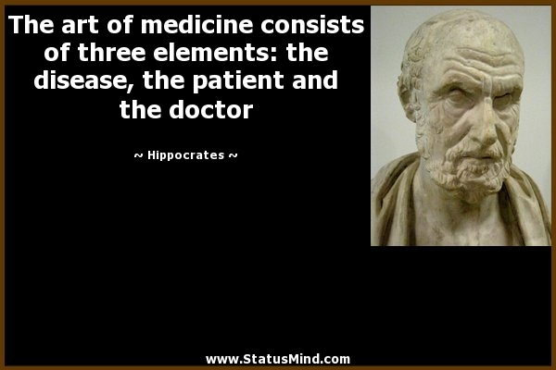

Slide 79
The Evidence
Effective communication skills impact patient satisfaction and health outcomes
Relationship demonstrated between effective communication and recovery of psychological/functional status
(Stewart, Brown, Weston, McWhinney, McWilliam, Freeman, 1995)
We also now know that high-quality communication is paramount in avoiding professional society complaints and medico-legal conflict

Slide 80
Communication Skills
Communicating with patients & family members
Communicating with colleagues & other members of the interdisciplinary healthcare team

Slide 81
Communication Skills
Communicating with patients & family members
Communicating with colleagues & other members of the interdisciplinary healthcare team

Slide 82
Effective Communication Skills in Medicine
Verbal and non-verbal communication
Patient-centered approach
Attentive Listening skills
Language skills
  Verbal (talking with the patient): use open-ended questions, avoid medical jargon, clarify concepts
  Written (letters, medical record entries, etc.)
  Expressive (body language)
Receptiveness (picking up on the patient’s body language and cues)
Culture and age appropriateness (adapt communication to the individual patient)
Attitudinal skills (ability to hear, understand, and discuss an opinion, idea, or value different from your own while respecting the patient’s autonomy)
Empathy

Slide 83
Patient-Centered Method (“6-components”)
1. Exploring both the disease and the illness experience
    a) differential diagnosis
    b) dimensions of illness (FIFE)
2. Understanding the whole person
    a) life history and personal/developmental issues
    b) context

Slide 84
Patient-Centered Method (cont’d)
3. Finding common ground regarding
    a) problems and priorities
    b) goals of treatment
    c) roles of physician & patient in management
4. Enhancing the patient-physician relationship
    a) characteristics of therapeutic relationship:
      open communication
      greater self-awareness

Slide 85
Patient-Centered Method (cont’d)
5. Health promotion/disease prevention
  a) risk reduction
  b) early detection of disease
6) Effective use of resources
  a) time
  b) allied health care professionals
  c) external sources of information
Stewart et al. 1995

Slide 86
Disease and Illness
Disease (bio-medical perspective):
  focus on the body, not the person
  a particular disease is what everyone has in common
  abnormalities of structure or function
    both physical and mental
  clinician’s area of expertise
  Physician’s agenda

Slide 87
Disease and Illness (cont’d)
Many patients present with psychosocial issues at the root of their complaints
Sometimes the diagnosis remains unclear/uncertain

Slide 88
Patient’s Agenda (FIFE)
Feelings about what is wrong
Ideas about problem or treatment
Function: impact of problem on daily life
Expectations of physician/visit
  Why did they come now? And why to me?

Slide 89
The Illness Experience
Illness (the patient’s perspective)
Questions:
  “How would you describe the problem that has brought you to me?”
  “Does anyone else you know have these problems?”
  “What do you think is causing the problem?”
  “Why do you think this problem has happened now?’

Slide 90
Types of questions
Open-ended questions- encourage a full narrative, allow the patients to express their own knowledge/feelings (patient’s agenda)
  Start with open-ended questions
  Active listening during the patient’s answer
  Do not interrupt
Sample open-ended question:
What can I do for you today?

Slide 91
Types of questions (cont’d)
Closed-ended questions- elicit a short or single-word answer (yes/no)
  Use once the patient has completed their narrative
  Use for clarification
Sample closed-ended question:
Are you allergic to any medications?

Slide 92
Types of questions (cont’d)
Leading questions- based on your own assumptions (doctor’s agenda) and lead the patient to answer what they think you want to hear
  Avoid this type of question
Sample leading question:
You do not smoke, do you?

Slide 93
Social/Developmental Context
Stage of life cycle
Living situation
Major roles: work, school, parent, caregiver
Support system
Culture/religion
Have there been recent changes?

Slide 94
Finding Common Ground
Reach agreement concerning:
  1. Nature of the problem and priorities
  2. Goals of treatment
  3. Roles of the physician and patient
Need to incorporate FIFE
Non-verbal communication: SURETY

Slide 95
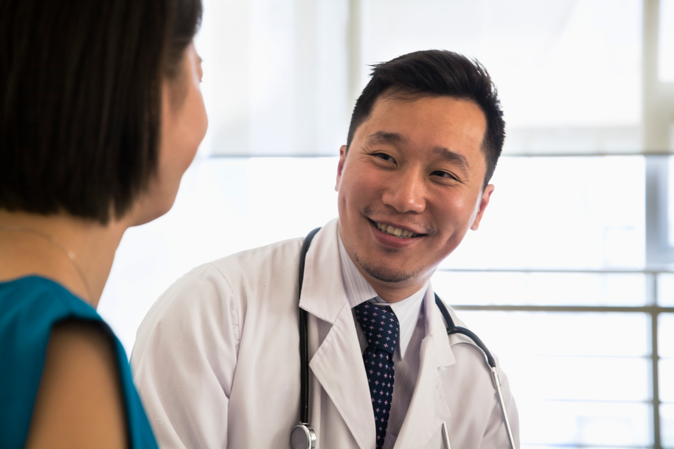
SURETY
Sit at an angle
Uncross legs and arms
Relax
Eye contact
Therapeutic touch
Your intuition
        Stickley & Stacey, 2009

Slide 96
Finding Common Ground Pivotal Questions
“What are you thinking about all of this?”
“How are you feeling hearing this summary?”
“What do you want to do now?”
“Where should we go from here?”

Slide 97
Summary
Patient-Centered Medicine
  6 Components
  Disease vs. Illness Experience
  Doctor’s vs. Patient’s Agenda
  Common Ground
Questions?

Slide 98
Communication Skills
Communicating with patients & family members
Communicating with colleagues & other members of the interdisciplinary healthcare team

Slide 99
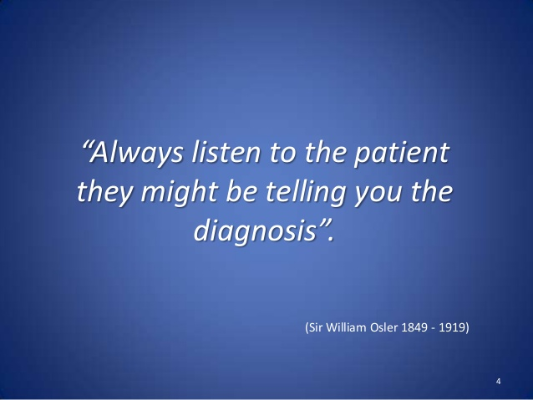

Slide 100

Rapport & Empathy

Slide 101
Barriers to Effective Relationships
Physician barriers
  Not listening
  Inattentive
  Bias
  Too narrow a focus
  Failure to recognize patient’s non-verbal behavior

Slide 102
Barriers to Effective Relationships
Patient Barriers
  Misperception of physician
  Feelings of fear, shame, guilt
  Hidden agenda

Slide 103
Clinical Skills
Communication Skills
The ‘Medical’ Interview
Physical Assessment
Procedural Skills
Lab Medicine
Medical recording and reporting

Slide 104
Empathy
“An act of imagination, of extending yourself beyond yourself, of feeling what you do not innately feel by invoking it.”
    (Solnit R. The separating sickness. How leprosy teaches empathy. Harper’s. 2013;6:50–7.)

Slide 105
Empathy
“We are all patients sooner or later, but particularly at the beginning and end of our lives” Christopher Booth, On Being a Patient. Oxford Textbook of Medicine. 6th edition, 2020.
How/What you would feel if you had walked a mile in someone else’s shoes

Slide 106
On disease
Different diseases have different “journeys”.
A patient with end stage heart or liver disease may maintain a self-image as a fully intact person with a “defective” part or a diseased organ (“ a bum ticker”). Contrast this with the patient with a malignancy, who is viewed both by society and themselves differently.

Slide 107
On disease
“Cancer is an exception to the coordinated interaction among cells and organs. In general, the cells of a multicellular organism are programmed for collaboration. Many diseases occur because the specialized cells fail to perform their assigned task [but] cancer takes this malfunction one step further. Not only is there a failure of the cancer cell to maintain its specialized function, but it also strikes out on its own”…in a traitorous manner. “The cancer patient feels that [they], and not just a body part, is diseased”. (Longo, D.L. Approach to the patient with Cancer. Harrison’s Principles of Internal Medicine 19th ed. 2015

Slide 108
Rapport
A harmonious relationship
To establish a connection with your patients

Slide 109
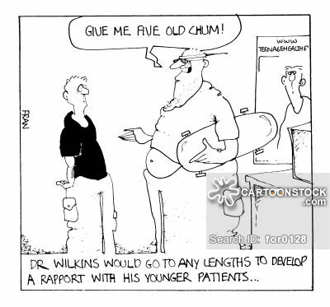

Slide 110
PEARLS Statements/Actions
Partnership:
  “Let’s look together at whether we’re doing everything to make certain you do not suffer more complications from diabetes.”
  Using “we” statements, rather than “you” statements
Empathy:
  “Having diabetes must be difficult for you.”

Slide 111
PEARLS (cont’d)
Apology:
  “I’m sorry, that must be very difficult.”
  The unreserved apology vs. the conditional apology.
Respect:
  “Independence has been your great strength since you were a teenager.”

Slide 112
PEARLS (cont’d)
Legitimization:
  “Most people find the frequent vital signs checks to be inconvenient.”
Support:
  “I am here to help you in any way I can.”

Slide 113
PEARLS in action (Longo, D.L. Approach to the patient with Cancer. Harrison’s Principles of Internal Medicine 19th ed. 2015
A skilled physician “also has much to offer the [cancer] patient for whom curative therapy is no longer an option”
Guilt and frustration over the inability to cure or effectively treat a patient and the pressures of a busy schedule often limit the time spent with a patient receiving “only” palliative care.
Resist.
“It is important to remember the comfort that is provided by holding the patient’s hand, continuing regular examinations, and [simply] taking the time to talk”.

Slide 114
PEARLS (cont’d)
How would you respond to these people?
  “I’m scared I may be pregnant”
  “I found a lump in my breast (appears very frightened)”
  “I hurt my leg (grimacing in pain)”
  “I don’t want to take insulin for my (poorly controlled) diabetes”
  “I don’t want chemotherapy”

Slide 115
Summary
Effective Clinical Interviewing/Communication
  Calgary-Cambridge Framework
    Initiating the session
    Gathering information
    Physical examination
    Explanation and planning
    Closing the session
  Rapport & Empathy
    PEARLS

