Slide 1
Cost of Medical Education
Orientation 2026: Financial Literacy for Medical Students
Dr. Wendy Schultz – Financial Counsellor, UGME and PGME Student Affairs
Dr. Aaron Chiu – Associate Dean Quality Improvement and Accreditation
Mark Venton – Doctors Manitoba

Slide 3
Objectives
By the end of the session, the participants will:
Understand the typical cost of medical education at Max Rady College of Medicine
  Be prepared for periods of higher cost outlays
Be familiar with historical debt incurred by local students and compare to national averages
Review anticipated earnings:
  Clerkship and residency
  Future earnings – average income for specific medical fields
Be familiar with terms of Student Loans (provincial and federal) and how they differ from Line of Credit provided by financial institutions
Recognize the importance of disability insurance and life insurance

Slide 4
Disclosure
Wendy Schultz, PhD, CPA, CA: None
Aaron Chiu, MD, FRCPC, FAAP, MBA, ICD, FTMS: None
Mark Venton - Doctors Manitoba
  licensed advisor who sells disability and life insurance to members (does not receive commissions on sales)
Why are we here talking to you? Personal experience.

Slide 5
Lifetime Financial Status
Retirement
SAVINGS
Age
DEBT

Slide 6
Financial Realities for Physicians
Accumulating debt is a commonplace reality for almost everyone including medical learners
Medical professionals delay entry into workforce
  Greater accumulation of debt (educational and lifestyle)
  Shorter duration for generating income
  Offset by higher earning potential
Continue to accumulate debt during residency and early practice
Greater amount of debt accumulated leads to longer time until establish net savings and shorter duration to establish retirement savings

Slide 7
Lifetime Financial Status of Physicians
Retirement
SAVINGS
Age
DEBT

Slide 8
Tuition Cost of 1-Year Medical School
Manitoba (2026): Med 1 Tuition
  $12,549
Year 1 Total with fees (2026)
  $14,800 (estimate)
Tuition Support Payment
  $1,000 rebate for each student
2026 | Tuition
U British Columbia | 20,803
Simon Fraser U (12 months) | 31,204
U Alberta | 10,229 (16,463 with fees)
U Calgary (12 months) | 25,748
Saskatchewan | 22,773
Northern ON School of Med | 23,711
Western Schulich | 24,000
Toronto | 23,550 (ON), 28,880 (non-ON)
Toronto Metropolitan | 27,375 (ON), 30,816 (non-ON)
McMaster (12 months) | 25,130
Queen’s | 25,540
Ottawa | 26,899
McGill (QC/non-QC) | 6,547/38,008
Dalhousie | 25,568
Memorial | 14,250 (19,968 with fees)

Slide 9
Anticipated Cost of MD from Max Rady College of Medicine
Total four-year cost of tuition and university fees based on 4% yearly increase in tuition and fees $63,000
If add housing $1,450/month, food $350/month
$149,400
NOT including inflation.
NOT including other personal expenses.

Slide 10
Additional Costs of Medical Education
External electives (summer electives and fourth year electives): $2,500 and up
CaRMs Application and Tour (application for residency)
  CaRMS match participation fee: $302
  Program application fee: $66 per program above initial 4
  Tour (travel and accommodation): $0 (virtual since COVID)
MCCQE Part 1 Examination: $1,500
Total Additional Costs: $7,066
(2 external electives, apply to 8 programs for CaRMS)

Slide 11
Total Cost of Four Years MD Degree at MRCM
Tuition and educational fees
Basic rent and food
Other typical costs for fourth year
$156,500

Slide 12
Is your debt level affecting your stress level?
Anticipated debt level after medical school (CND$)
AFMC GQ (2026) | Out of 1173 graduating Canadian medical students
Yes, a lot | 22.1%
Yes, a little | 44.2%
No | 33.7%
AFMC GQ (2026) | Out of 1173 graduating Canadian medical students
$0 to $25,000 | 26.3%
$25,001 to $50,000 | 14.8%
$50,001 to $100,000 | 19.5%
Over $100,000 | 35.4%
Uncomfortable to share | 4.1%

Slide 13
Comparison Manitoban to Canadian Student Debt
AFMC SURVEY | 2023 |  | 2024 |  | 2025
 | Manitoba | National | Manitoba | National | Manitoba | National
Median Medical School Debt | $60,000 | $98,700 | $60,000 | $90,000 | $65,000 | $90,000
Percentage graduate with debt related to medical studies ≥ $100,000 | 34% | 50% | 32.9% | 46.9% | 37.2% | 48.3%
Percentage graduate with debt related to medical studies ≥ $200,000 | 12.5% | 14.7% | 13.4% | 16% | 16.7% | 15.7%

Slide 14
AFMC 2026
67.7%
MRCM graduates who answered stated finances was a factor negatively impacting wellbeing/wellness/quality of life

Slide 15
Other Non-Educational Expenses
Housing
  Sharing an apartment versus living on own
Food and drink
  Dining out/order in versus homemade; coffee and drinks
Automobile use and maintenance
  Public transport versus personal vehicle
  Purchase of new versus used vehicle
Vacation travel

Slide 16
Income During Medical School
During Pre-Clerkship Years:
  Summer Research Program, B.Sc. Med (2 year): $7,500 each summer
  Home for the Summer (clinical exposure in rural Manitoba Year 1): $20/hour
Clerkship Stipend:
  $5,100 paid over second half of Year 3 and first half of Year 4.

Slide 17
Salary of Residents
 | Manitoba As of July 1, 2026 | British Columbia as of April 1, 2026 | Ontario as of July 1, 2025 (new contact under negotiation)
PGY 1 | $72,171 | $69,311 | $73,367
PGY 2 | $77,415 | $77,253 | $79,669
PGY 3 | $83,372 | $84,131 | $85,564
PGY 4 | $89,328 | $90,514 | $92,700
Salary is NOT take home pay
Taxes approximately 25-30%
Most residents accumulate more debt versus pay down debt

Slide 18
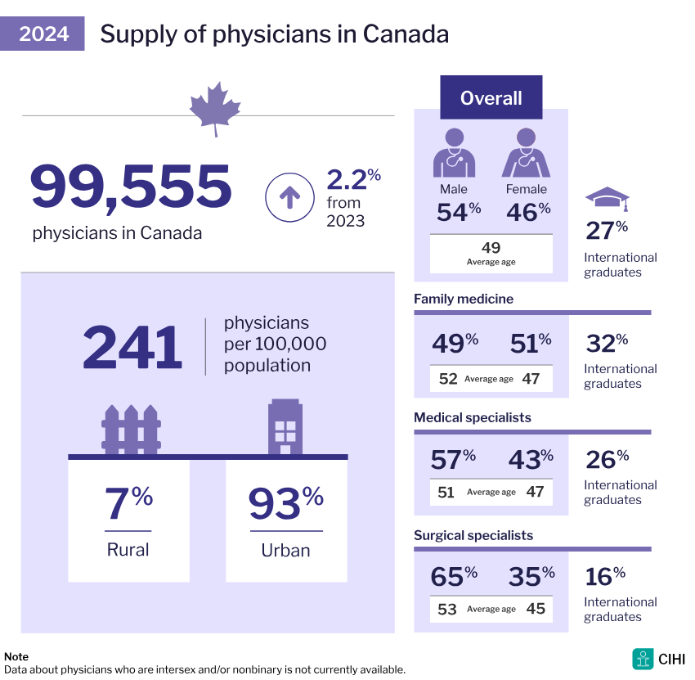
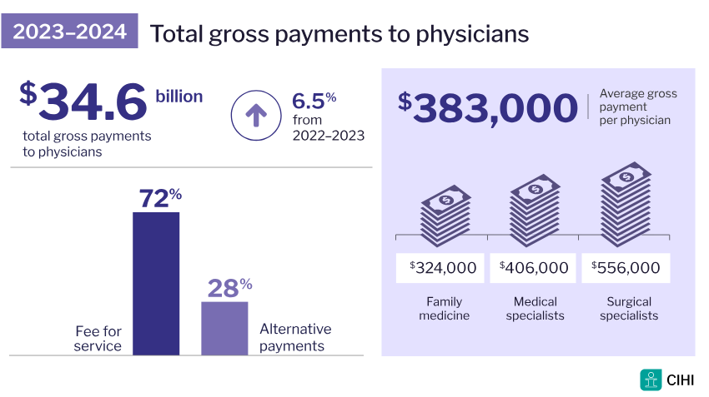

Slide 19
Government Student Loans
Manitoba and Federal*
  Payment free until 6 months after graduation or leave school
  No interest accumulated while going to school full time or while repaying loan
Canada Student Grant for full-time students
  Up to $4,200/year (income dependant)
Manitoba bursary
  Amount varies
*Canada Student Loans became permanently interest free effective April 1, 2023

Slide 20
Government Student Loans
If applied for student loans in the past but not in current year:
  Must notify about ongoing studies
  Visit the National Student Loan Service Centre website to complete a confirmation of enrolment request

Slide 21
Government Student Loan Forgiveness
Canada Student Loan forgiveness for family physicians/family practice residents working in underserved rural or remote communities:
Increased from $40,000 up to $60,000 as of 2023-24, spread over 5 (non-consecutive) years
An eligible community is defined as:
  A rural area, or
  A population centre with no more than 30,000 people living in it.
  Designated communities identified by postal code
Canada Student Loan forgiveness for family doctors and nurses

Slide 22
Bank Offered Line of Credit
Each bank offers a professional student line of credit
None require a co-signer
All offer a package with credit card and bank account
Total credit available of $350,000 to $400,000
  Some offer additional credit once in residency
  Annual borrowing limit varies from no restrictions to yearly restrictions

Slide 23
Bank Line of Credit – Interest Rate
Typical interest rate is prime minus 0.25%
Current prime rate is 4.45% but will vary over course of loan (variable rate)
  Last year it was 4.95%
Current LOC interest rate is 4.2%
  Yearly interest on $100,000 borrowed on LOC is $4,200
  Two years ago, interest rate was 6.2% and interest was $6,200
  Economists predict BOC will hold rates steady through 2026, but decisions are dependent on the state of the Canadian economy
  Canada’s annual inflation rate was 2.8% in June 2026.

Slide 24
Bank Line of Credit (LOC) – Interest Charge
All LOC charge interest once access funds within credit line
Require regular payment of interest
  Most students end up using LOC to pay interest charge
No payment of principal while in medical school or residency

Slide 25
Bank Line of Credit (LOC) – Repayment
Some banks offer a 1-2 year grace period once finish residency
Afterwards, conversion to loan with amortization period or to professional line of credit
  Amortization varies from 10-20 years and can vary depending on amount borrowed
Interest rate during repayment may differ from initial rate and may require renegotiation
If unable to complete degree/training – still required to repay loan

Slide 26
Disability Insurance - Optional for Med Students
Protection during injury or illness that prevents you being a medical student (or Resident or Practicing Physician when earning an income).
  Income replacement insurance (wait… I’m a student and earn $0).
  Amounts offered: up to $1,500/month for Med1+2, $2,500 for Med3, $4,000 for Med4
Ability to earn income is your greatest financial asset… and physicians are not immune from suffering illness and injuries over the course of your career.

Slide 27
Disability Insurance - Optional for Med Students
As medical student, often:
  Younger and healthier than in future – less expensive for insurance.
  Do not need to provide medical evidence.
  Do not have clauses excluding pre-existing conditions.
  Benefits to age 65 if disability is permanent.
  Match to Manitoba for Residency?
    Mandatory Disability, Term Life and Accident Insurance via DRMB.
    Mandatory Health & Dental via Shared Health.

Slide 28
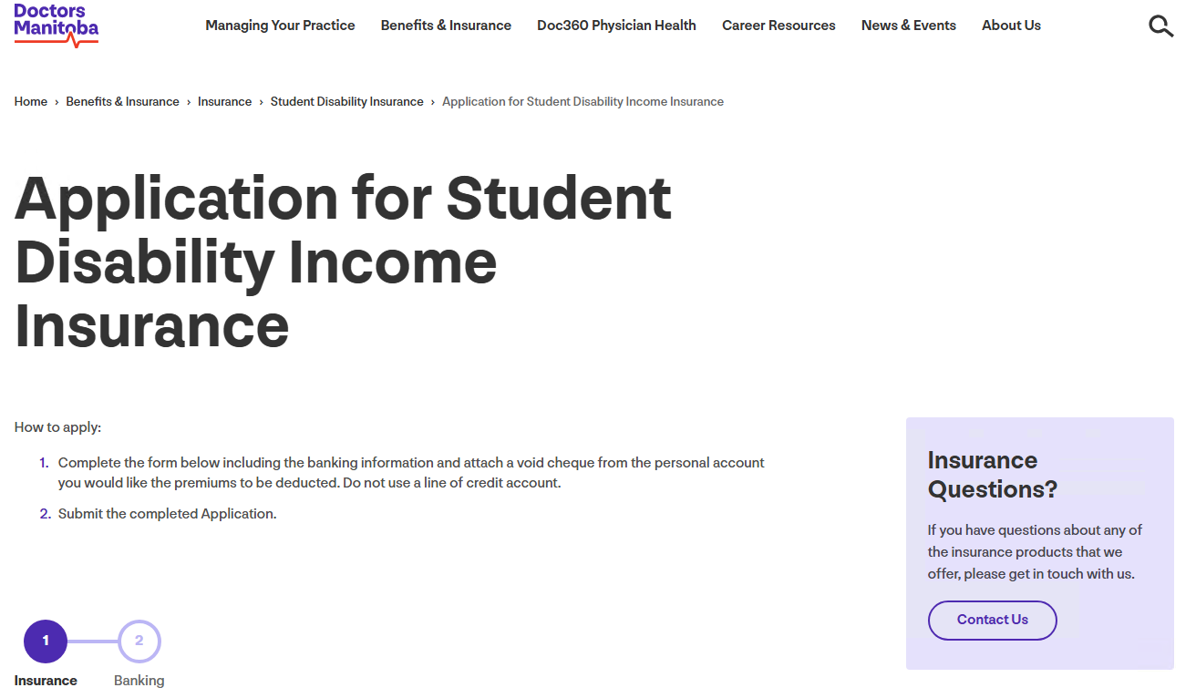
How to Apply for Student Disability Insurance:
https://doctorsmanitoba.ca/benefits-insurance/insurance/student-insurance/studentdi

Slide 29
Life Insurance - Optional
Protection for your estate and dependents in event of death
In event of death, life insurance provides funds to cover incidentals like funeral costs, but also covers any debts and provides financially for dependents (partner, children, etc.)
Need for life insurance as a student depends on your personal situation
  An individual with no dependents may not need life insurance
  A student with a co-signed LOC... should consider Term Life Insurance.

Slide 30
Objectives
By the end of the session, the participants will:
Understand the typical cost of medical education at Max Rady College of Medicine
  Be prepared for periods of higher cost outlays
Be familiar with historical debt incurred by local students and compare to national averages
Review anticipated earnings:
  Clerkship and residency
  Future earnings – average income for specific medical fields
Be familiar with terms of Student Loans (provincial and federal) and how they differ from Line of Credit provided by financial institution
Recognize the importance of disability insurance and life insurance

Slide 31
Contact?
Always available for discussion/advice:
Wendy Schultz: Wendy.Schultz@umanitoba.ca
Aaron Chiu: Aaron.Chiu@umanitoba.ca
Mark Venton: mventon@doctorsmanitoba.ca
Student Awards: AwardsUGME@umanitoba.ca

