Slide 1

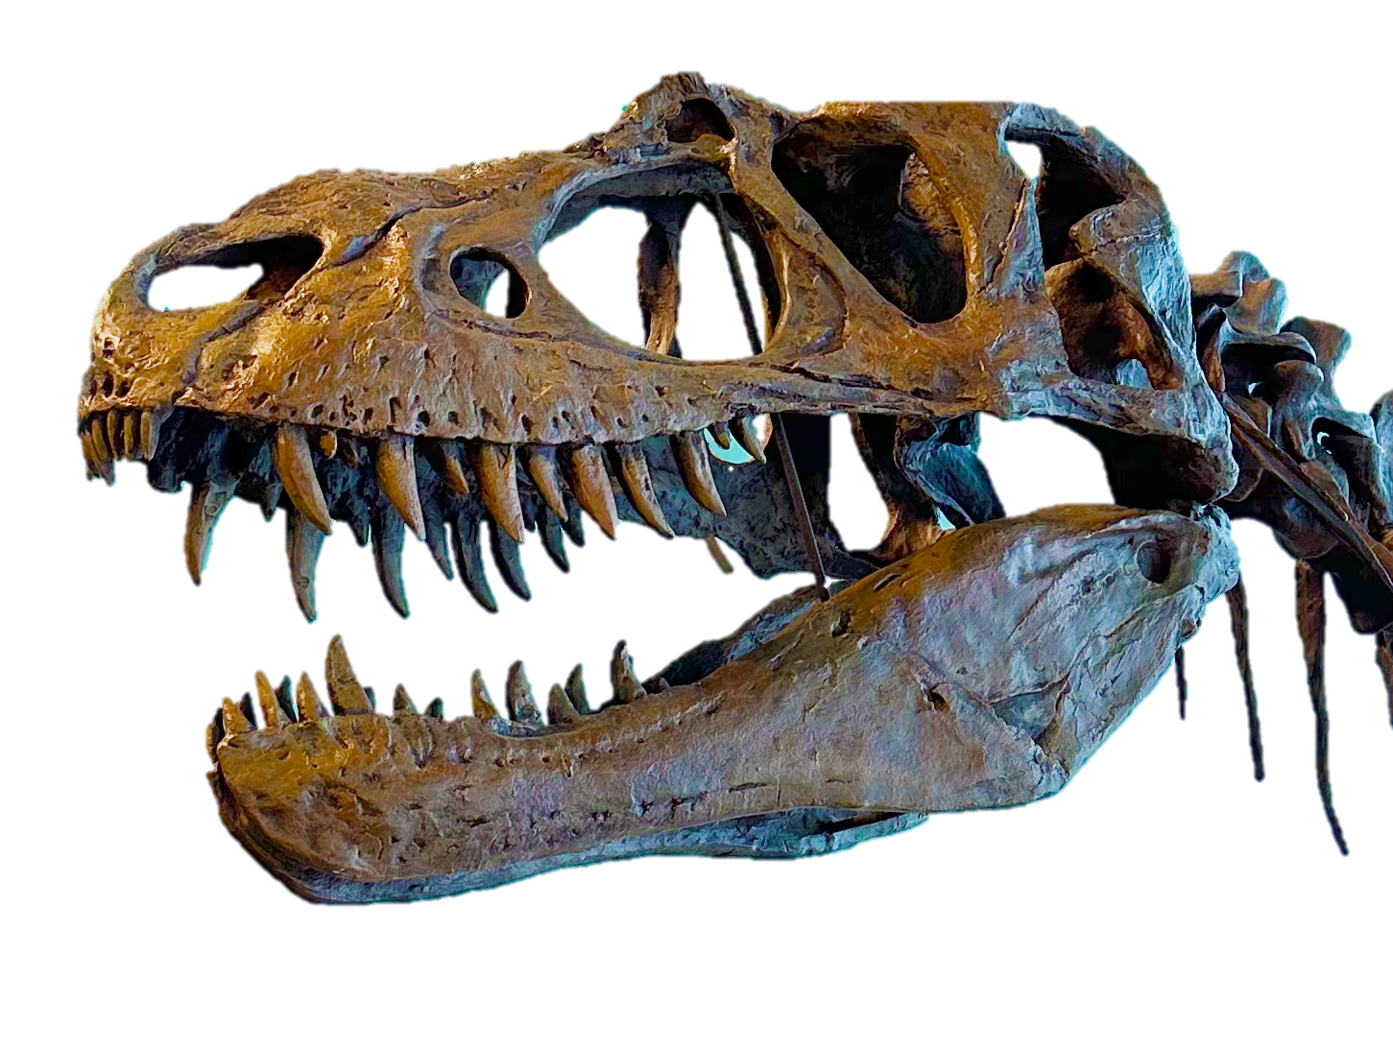
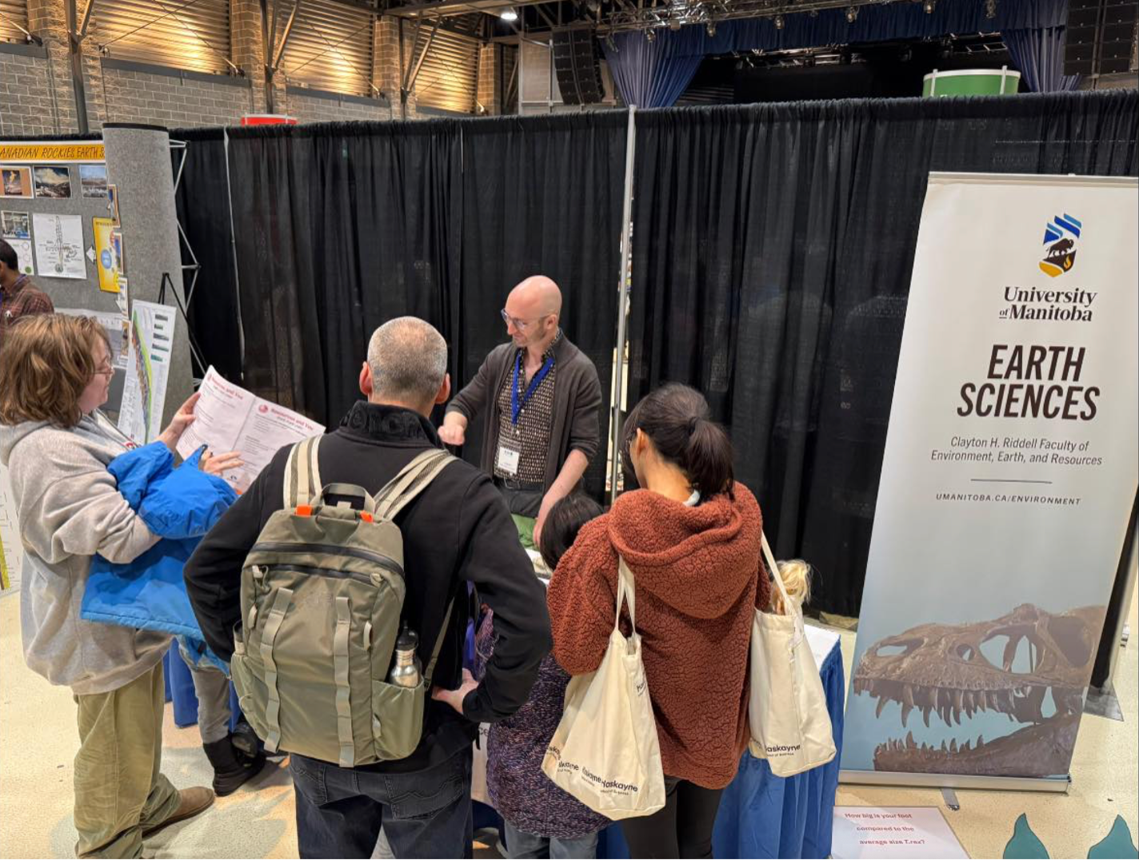
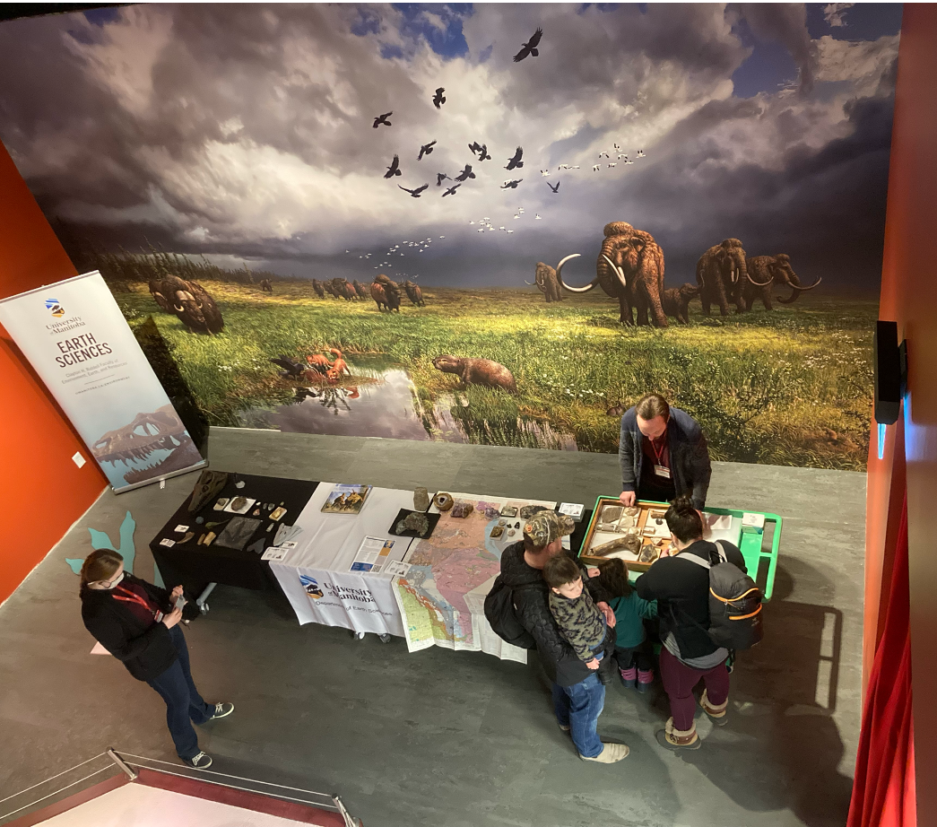
Come visit Daniel from the Ed Leith Cretaceous Menagerie around Winnipeg during Spring Break!
YWG Airport: Saturday March 28-Monday March 30th at the community table on the departures floor
The Leaf: Discovery Station in the Mediterranean Biome, March 31 and April 1, 10:00am-3:00pm
The Zoo: Discovery Station at Gateway to the Arctic, April 2, 10:00-3:00pm
The Manitoba Museum: April 3, 4:00-9:00pm First Fridays

