Slide 1
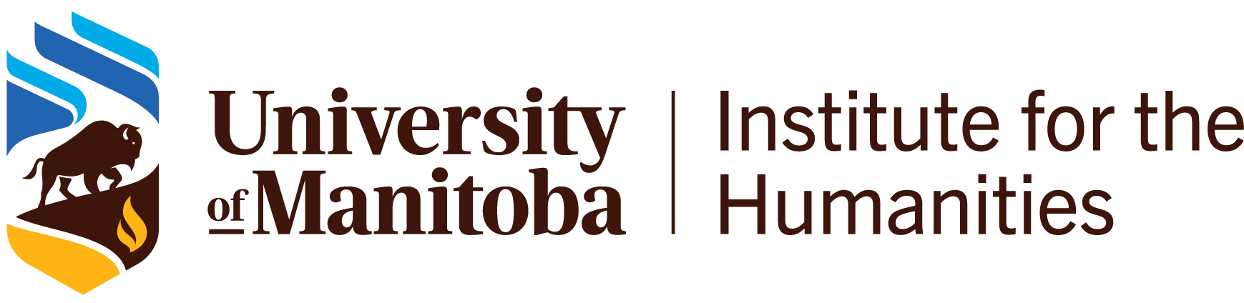
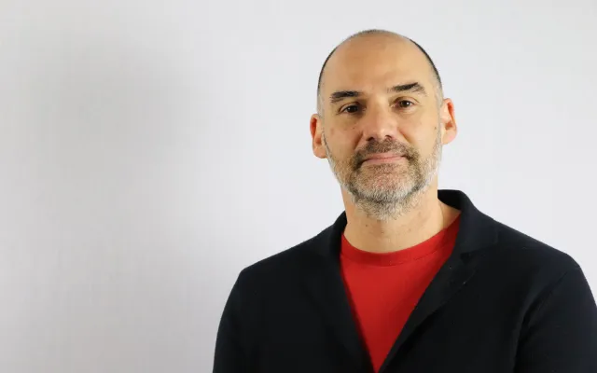
Unnatural mothers: motherhood and nature in Venezuelan cinema
Dr. Omar Rodríguez
University of Lethbridge
Thursday, March 5, 2026
2:30 –3:30 PM
409 Tier
Are all women “natural” mothers? Is nature a protective, nurturing force? Can a relative, a stranger or a community assume the role of a mother?
Join us for a discussion of these questions through Venezuelan cinema. From the stark black-and-white landscapes of Araya (1958) to the excesses of melodrama in El pez que fuma (1977), to contemporary films such as La distancia más larga (2015), we explore how cinema reimagines, subverts and at times reinforces the conception of mothering and the trope of Mother Nature.

